Slide 1
Myeloma Treatment Pathway and role of
Bi-Specific Antibodies
Dr Sarah Lawless
Consultant Haematologist
Belfast City Hospital

Slide 2
Objectives
NICE Pathway
Factors to consider when choosing therapy
Triple class exposed patients (IMiD, proteasome inhibitor and monoclonal antibody)
Bi-specific antibodies
  Mechanism of action
  Evidence base
Case study

Slide 3
Multiple myeloma is characterised by a pattern of remission and relapse
Asymptomatic
Symptomatic
Relapsing
Refractory
Remission duration decreases
with each line of therapy
M-protein level
Active
myeloma
Relapse
Remission
MGUS or indolent
myeloma
//
//
Time
Front-line
therapy
2nd, 3rd and subsequent-line therapy
Adapted from : Durie. Concise Review of the Disease and Treatment Options: Multiple Myeloma. International Myeloma Foundation, 2011/2012 edition.
Date of preparation: June 2018 Job bag Number UK-MM180052
Notes:
Clonal evolution
Evolving co-morbidities and side effects
Time in remission gets shorter

Slide 4
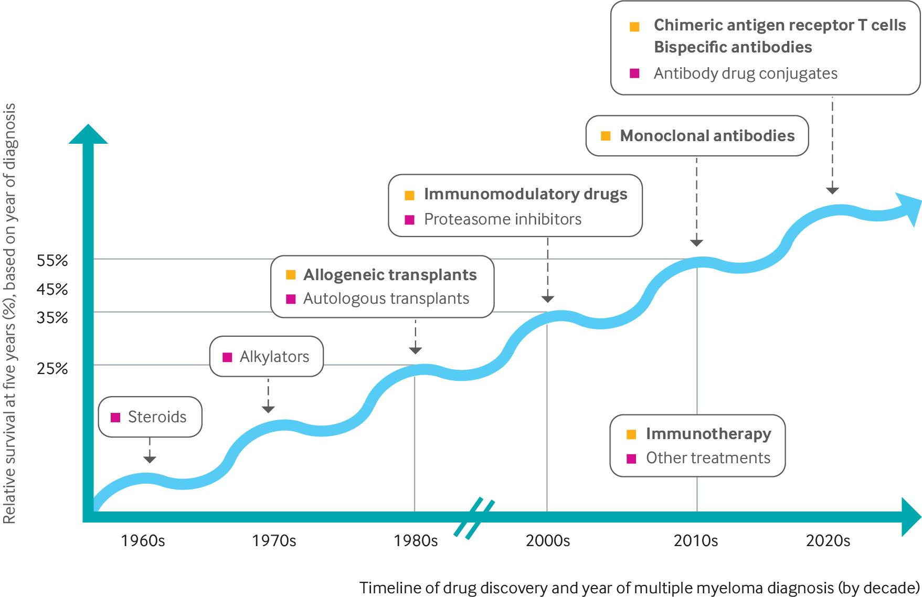
Notes:
Novel agents 2000s
For patients diagnosed before 2000, the relative survival at five years was less than 35%

Slide 5

Multiple myeloma: patient outcomes in real‐world practice. Yong K, et al. Br J Haematol. 2016;175:252–64
Proportion of patients reaching this line of therapy (%)
100%
Diagnosis
1 m
6 m
6 m
1L
95%
Start
1L
End 1L
induction
End 1L
maintenance
Treatment-free interval
Active treatment
Maintenance treatment
Mean (95% CI): diagnosis, 2 m (1.60, 2.40); 1L, 8 m (7.74, 8.26); 1L maintenance, 9 m (7.78, 10.22)
10 m
7 m
2L
61%
Median duration in months shown
Start
2L
End
2L
Mean (95% CI): interval, 1L-2L, 16 m (15.0, 17.0); 2L, 9 m (8.64, 9.36)
3L
38%
5 m
6 m
Start
3L
End
3L
Mean (95% CI): interval, 2L-3L, 11 m (10.22, 11.78); 3L, 8 m (7.63, 8.37)
3 m
5 m
4L
15%
Start
4L
End
4L
Mean (95% CI): interval, 3L-4L, 7 m (5.9, 8.1); 4L, 6 m (5.5, 6.5)
1 m
4 m
5L
1%
Start
5L
End
5L
Mean (95% CI): interval, 4L-5L, 3 m (1.8, 4.2); 5L, 4 m (3.15, 4.85)
Date of preparation: June 2018 Job bag Number UK-MM180052

Slide 6
Current NICE approvals
Eligible for stem cell transplant
Not eligible for stem cell transplant
1st line
DARA+BORT+THAL+DEX (TA763)
DARA+LEN+DEX(TA917)
BORT+THAL+DEX (TA311)
HDT+ASCT (NG35)
BORT+ALK A+CORTICO (TA228)
LEN maintenance (TA680)
LEN+DEX (TA587)
THAL+ALK A+CORTICO (TA228)
2nd line
DARA+BORT+DEX TA897
SEL+BORT+DEX
TA974
CAR+DEX+LEN (TA695)
BORT+DEX (TA129)
LEN+DEX (TA586)
CAR+DEX (TA171)
3rd line
PAN+BORT+DEX (TA380)
LEN+DEX (TA171)
IXA+LEN+DEX (TA870)
4th line
POM+DEX (TA427)
DARA (TA783)
PAN+BORT+DEX (TA380)
IXA+LEN+DEX (TA870)
Teclistamab
or
Elranatamab
5th line
PAN+BORT+DEX (TA380)
SEL+DEX (TA970)
Penta drug refractory

Slide 7

Choosing first line therapy
Efficacy Quadraplet>Triplet>Doublet
Fraility
Performance status
Co-morbidities
Patient choice

Slide 8
Supportive Therapies
Bone protection
Bisphosphonates e.g zometa
Care with strenuous activities –avoiding falls and injury
Preventing infection
Prophylactic antibiotics and antivirals
Vaccinations
Pain relief
Pain specialists and palliative care team
Calcium and vitamin D supplements
Replacing immunoglobulins
Role of radiotherapy
Role of surgery or braces
Protecting kidney function
Stay hydrated
Avoid non steroidal drugs
MDT
CNS
Pharmacist
Physiotherapist
OT
Social Worker
Counselling

Slide 9
Choosing therapy at relapse
Efficacy
Fraility
Performance status
Co-morbidities
Patient choice
Duration of response to previous therapy
Toxicities from previous therapies e.g. peripheral neuropathy

Slide 10
Current NICE approvals
Eligible for stem cell transplant
Not eligible for stem cell transplant
1st line
DARA+BORT+THAL+DEX (TA763)
DARA+LEN+DEX(TA917)
BORT+THAL+DEX (TA311)
HDT+ASCT (NG35)
BORT+ALK A+CORTICO (TA228)
LEN maintenance (TA680)
LEN+DEX (TA587)
THAL+ALK A+CORTICO (TA228)
2nd line
DARA+BORT+DEX TA897
SEL+BORT+DEX
TA974
CAR+DEX+LEN (TA695)
BORT+DEX (TA129)
LEN+DEX (TA586)
CAR+DEX (TA171)
3rd line
PAN+BORT+DEX (TA380)
LEN+DEX (TA171)
IXA+LEN+DEX (TA870)
4th line
POM+DEX (TA427)
DARA (TA783)
PAN+BORT+DEX (TA380)
IXA+LEN+DEX (TA870)
Teclistamab
or
Elranatamab
5th line
PAN+BORT+DEX (TA380)
SEL+DEX
Penta drug refractory

Slide 11
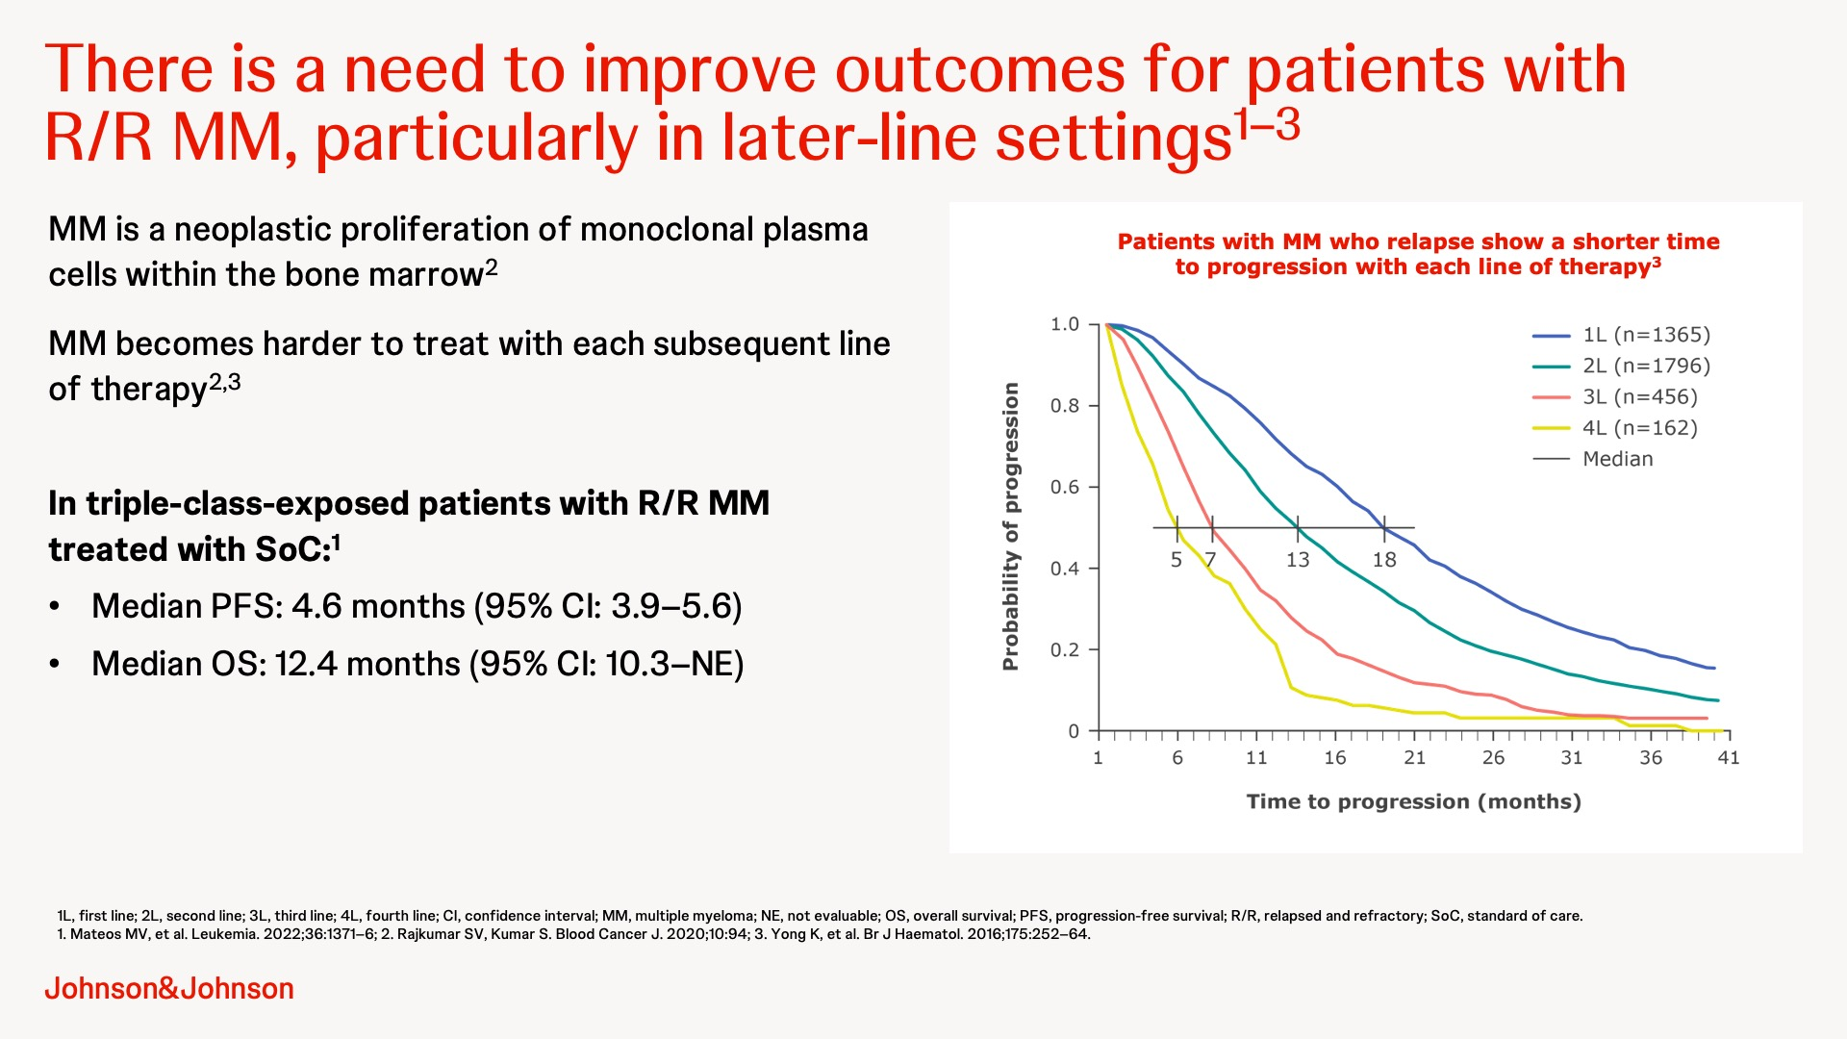

Slide 12
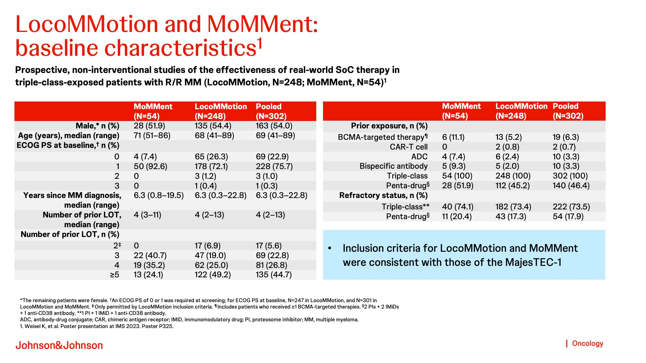

Slide 13
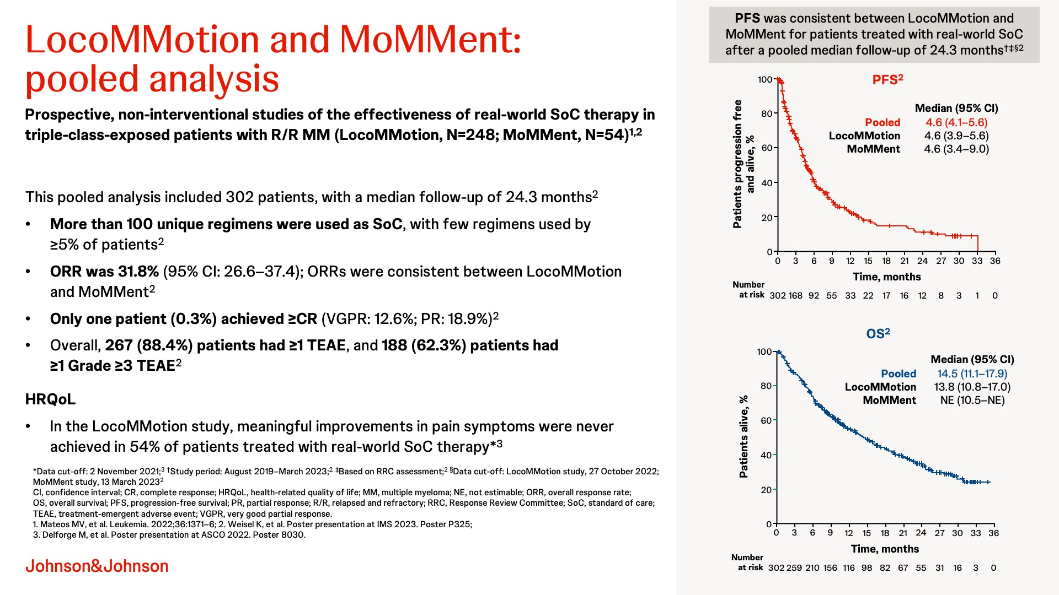

Slide 14
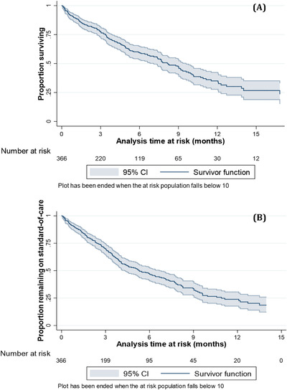
Triple Class Exposed
UK real world outcomes
.
Retrospective study of cancer registry and health data in England showed triple-class exposed patients waited a median of 5.3 months until their next treatment, and OS was just 8.2 months at a median follow-up of 6.4 months.
Elsada et al. EJHaem

Slide 15
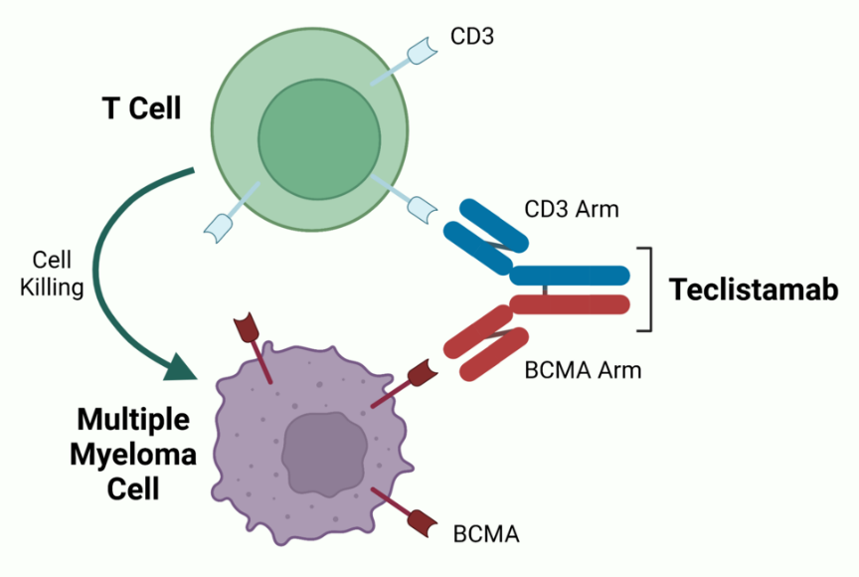
Approved bi –specific antibodies in the 4th line setting
Teclistamab
Elranatamab
Bispecific antibodies target two cell surface molecules at the same time, one on the MM cell and one on T cell
Both teclistamab and elranatamab target BCMA
B Cell Maturation Antigen (BCMA) is highly expressed in myeloma cells, thus representing a target for novel therapies.
Several other target BCMA through different mechanisms, including antibody drug conjugate belantamab and CAR-T cells

Slide 16
Other bi-specific antibodies
Talquetamab GPRC5DxCD3
Linvoseltamab BCMAxCD3
Alnuctumab BCMAxCD3
Forimtamig GPRC5DxCD3
Cevostamab FcRH5xCD3

Slide 17
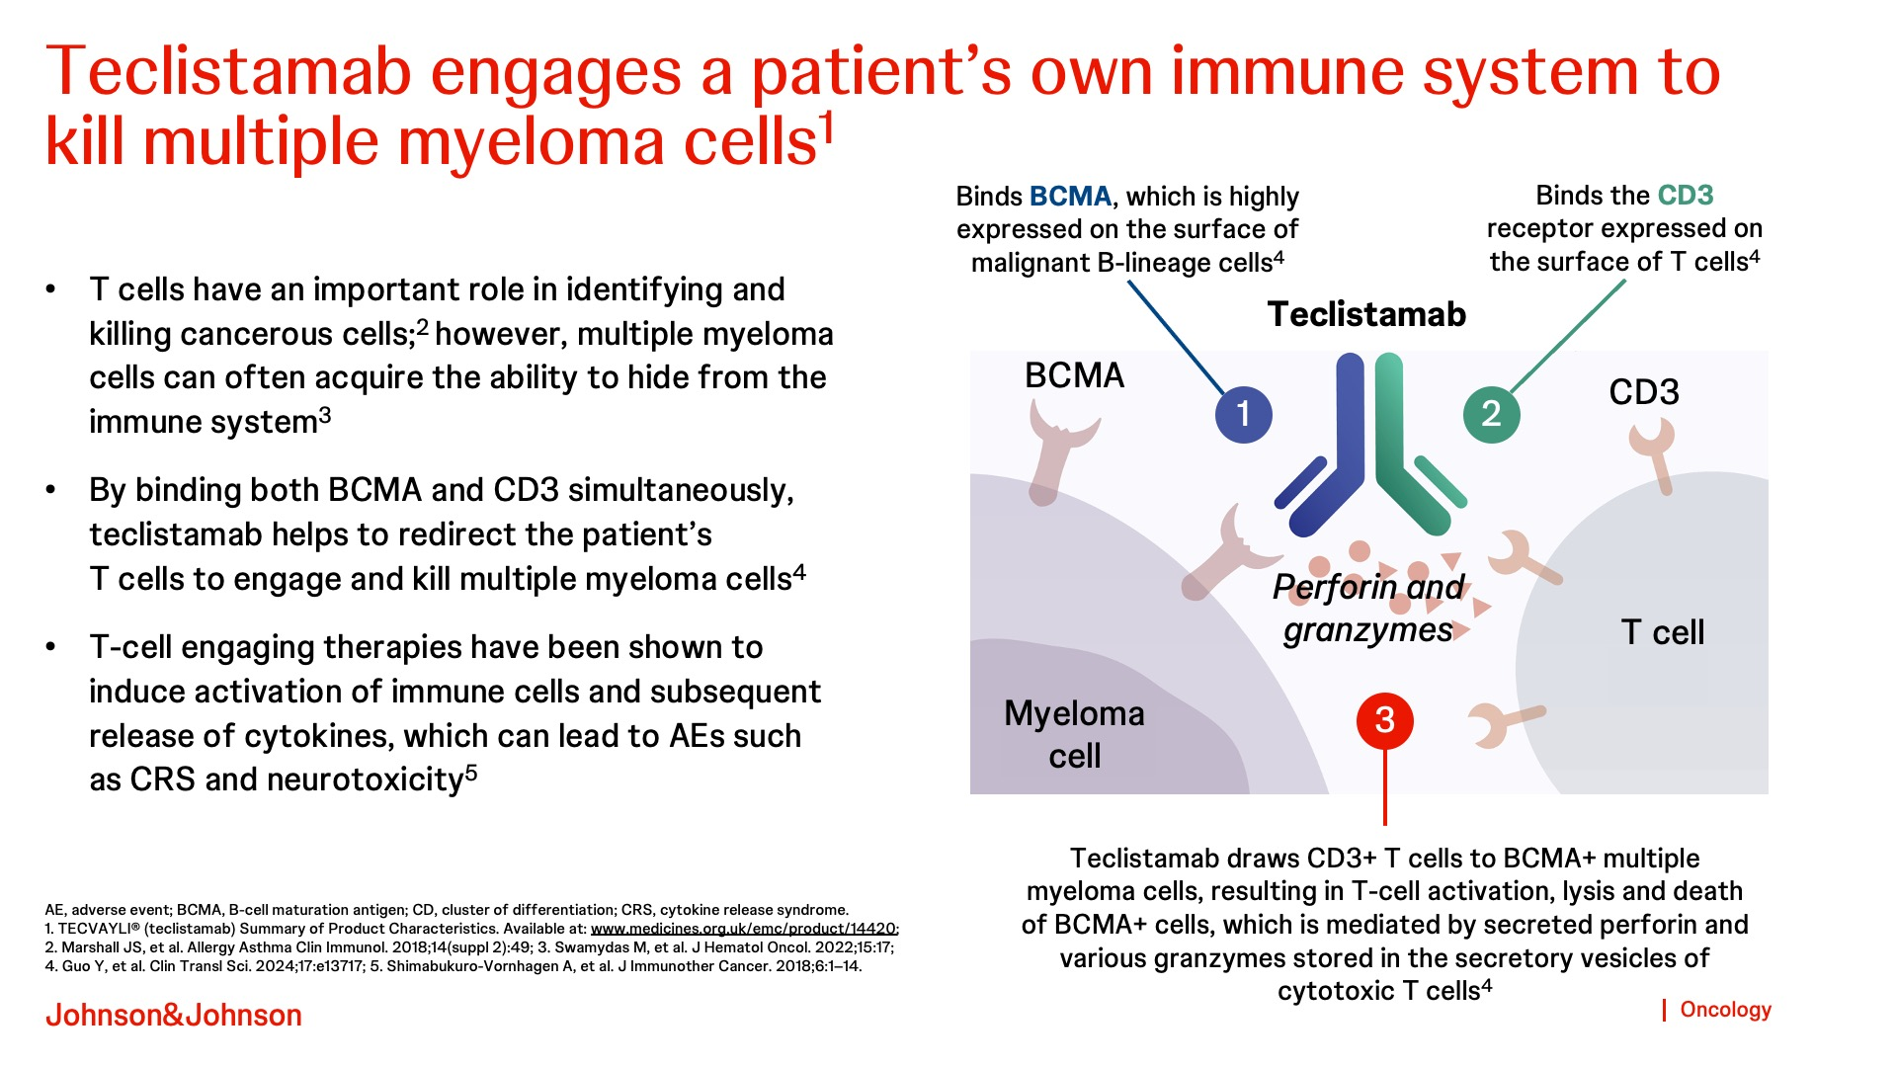

Slide 18
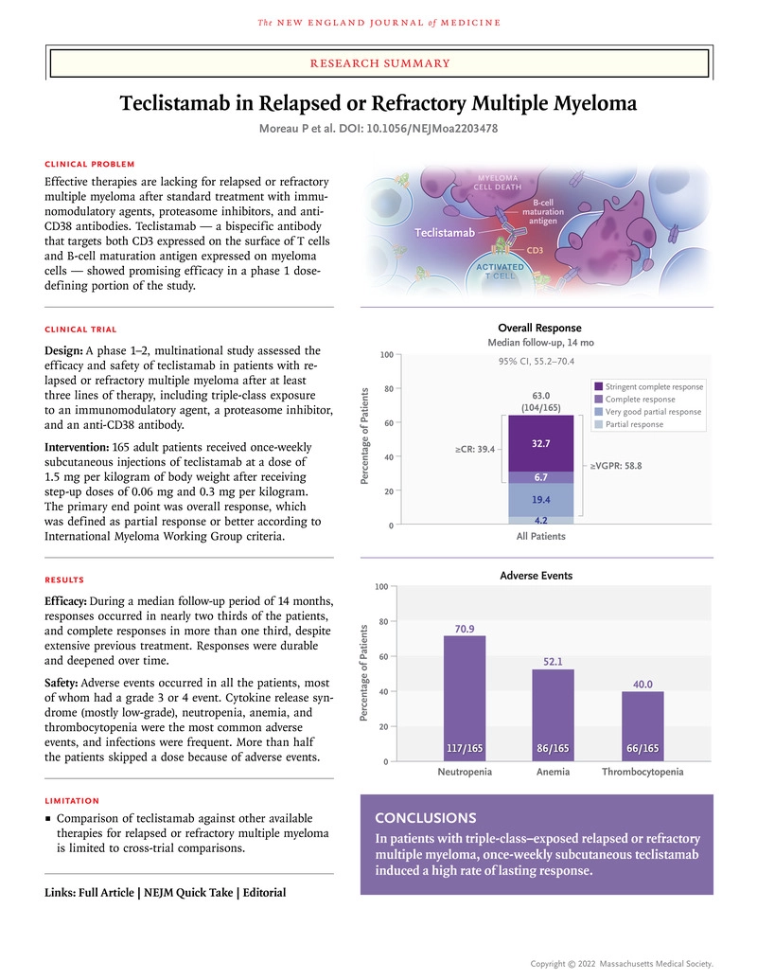
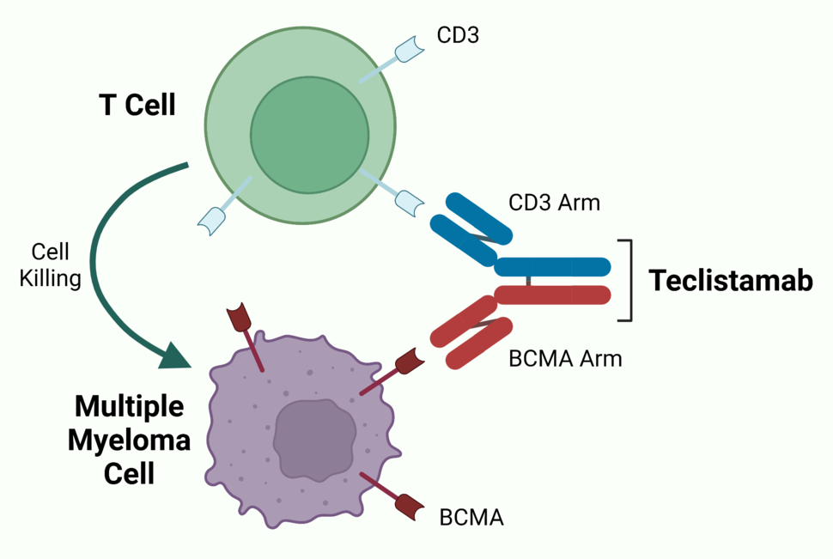
MajesTec 1

Slide 19
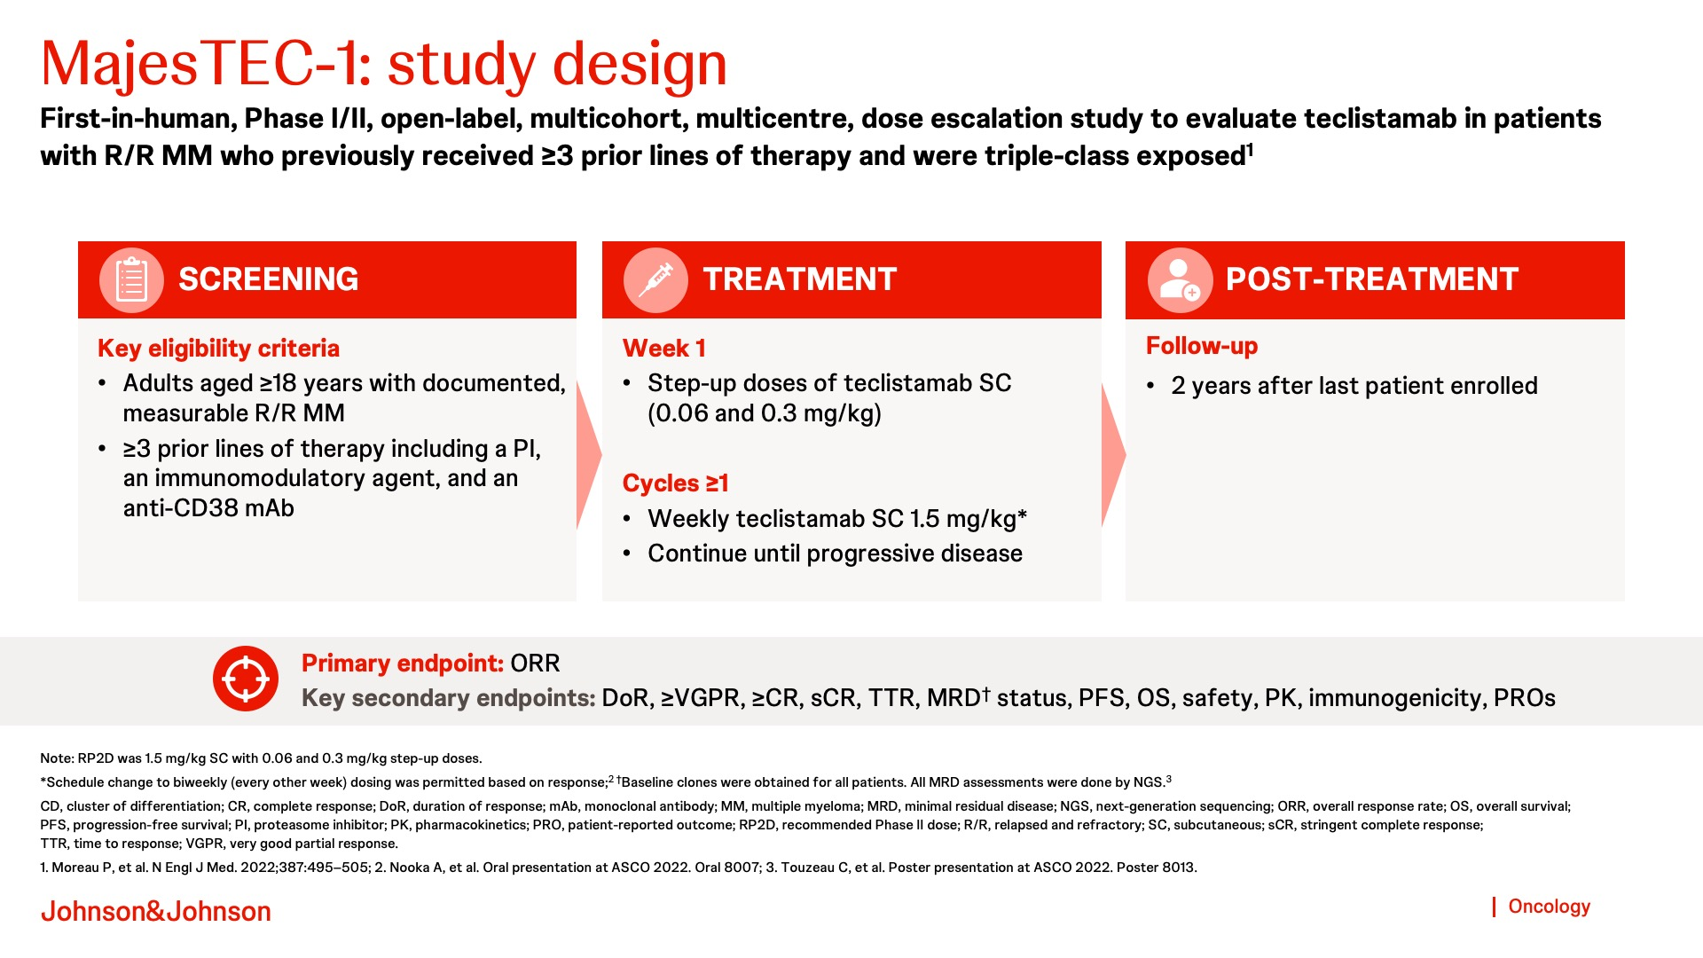

Slide 20
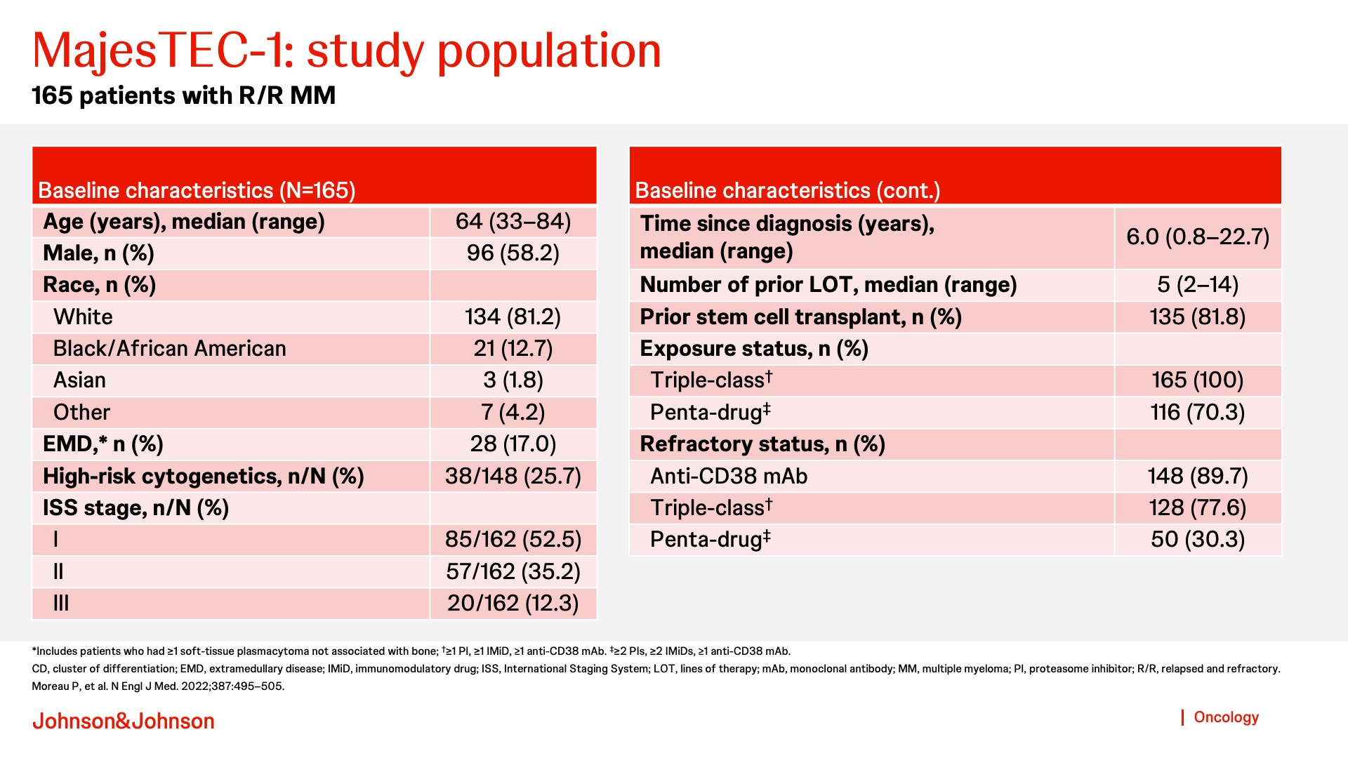

Slide 21
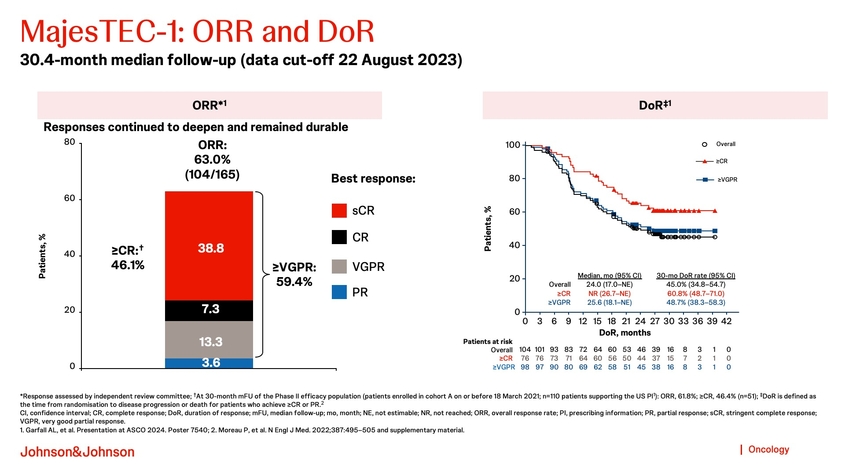

Slide 22
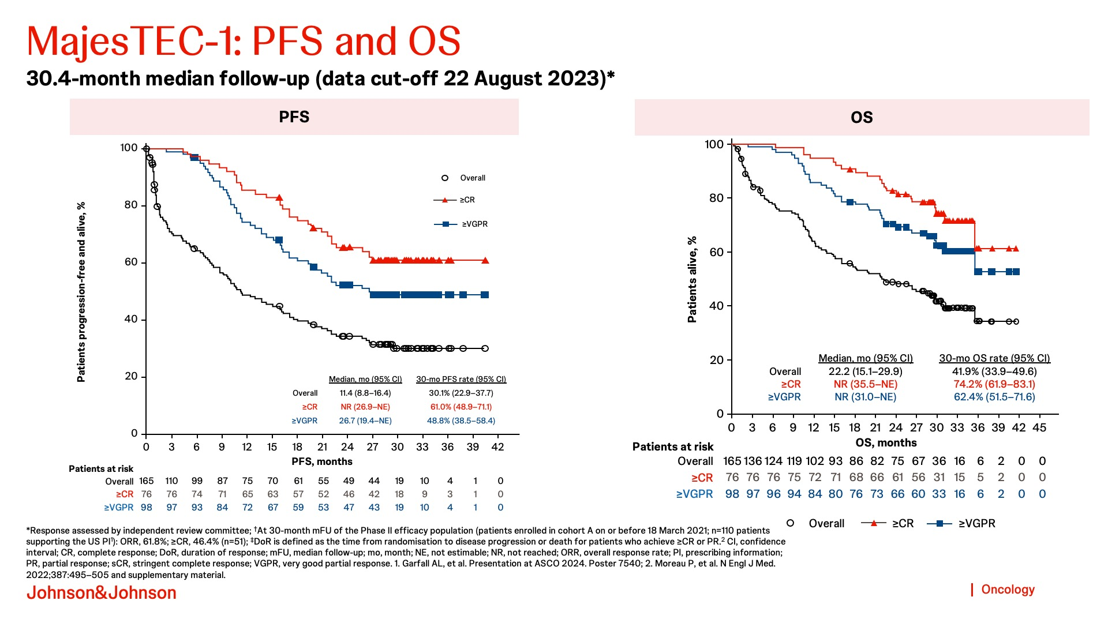

Slide 23
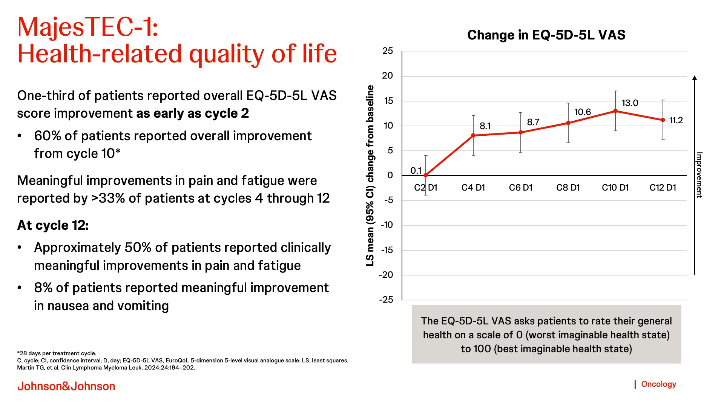

Slide 24
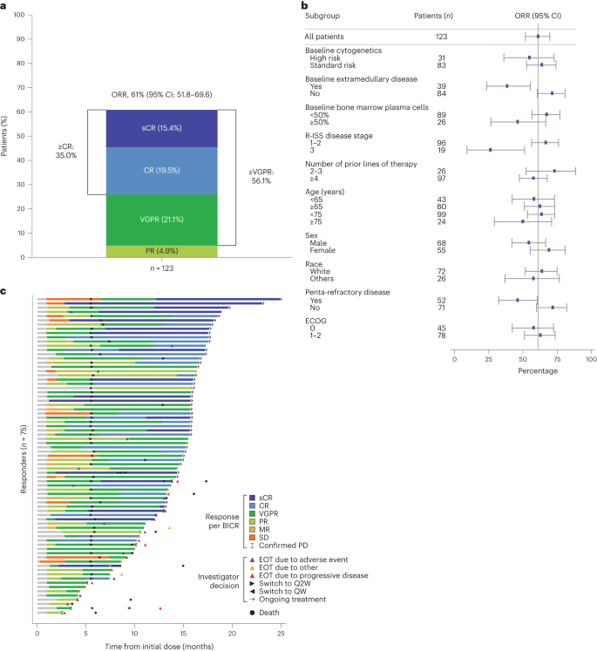
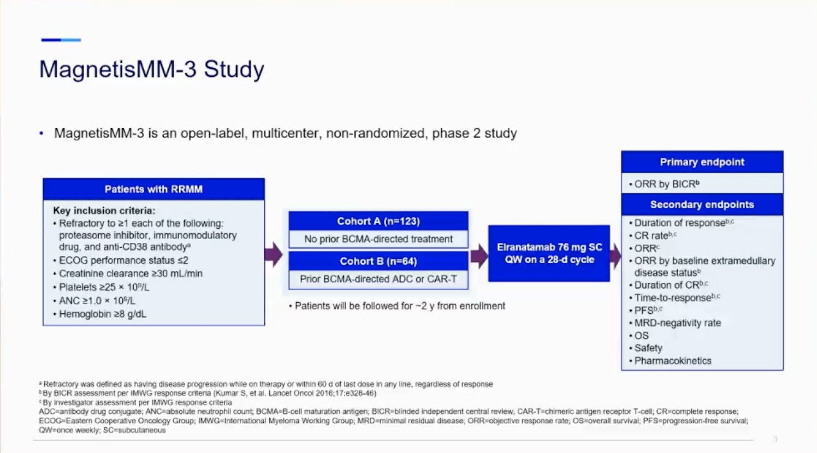
Elranatamab

Slide 25
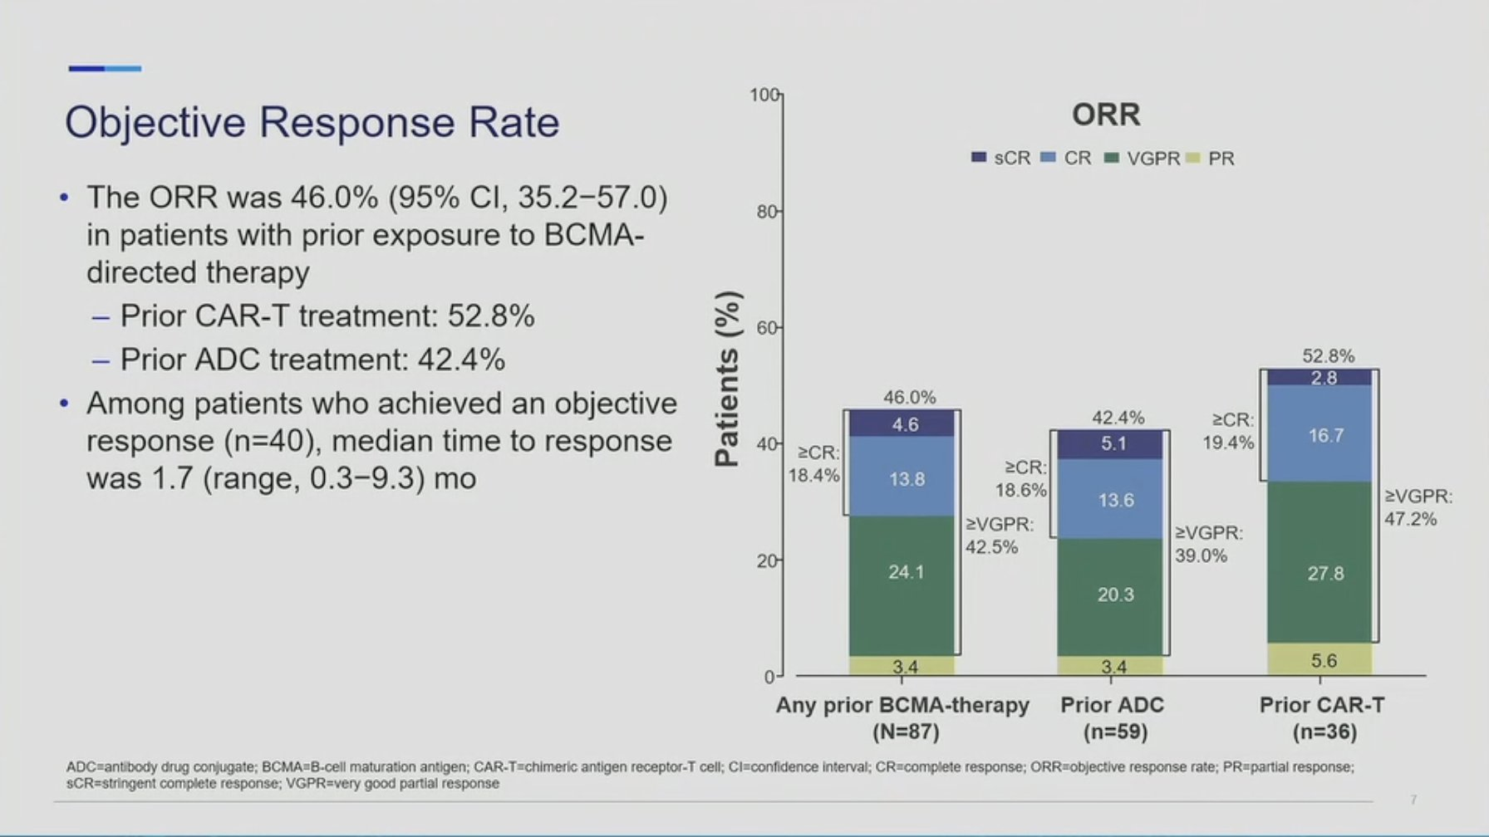
Elranatamab
MagnestisMM-3

Slide 26
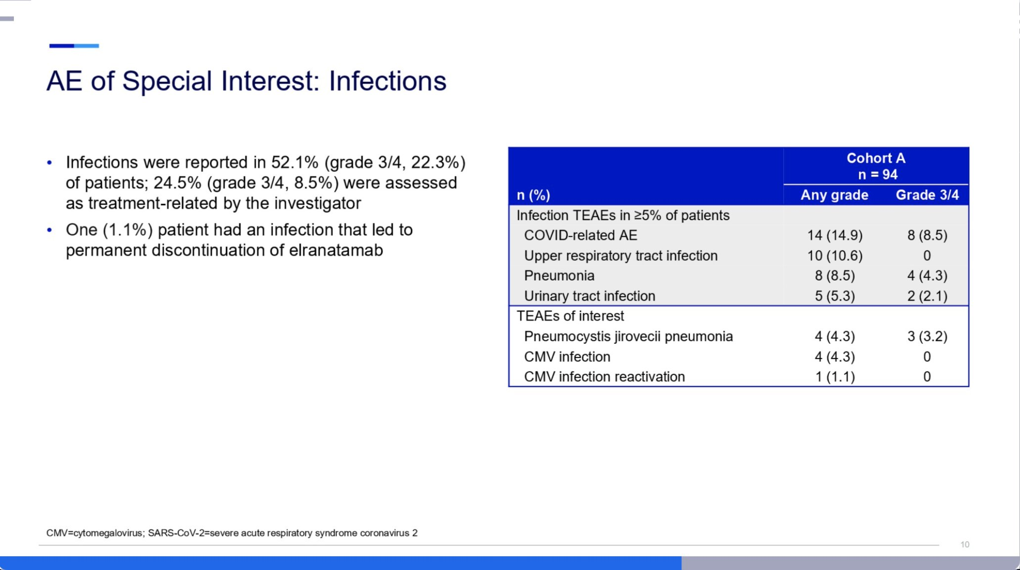
Elranatamab
MagnestisMM-3

Slide 27
Front line bi-specific trials
ASH 2024 ABSTRATC 493 Phase 2 Study of Teclistamab-Based Induction Regimens in Patients with Transplant-Eligible (TE) Newly Diagnosed Multiple Myeloma (NDMM): Results from the GMMG-HD10/DSMM-XX (MajesTEC-5) Trial
ASH 2024 ABSTRACT 494 Phase 3 Study of Teclistamab (Tec) in Combination with Lenalidomide (Len) and Tec Alone Versus Len Alone in Newly Diagnosed Multiple Myeloma (NDMM) As Maintenance Therapy Following Autologous Stem Cell Transplantation (ASCT): Safety Run-in (SRI) Results from the Majestec-4/EMN30 Trial
MAGNETISMM-6: A PHASE 3 STUDY OF ELRANATAMAB + DARATUMUMAB + LENALIDOMIDE VS DARATUMUMAB + LENALIDOMIDE + DEXAMETHASONE IN TRANSPLANT INELIGIBLE PATIENTS WITH NEWLY DIAGNOSED MULTIPLE MYELOMA
MagnetisMM-7: An open-label, multicenter, randomized phase 3 study of elranatamab versus lenalidomide in post-transplant patients with newly diagnosed multiple myeloma.

Slide 28
Case Study

Slide 29
Case study
48 year old male
Previously fit and well, no co-morbidities, father of two young boys
43 years at diagnosis in 2019
IgA kappa paraprotein 18 g/l
Plasmacytoma of sternum
R ISS stage I, no high-risk FISH abnormalities.
Complete biochemical response to VTD 24/12/19
High dose melphalan and ASCT May 2020 (delay due to COVID 19)
Maintenance lenalidomide until Jan 2024.

Slide 30
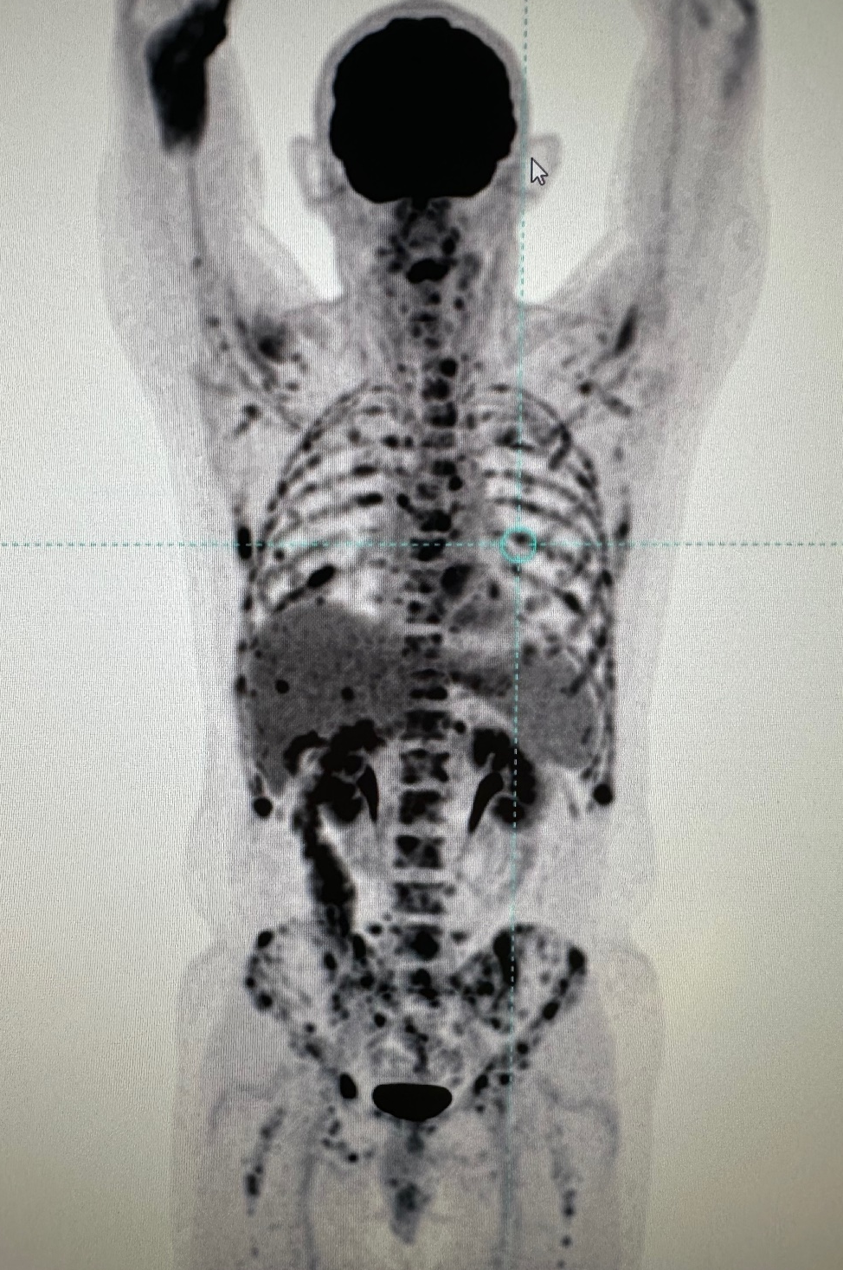
Case study
Jan 2024 brisk rise in SFLC and SPE
New bone pain
CT PET extensive disease
Repeat marrow, FISH 1q gain only
Enrolled in Exacaliber trial (DVd versus Daratumumab, iberodmide and dexamethasone) and drew SOC-DVD.
Significant progression while on DVd. Required plasma exchange and treatment of hypercalaemia (corr ca 3.04)
What next?- 2lines of therapy, TCE and aggressive/rapid progression

Slide 31
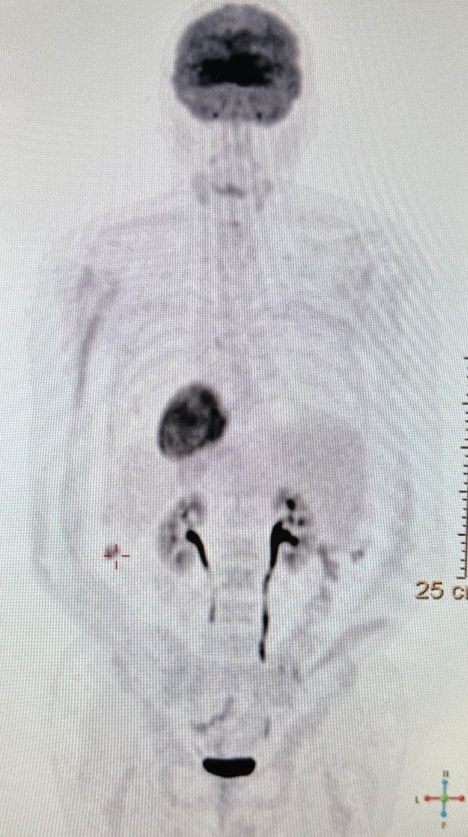
Case study
Bridging PACE chemotherapy
Access to elranatamab via FOC scheme
Complete response
IVIg 4 weekly
CMV monitoring

Slide 32

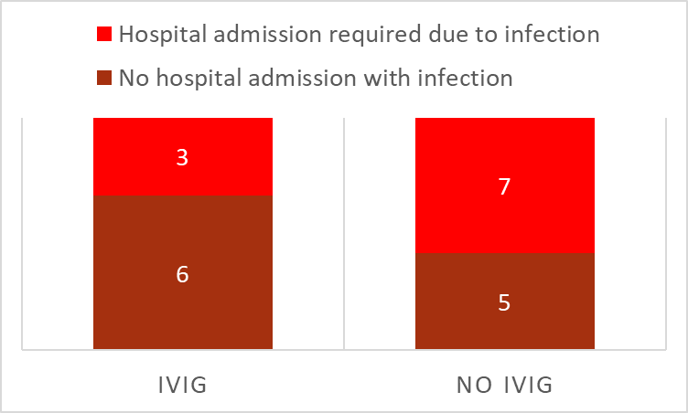
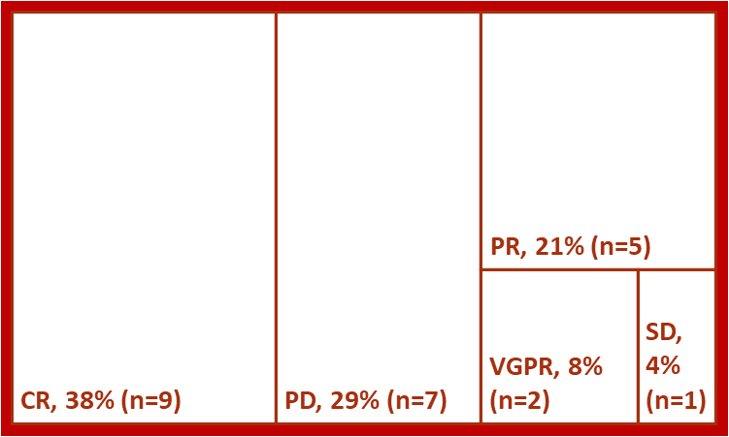
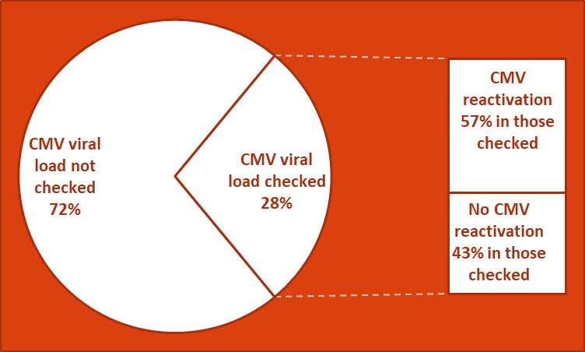
HAI Annual Conference
Friday 11th and Saturday 12th October 2024
Real World Analysis of Bi-specific Antibodies in the Management of Patients with Multiple Myeloma in Northern Ireland
D Duncan, H Hiles, S Lawless, O Sheehy, P Elder, C McConville, A Niblock, M Bowers, D Donaldson, S McCloskey, R McCormick, F McNicholl
Bispecific antibodies are currently altering the therapeutic landscape of relapsed and refractory multiple myeloma (RRMM). In clinical trials these drugs have displayed high response rates, resulting in durable remissions lasting over a year. While two new bi-specific agents (teclistimab and elranatamab) have just received NICE approval patients with RRMM were able to gain access to three agents Teclistimab, Talquetamab and Elranatamab via compassionate use programmes spanning a 26 month period. Here we present real world data on efficacy and toxicity.
76% (n=16) patients had an infection while on a bi-specific with 48% (n=10) requiring at least one admission to treat infection.
87% (n=13) patients on elranatamab, 100% (n=3) patients on teclistimab and 57% (n=4) patients on talquetamab had an infection. Not all patients with an infection required admission. 42% (n=7) on talquetamab, all (n=3) patients on teclistimab and 40% (n=6) on elranatamab required admission due to infection.
78% (n=7) patient on IVIG had an
infection and 33% (n=3) patients
on IVIG required admission for
Treatment of infection. 75% (n=9)
patients not on IVIG had an
infection however 58% (n=7)
required hospital admission for
treatment. See chart 2.
33% (n=7) of patients had a
Respiratory transmitted viral illness
including COVID (n=4), 19% (n=4) Comparing hospital admissions
had a CAP, 2 patients had PICC due to infections while on IVIG
infections, 1 had shingles, 1 otitis media (Chart 2)
and 1 other an e coli bacteraemia.
Introduction
Infections
A retrospective analysis identified 21 patients started on a bi-specific between 1st May 2022 to 30th June 2024. Two patients received two bi-specific agents (teclistimab followed by elranatamab and talquetamab followed by elranatamab) and one patient received all three. The age range was 48-78 with a median of 66. There were 12 male patients and 9 female patients. Patients had 3-8 prior lines of therapy with a median of 5 prior lines of therapy. All patients were triple class refractory.
15 patients received elranatamab (March 2024-July 2024), 7 patients received talquetamab (June 2023-November 2023) and 3 patients received teclistimab (May 2022-Feb 2023).
Methods
Efficacy
CMV
The overall response rate was 67%. The complete response (CR) rate was 38% , very good partial response (VGPR) rate was 8% and the partial response (PR) rate was 21% . See chart 1.
4% patients had stable disease (SD)
and 29% had progressive disease
(PD). Unable to assess response in
one patient as treatment
commenced due to plasmacytoma
and imaging not updated.
Median time to best response
was 2 months. Best Response (Chart 1)
28% (n=7) had CMV PCR monitoring while on treatment with at least one CMV viral load checked (see chart 3) . 4 patients had a detectable viral load indicating CMV reactivation, of these 1
patient needed treated with
IV Ganciclovir. The other
three had acyclovir switch
to valaciclovir.
All patients that had CMV
reactivation were on
elranatamab. Of the 3
patients that had a CMV
viral load checked that was
negative 1 was on
elranatamab and 2 were on
talquetamab. 80% (n=4) of CMV viral load monitoring and re-activation
patients on elranatamab that (Chart 3)
had CMV viral load monitoring had CMV reactivation.
Toxicity
56% (n=14) of patients experienced Cytokine Release Syndrome (CRS) on starting a new bi-specific. 52% (n=13) had grade 1-2 CRS and 1 patient had grade 3 CRS.
64% (9 of 14) of patients received tocilizimab. The patient that had grade 3 CRS required 2 doses of tocilizimib and symptoms settled within 48hours. There were no ICU admissions due to CRS.
Sadly 1 patient developed grade 4 ICANS following D4 elranatamab with an acute deterioration in GCS. He required ICU for vasopressor and ventilator support. He passed away 11 days after starting elranatamab.
Conclusion
When we compare our real world experience to the outcomes in the in MajesTEC-1 and MagnestisMM-3 trials the ORR and CR rates within our cohort are reassuringly similar.
CRS is common but often low grade but our experience also highlights risk of ICANs in these patients. Importantly we show the significant reduction in the need for hospital admission due to infections on those receiving IVIG. CMV reactivation was common in this cohort suggesting a role for regular CMV viral load monitoring.
This data will help inform colleagues with wider role out of these agents.
43% (n=9) received IVIg. 5 of these 9 patients were not on IVIG prior to starting bi-specific – these were all started pre-emptively. IgG levels were low prior to commencing IVIG and ranged between <0.05 and 4.0.
IVIg

Slide 33
Summary
Myeloma treatment pathway continues to evolve rapidly
Multiple factors determine choice of therapy at first line and in the relapsed setting
For triple class exposed patients bi-specific therapies offer a valuable treatment option
Bi specific antibodies will likely move forward in the treatment pathway with time

