Slide 1

Rehabilitation Approaches for Myeloma Patients
Orla McCourt PhD MCSP
Clinical Specialist Physiotherapist in Myeloma
Honorary Clinical Lecturer, UCL Cancer Institute

Slide 2
Disclosures
Gilead Sciences – education grant
Menarini Stemline – honorarium
Johnson & Johnson – honorarium

Slide 3
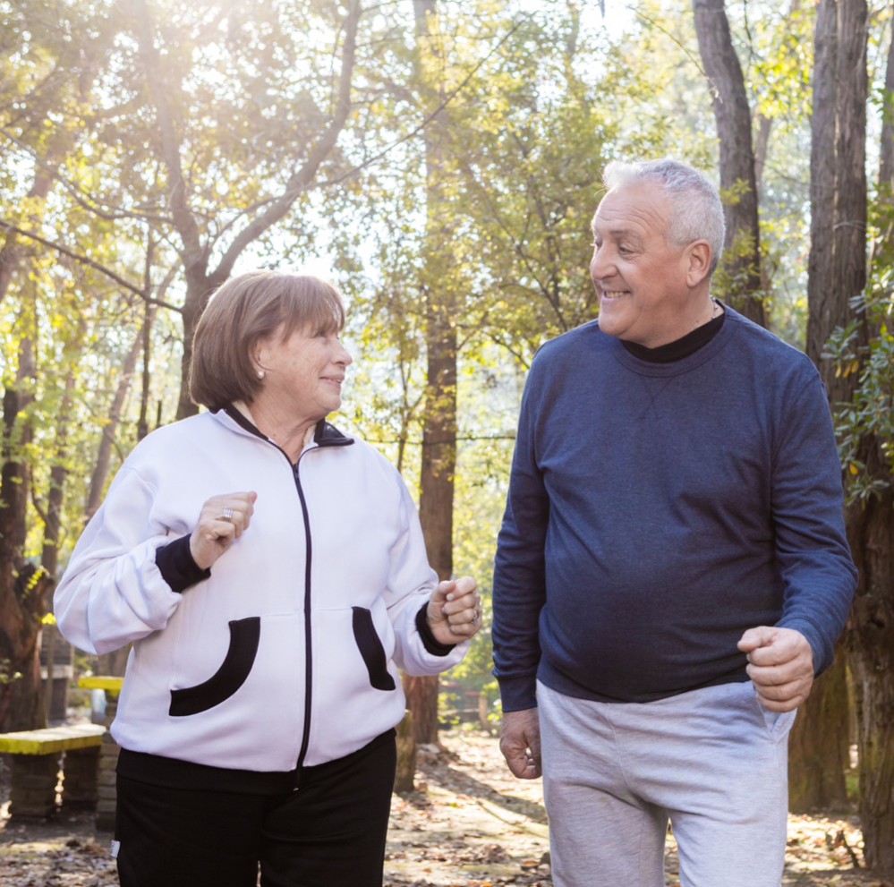
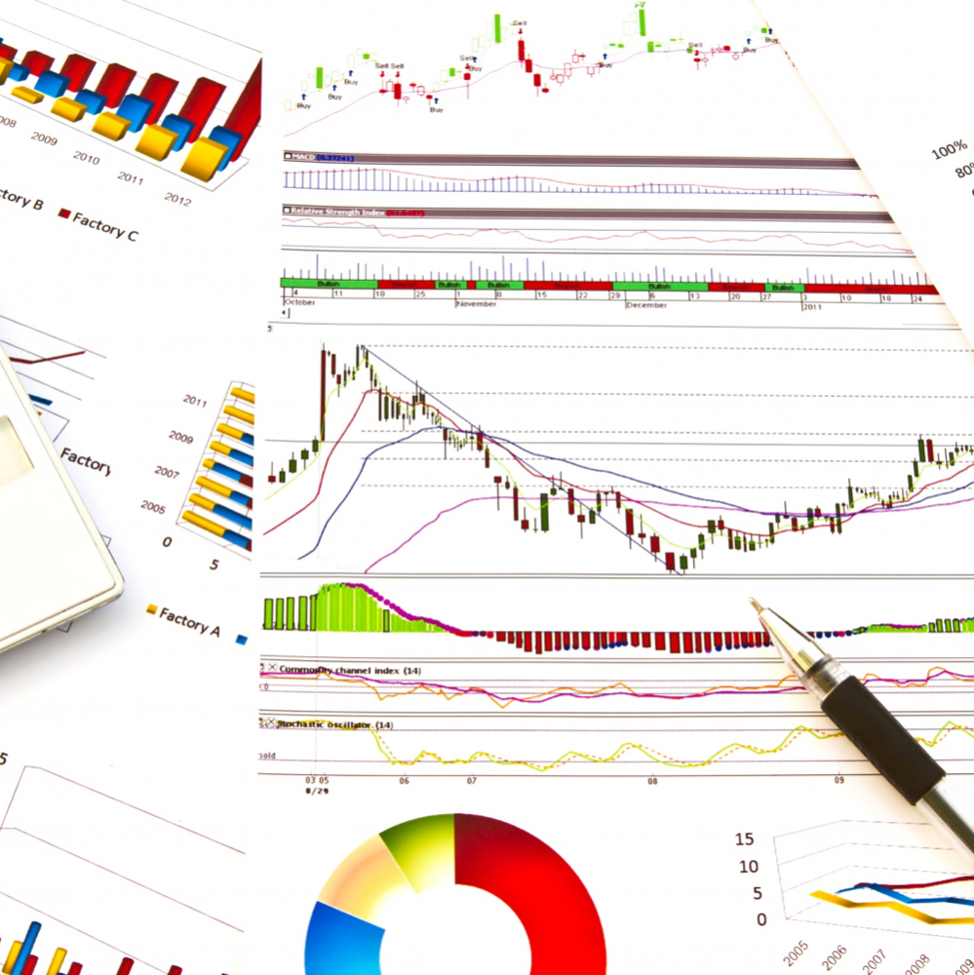


Overview
Impact of disease symptoms and reduced physical function on quality of life in myeloma
What does research tell us about the role of rehabilitation in cancer?
The benefits of physical activity and exercise in myeloma
Example of pathway-based rehabilitation in the ASCT pathway at UCLH

Slide 4
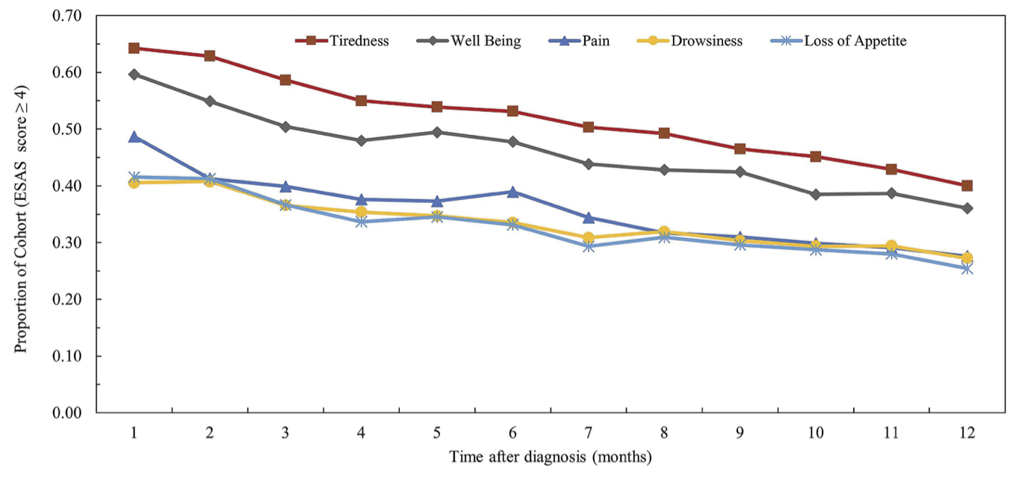
Myeloma disease symptoms & treatment toxicities
High prevalence of severe symptoms
  Most common: Fatigue, Pain, Peripheral Neuropathy
Clinically relevant levels of psychological impact
  Anxiety 27%
  Depression 24%
Image adapted from Mian et al.,
Haematologica 2020 106(7):1991-1994
Ramsenthaler et al., Eur J Haematol 2016 97: 416-429; Strasser-Weippl & Ludwig Eur J Haematol 2008 81: 374-379
Notes:
Ramsenthaler systematric r/v n=35 studies
Mian et al – figures = The trajectory of moderate to severe symptoms in each month following diagnosis in NDMM transplant-ineligable pts (n=2876) (wellbeing='impaired' well-being)
Psychological impact of relapse perceived as more devastating than initial diagnosis (Carwford et al 2021, Cancer Reports e1603)

Slide 5
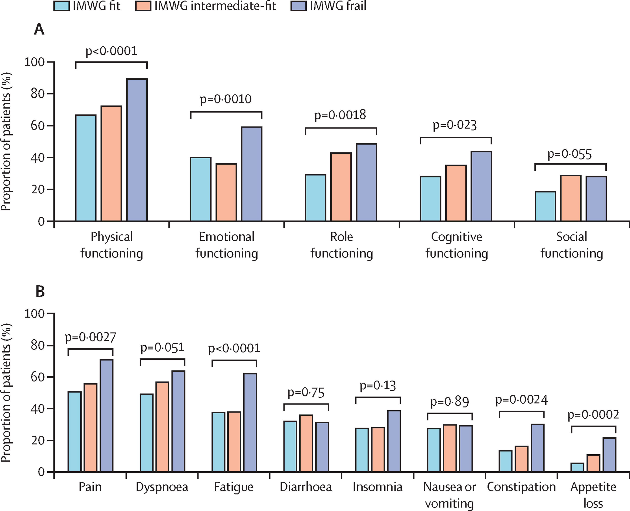
Frailty and functioning in Myeloma
Prevalence of patient-reported clinically important problems (A) and symptoms (B) from EORTC QLQ-C30 of patients with relapsed or refractory multiple myeloma, by IMWG frailty groups
Efficace et al., Lancet Healthy Longev 2022; 3: e628–35
Notes:
Efficace study – n=415 mean age 69.8yrs median 4.4 yrs post diag. 85%> lines.

Slide 6
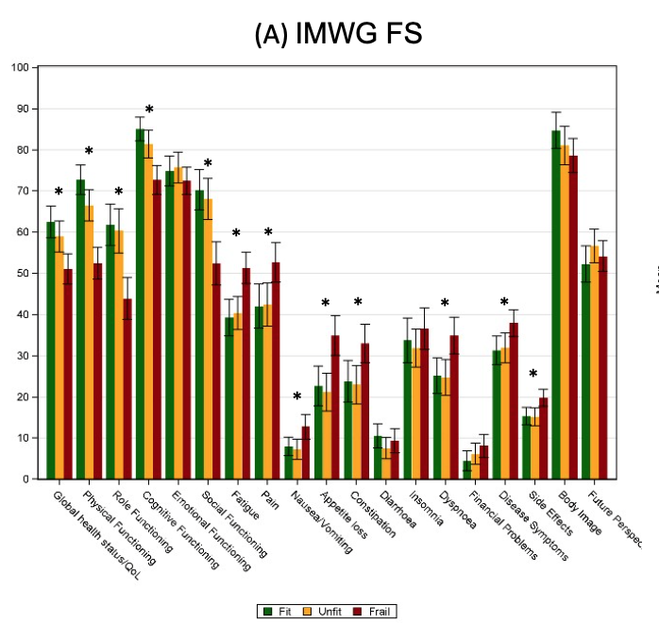
Impact on Quality of Life
IMWG Frailty Score combines age, comorbidities, activities of daily living (ADLs) to classify patients as Fit, Unfit or Frail
‘Frail’ group had worse QOL across most domains
Age and comorbidities had no effect on QOL, only ability to perform ADLs
ADL performance is modifiable with rehabilitation and could improve QOL
McCourt et al., Blood 2023; 142 (Supplement 1): 3368
Notes:
Enhancing ADL scoring may alter frailty categorising as assessed through the IMWG FS, is likely to enhance HRQOL and may impact on treatment tolerability in older patients.
N=559 pts enrolled in FiTNEss – ND,NTE, median age 76 yrs

Slide 7
Physical function has largest impact on quality of life in myeloma
Fatigue
Pain
Reduced physical functioning
Reduced Quality of Life
Notes:
Most common – compounded by context of bone damage. Psychological impact of patients associating these symptoms with signs of relapse.
Impact on QOL – reduced mobility, inability to carry out ADLs, limited leisure and work. Perceived loss of independence and control in life – source of emotional distress
Stasser-Weippl – n=92 QOL substudy. Prognostic relevance of QOL – most commonly PF. Variability in PF can be explained by disease activity – supports notion of need for better physical and psychosocial support around medical care.
Although PF is likely influenced by disease features, other functional domains are most likely influenced by individual psychological factors.

Slide 8
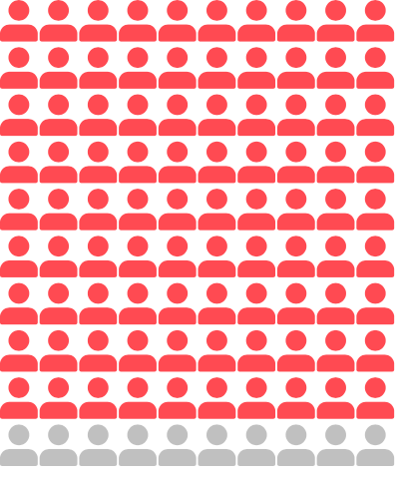
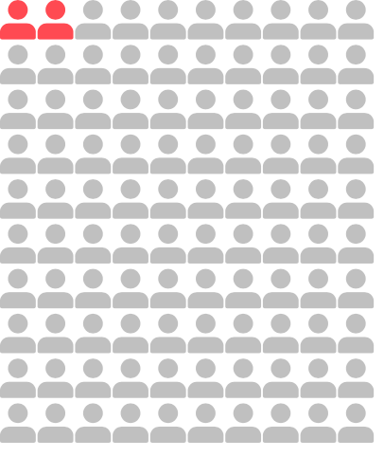
Role for Cancer Rehabilitation
“Rehabilitation and exercise interventions reduce the negative impact of treatment-related symptoms and improve function of individuals living with and beyond cancer”
Up to 90% of people affected by cancer have rehabilitation needs
Less than 2% have rehabilitation needs addressed
Cheville et al. J Clin Oncol. 2008; 26; Pergolotti et al. J Geriatr Oncol. 2015; 6; Schmitz et al. Cancer. 2012; 118(s 8); Stout et al. CA Cancer J Clin.2021; 71:2; Thorsen et al. Acta Oncol. 2011; 50.
Notes:
Rehab is “a set of interventions designed to optimize functioning and reduce disability in individuals with health conditions in interaction with their environment” ​
It is recommended and highlighted in numerous guidelines
People have goals and aims whether it be regaining or maintaining abilities to take part in their own lives

Slide 9
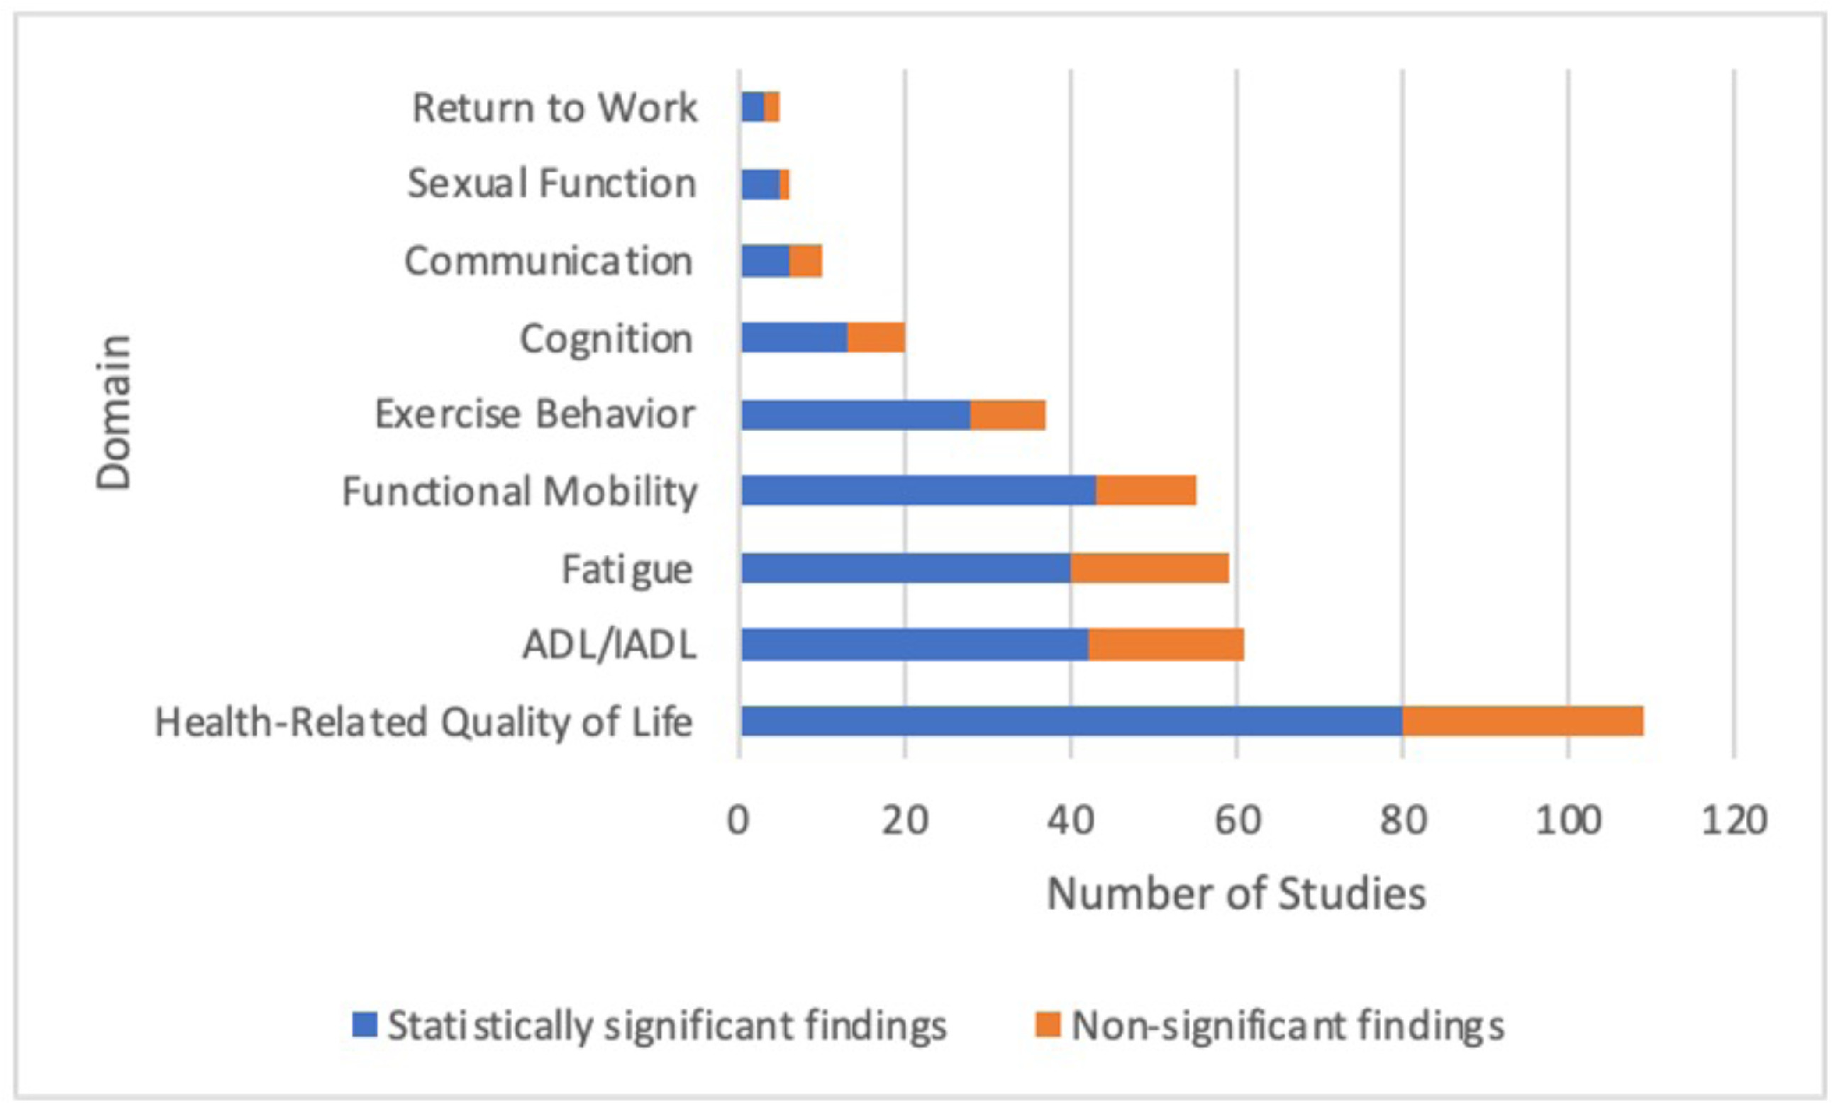
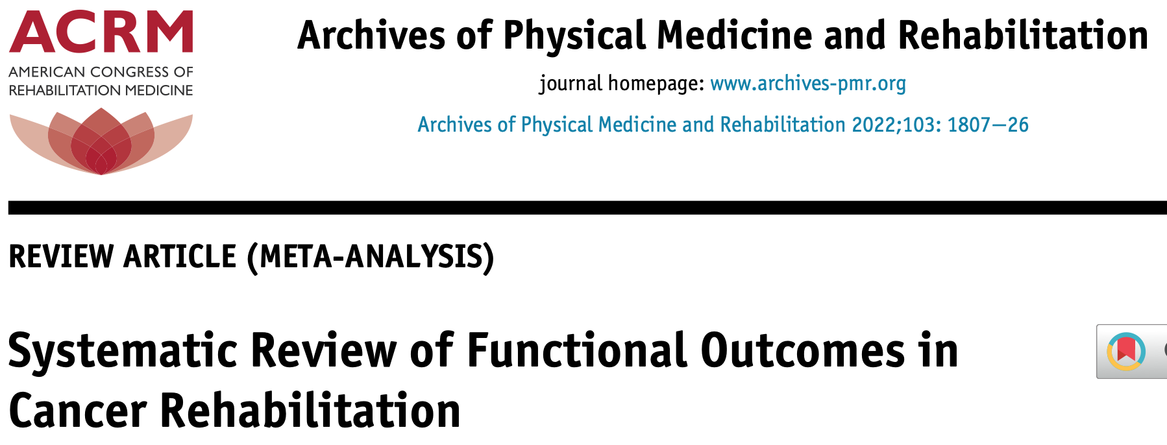
Rehabilitation improves Quality of Life
Sleight et al., Archives of Physical Medicine & Rehabilitation 2022 103(9)
Notes:
Review of cancer rehabilitation on functional outcomes (sleight et al 2022)
n=362 studies, 54% post-Rx (12 studies haem)
73% of 108 studies had significant effect on QOL as primary outcome
Emphasis – not all about recovery – adaptation key component of rehab

Slide 10
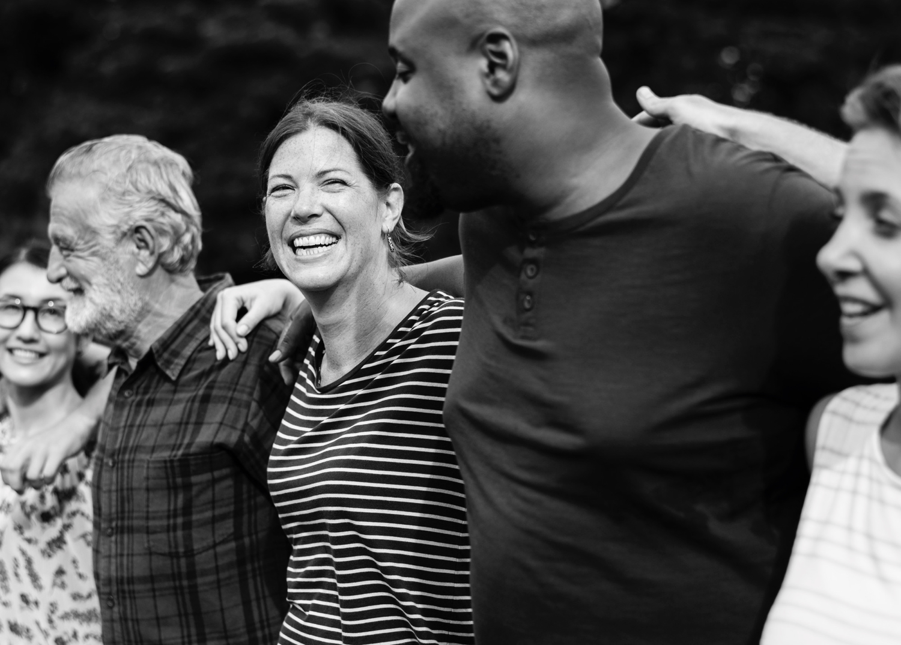


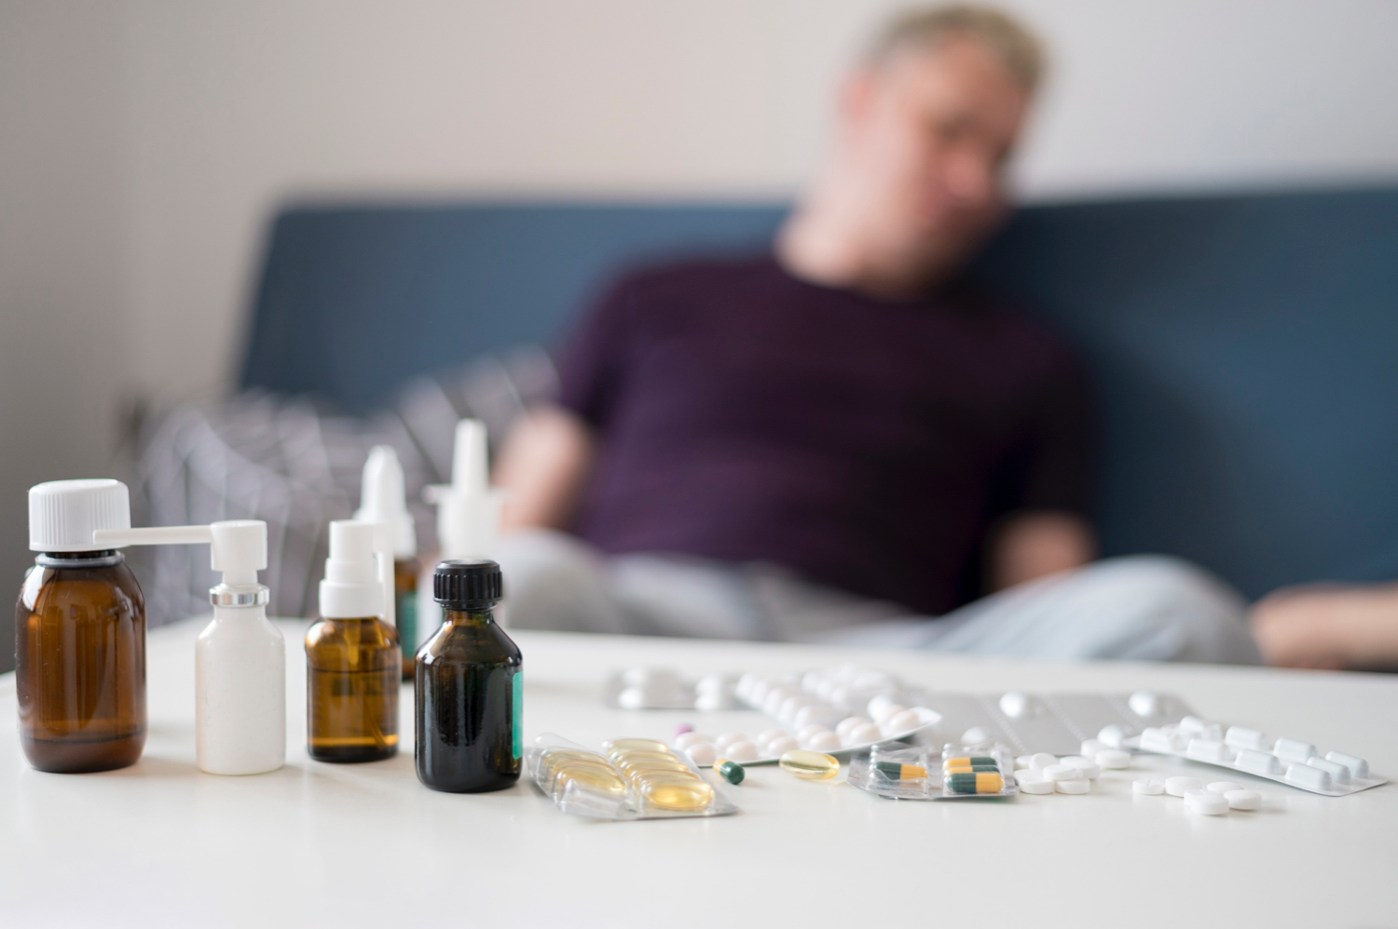
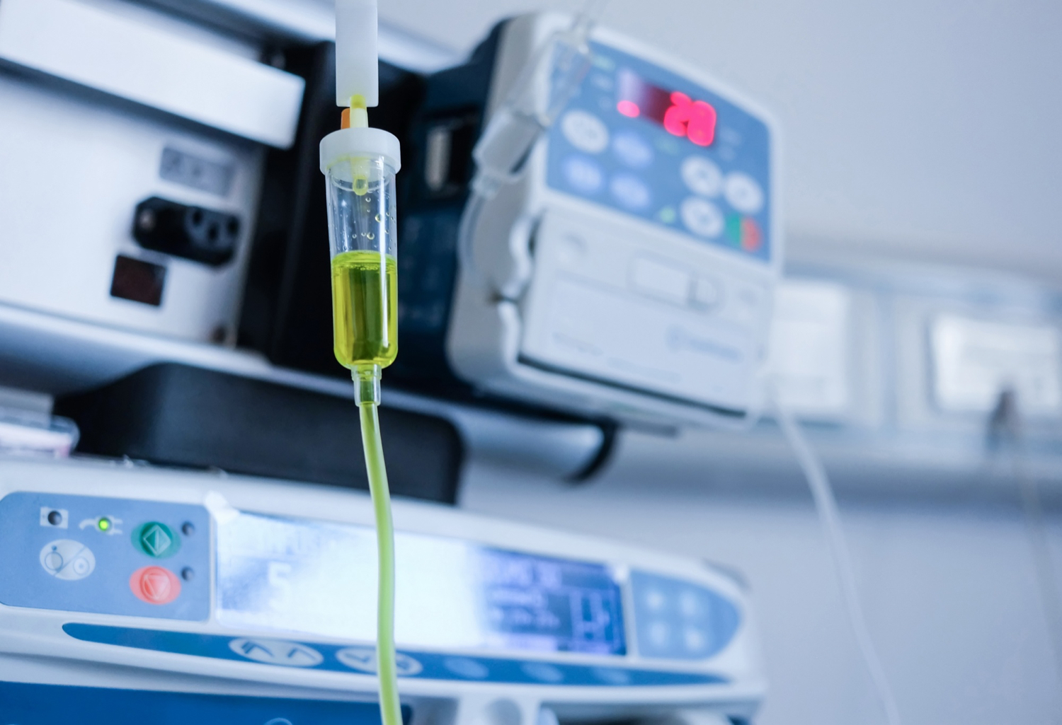
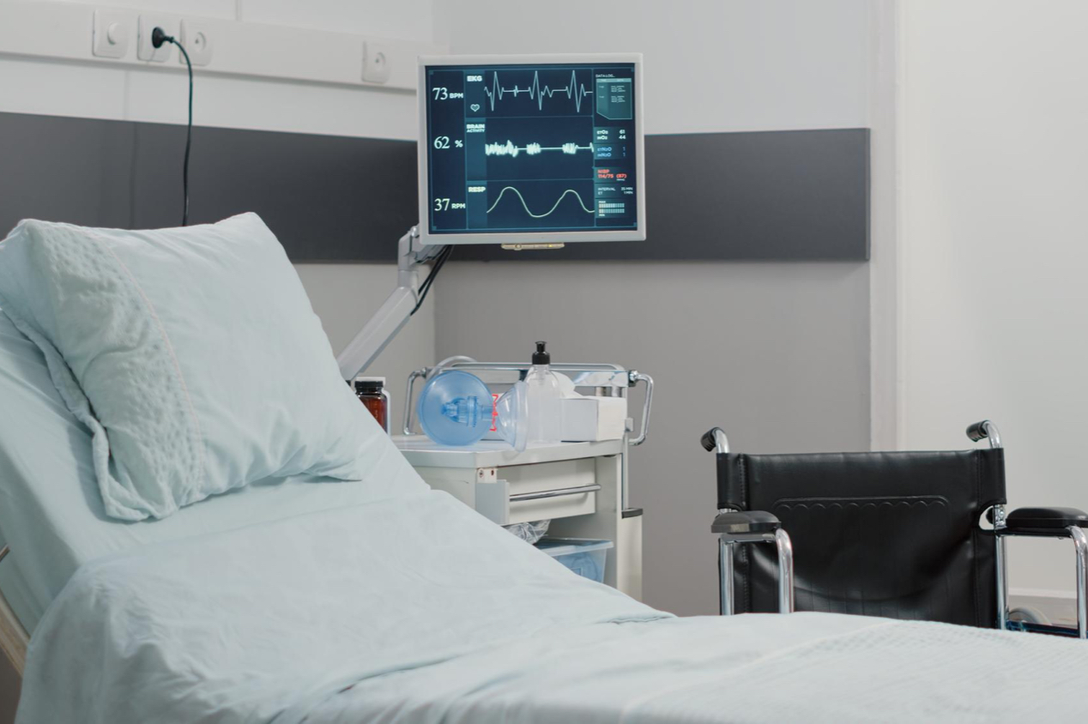
Physical Activity in Myeloma
Greater physical activity in people with myeloma has been associated with
Lower Fatigue
Fewer Comorbidities
Better
Quality of Life
Better Treatment Tolerance/Less Dose Reductions
Fewer Treatment Side-effects
Less Time in Hospital
Moller et al., Journal of Geriatric Oncology 2021 12(4): 521–530; Servadio et al., BMJ Supportive & Palliative Care 2020 10(4):e35

Slide 11





Recommendations for Physical Activity
Cardiovascular or Aerobic Activities
>150 minutes of moderate intensity or 75 minutes of vigorous intensity activity per week
Reduce time spent sitting or lying down
Break up long periods of not moving with activity
Muscle Strengthening Activities
Muscle strengthening on at least 2 days per week
Balance Activities
Balance exercises on at least 2 days per week
Spread activity evenly over 4-5 days,
or every day
Guidance for people living with cancer is to aim to achieve these recommendations
Physical activity guidelines: UK Chief Medical Officers' report available from Gov.UK
Notes:
This will sound like a lot for most people. The important thing is to start with some level of regular physical activity and build up gradually.
Physical activity guidelines: UK Chief Medical Officers' report

Slide 12
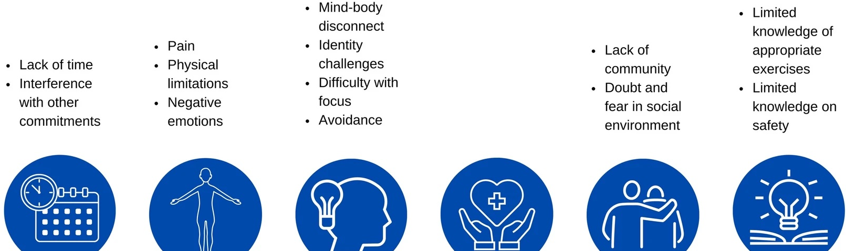
Barriers to being physically active
Inconsistent or lack of advice from healthcare professionals
Adapted from Van Dijck, S. et al. Barriers and facilitators to physical activity in cancer survivors with pain: a systematic review. Support Care Cancer 31, 668 (2023)
Notes:
Potentially remove

Slide 13
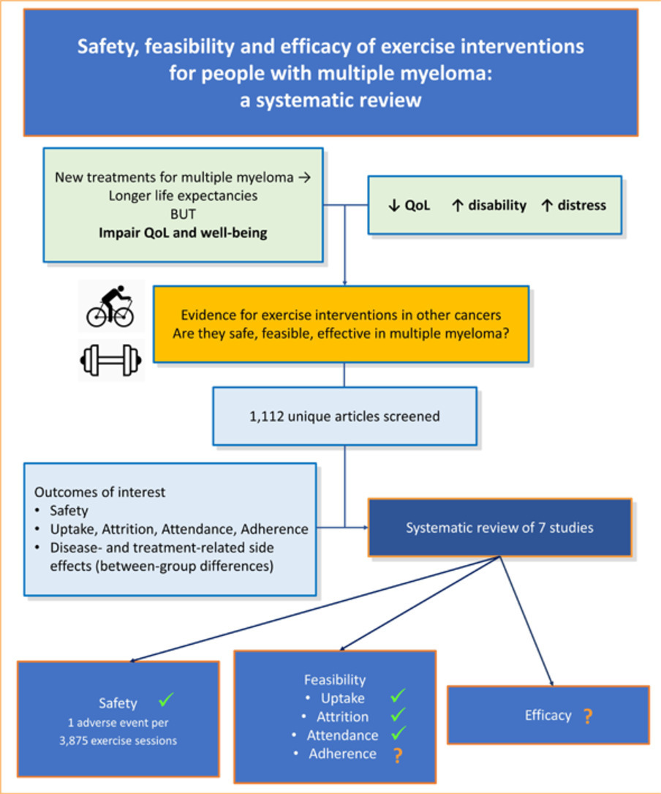
Exercise Research in Myeloma
Evidence base in small, but growing
Individual studies indicate possible benefits
  Improving lower limb strength
  Improving cardiovascular fitness
  Increasing physical activity engagement
  Improved fatigue if clinically fatigue
Nearly all studies in newly diagnosed, transplant eligible cohorts
Nicol et al., Clinical Lymphoma, Myeloma & Leukemia 2023 23(2): 86 - 96

Slide 14





Exercise in stem cell transplantation
Systematic review included 2432 participants from 27 studies
(24 RCTs; 3 non-random)
Safe and feasible
>27 studies
Increased functional capacity
MD +29m (95% CI 12.6, 45.4), p=.0005
8 studies
Increased quality of life
MD +3.4 (95% CI 0.4, 6.4). p=.03
11 studies
Reduced length of admission
MD -2.1 (95% CI 0.4-3.7), p=.01
7 studies
Improved fatigue
MD +2.5 (95% CI 0.4, 4.6), p=.02
8 studies
Abo et al (2021) Physical Therapy; 101(8)
Notes:
We now have strong evidence for safety of exercise during SCT – with few adverse events and no serious ones related to exercise reported in the literature.
This most recent review found exercise is effective at improving multiple domains of physical and psychosocial health, with good evidence for improved functional capacity, QOL, and reduced fatigue.
There is also indication of significantly reduced hospital LOS.
Importantly, many of these effects were seen to be more significant among allogenic SCT recipients than those receiving an auto and in interventions started before or during transplant admission. So earlier input may make the greatest difference, rather than focussing on recovery after transplant alone.
[This review included over 2000 patients from 27 studies.
Median study size was n=42 (IQR 30-100) and studies included: 13 allo; 5 auto; 10 both
Timing: 6 post-SCT; 10 during admission; 2 pre-SCT only; 10 continuum pre-post]

Slide 15
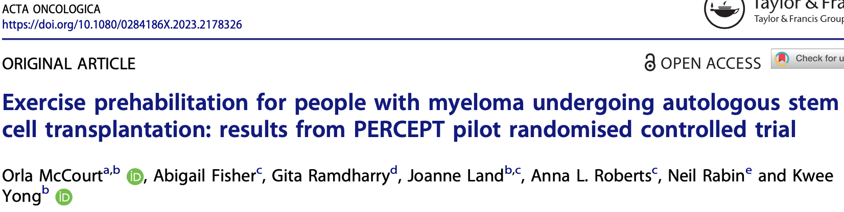

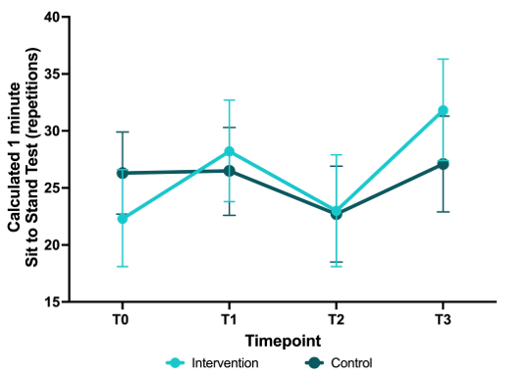
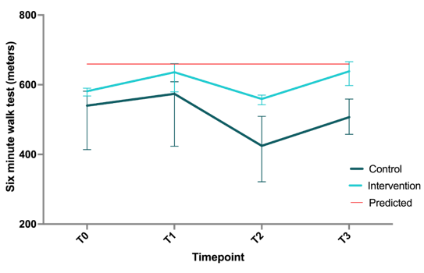
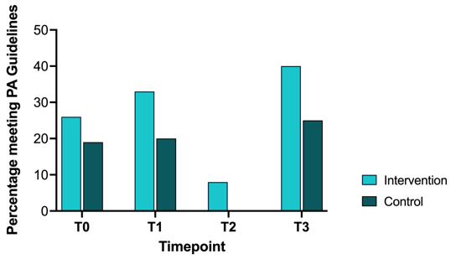
Prehab Research at UCLH
Physiotherapist-led exercise in ASCT pathway indicates promise
↑ lower limb strength, ↑ gait speed and ↑ physical activity engagement

Slide 16
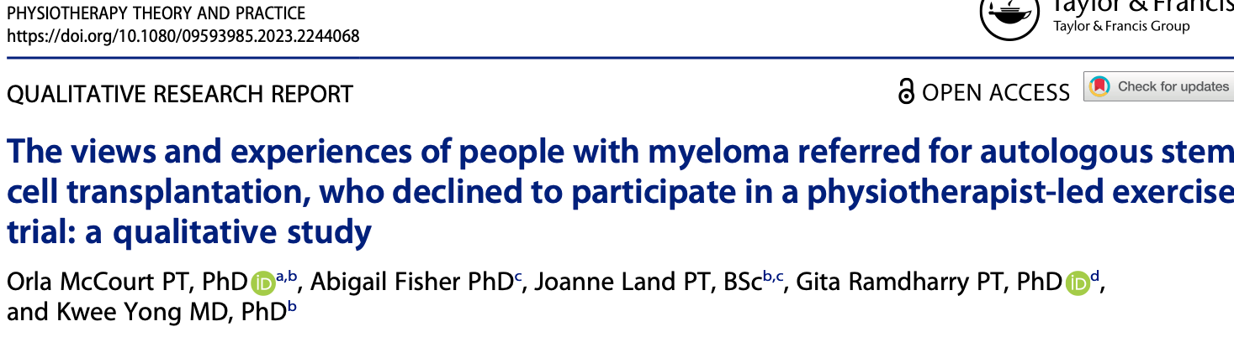
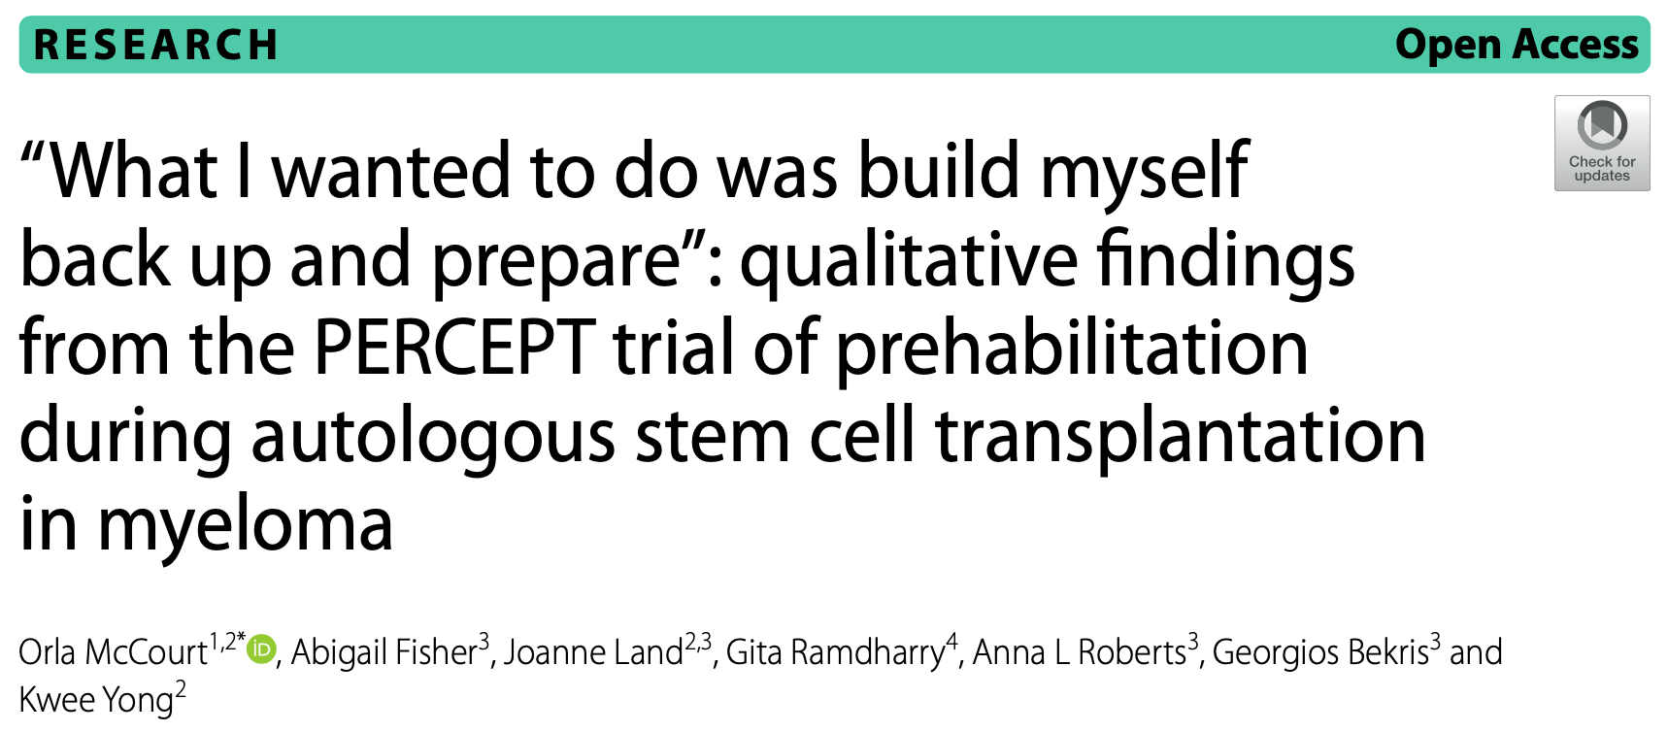
Qualitative Research Findings
Notes:
Common themes related to impact of diagnosis and early chemotherapy on functional impairment, with lack of access to PA/Rehab support.
Patients identify the time pre transplant as a key moment of motivation for engaging in PA.
Completers – indications of dissatisfaction with ‘no exercise’ control, led to engaging in PA/physio elsewhere and indicates contamination of control arm.
But we did see differences in experience of recovery between exercise group and controls,

Slide 17
Functional Outcomes
Pre-harvest ASCT Patients
Six Minute Walk Test n=43
1min Timed Sit to Stand Test
Mean distance 451.4m (SD106.5, range 180-750m)
Median % predicted = 70.7% [IQR 61, 80.2]
Mean reps 21.9 (SD 11.2, range 0-56) n=46
High levels of reduced functional capacity
Notes:
Context - predicted 6MWT for 61 yo male = ~686m
- average STS for 60-64yo >28 women or >31 male
53% trial participants <80%

Slide 18





Translation to ‘Usual Care’ at UCLH
Pre-Admission
Face to face Reassessment of outcomes
Admission Physiotherapist input
Post-Discharge Telephone Calls
Week 1 and 3
Pre-admission Education Session
Rehabilitation
Online group sessions
Weeks 4-8 & 10
2-4 week
hospital stay
Pre-habilitation
Online group sessions
x6 weeks
Hospital
admission
Post-transplant
Acute <100 days
Outcomes
6MWT
Timed STS
EORTC C30 + EQ5D
G8 Frailty Screen
Physical Activity
D100 post-ASCT
Face to face reassessment of outcomes
Pre Harvest
Face to face Physiotherapist assessment
Preceding
treatment
>6-12 months post-transplant
Patient Experience
Survey, Interviews
Process
LOS, PT activity/time

Slide 19
Functional Changes after Prehabilitation
 | Baseline | Pre-TCI | Change | Effect
Six Minute Walk Test (m) | n=31
Mean (SD) | 445.7 (111.5) | 505.9 (121.8) | +60.2 m (95% CI 41.5, 78.9) p<.001 | 1.2
% of Predicted 6MWT
Mean (SD) | 68.3 (16.6) | 77.5 (18.5) | +9.3 % (95% CI 6.5, 12.1) p<.001 | 1.2
6MWT <80% of Predicted n(%) | 24 (77%) | 16 (52%) | -25% (8 patients)
Timed 1 Minute Sit to Stand Test (reps) | n=35
Mean (SD) | 21.3 (11.6) | 28.1 (12.3) | +6.8 reps (95% CI 4.9, 8.7) p<.001 | 1.2
1min STS <25th centile reference value n(%)‡ | 26 (74%) | 21 (60%) | -14% (5 patients) p=.07 | -0.7
1min STS <2.5th centile reference value n(%)‡ | 18 (51%) | 11 (31%) | -20% (7patients) p=.01 | -1.0

Slide 20
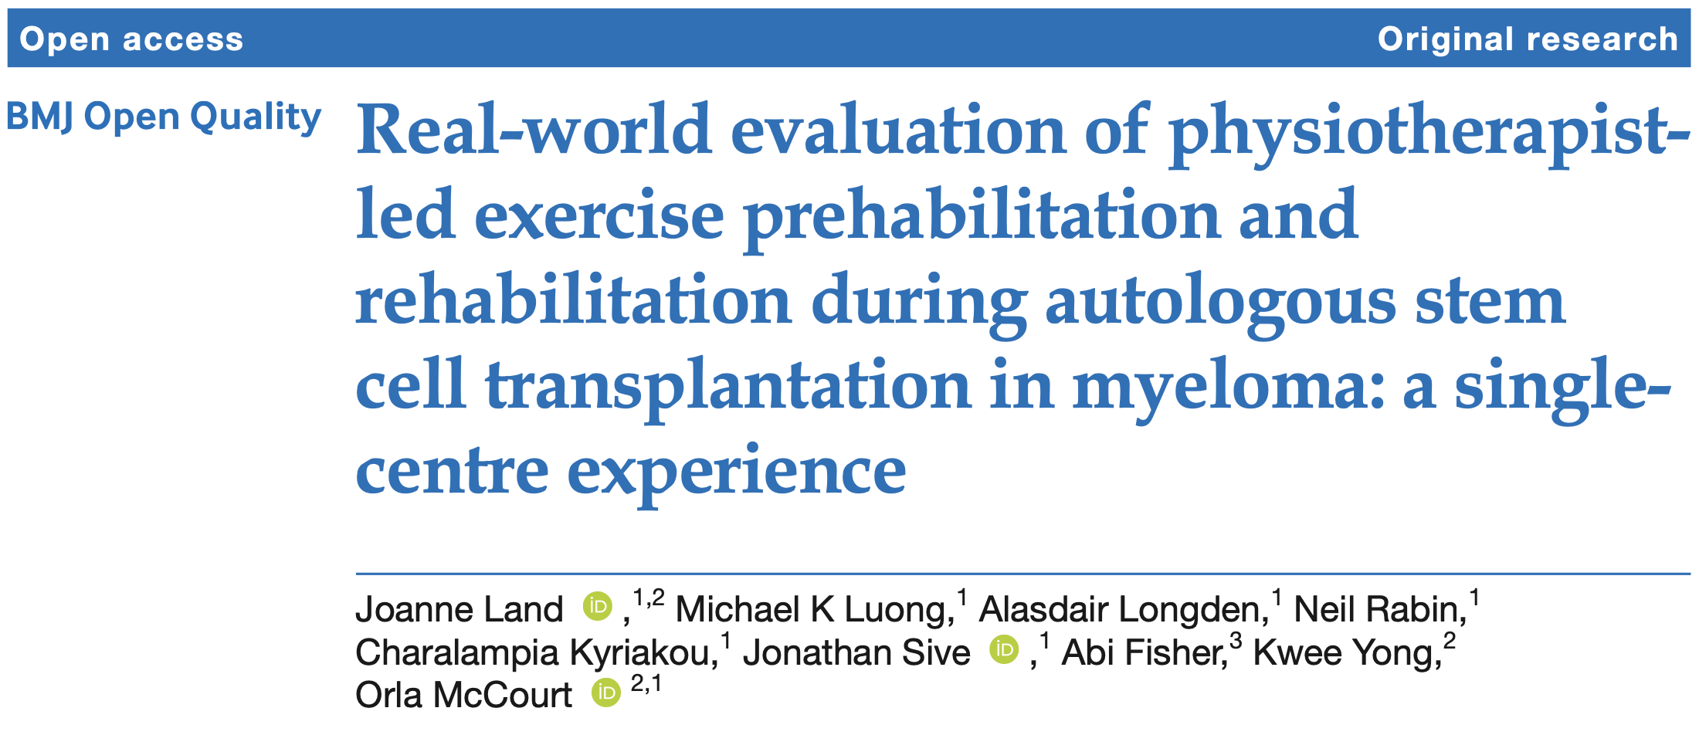
UCLH Implementation Report

Slide 21


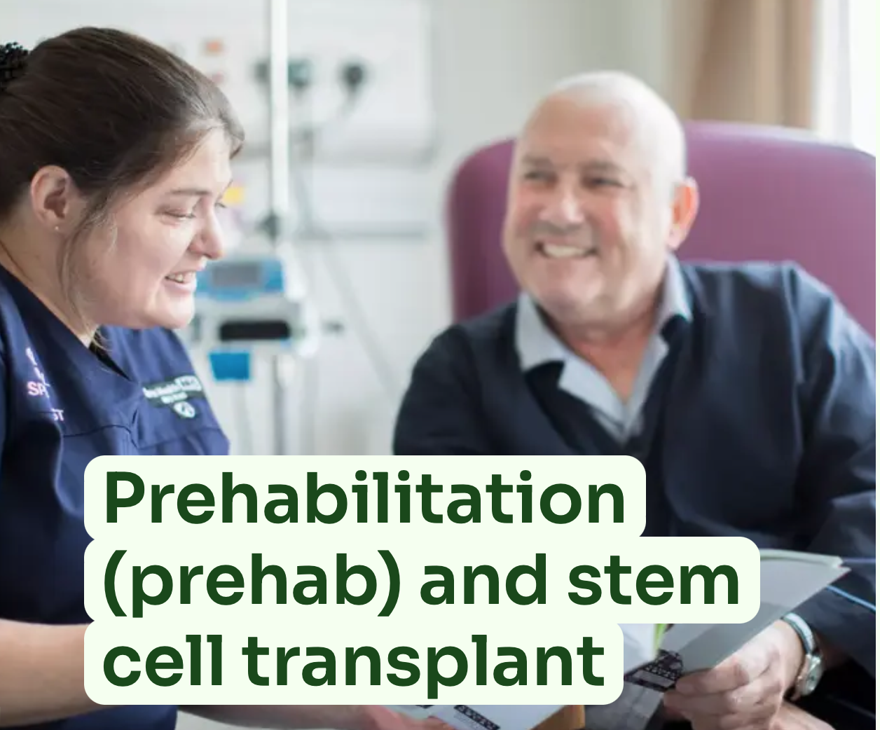
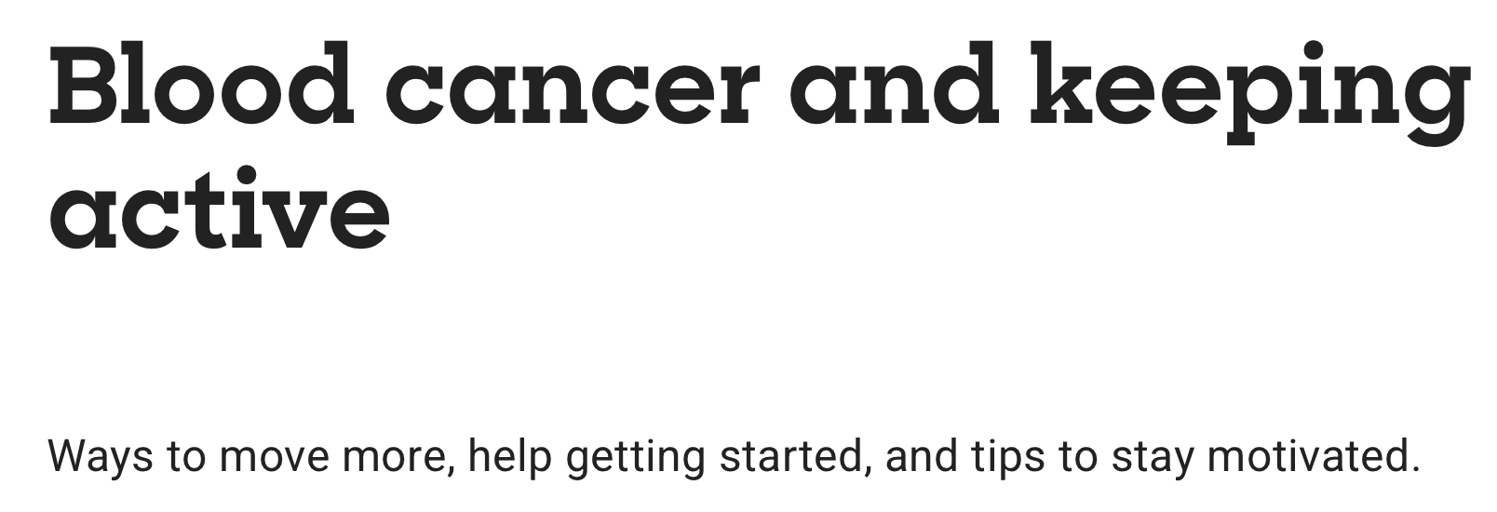


Promoting Physical Activity & Exercise
Endorse and promote physical activity and exercise to patients
Find out about your local services
Signpost
Patient charity resources
  Booklets
  Websites

Slide 22
Summary
Myeloma disease symptoms and treatment side-effects have huge impact on physical function, which drives poorer quality of life
Cancer rehabilitation is effective but rehab needs are often under identified and access to services is variable
Physically active people with myeloma have better quality of life and tolerate treatment better
Barriers to being active often require specialist support to overcome, particularly in myeloma
Growing evidence for role of exercise-based rehabilitation for improving outcomes during treatment, especially transplantation

Slide 23




Thank you for listening!
Questions?
o.mccourt@nhs.net
@orlamccourt.bsky.social
www.linkedin.com/in/
OrlaMcCourt

