Slide 1


Mock subtitle for presentation name
Author’s name
Affiliation

Slide 2







Online platform for healthcare professionals

Slide 3


Explore the HCP Hub
Join expert-led conversations on real clinical challenges and evolving treatments in myeloma care.
Access free resources, CPD courses, and webinars to support your professional development.
Discover best practices and the latest research shaping myeloma treatment across the UK.
Together, we are a community for change.
hcp.myeloma.org.uk

Slide 4
Join the HCP Hub community, for exclusive members-only content
Connection and conversation
Updates from community experts
Featured discussions on hot topics
Latest Myeloma UK news
Journals
Shared practice articles
Education and support
Information guides and tools
Nurse learning programme
Videos and animations
Online courses
Guidelines
Join at hcp.myeloma.org.uk
Notes:
Add the QR scan code

Slide 5
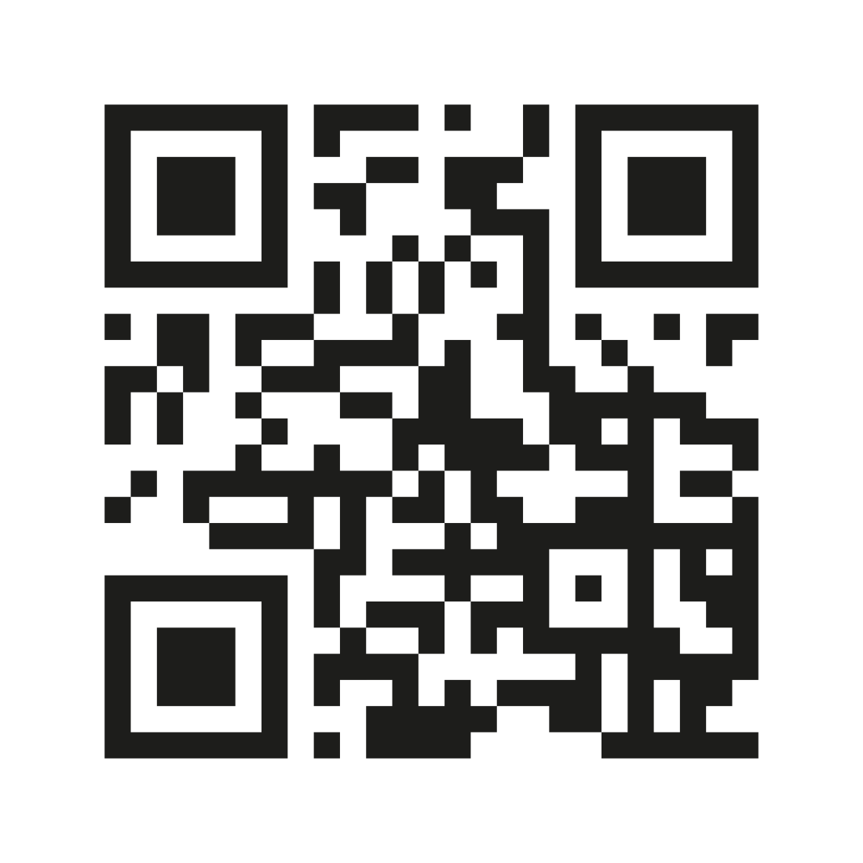
Visit the Myeloma UK HCP Hub
hcp.myeloma.org.uk
Notes:
Can remove this slide

Slide 6




Patient information: What’s new?
“ Ice lollies were an absolute godsend. They eased the soreness and got fluids into me! ”
UPDATED Infoguide on HDT-SCT
Includes Hints and Tips section for patients
NEW Treatment guides for
Elranatamab, Teclistamab and Selinexor

Slide 7


Patient Infodays 2025
Opportunity for patients and their families to:
  Share experiences
  Ask myeloma experts questions
  Learn about the latest treatments and research
  Discover information and support from Myeloma UK
Stirling
1 November
Newcastle
27 September
Leeds
26 April
Birmingham
18 October
Bristol
17 May
London
6 September

