Slide 1

Equity in Multiple Myeloma Bispecific Research and Access (EMMBRAce)
Bispecific Antibody Implementation Group
May Low, Senior Haematology Pharmacist
Dunsi Bolarinwa Senior Haematology Pharmacist
March 2025

Slide 2
Objectives | Members | Task Groups | Pathway | IVIG | PPIE | Training | Next Steps
Our overarching goal is to improve patient access to Bispecific antibodies(BsAbs)
Achieve through targeted quality improvement strategy
Assess the effectiveness of a quality improvement programme focused on provider-related factors
Increase number of hospitals able to deliver bispecifics and
Reduce the implementation time for patients to receive these treatments.
DO
STUDY
ACT
PLAN
Notes:
Through this targeted quality improvement strategy we aim to demonstrate increased number of hospitals able to deliver bispecifics and reduce the implementation time for patients to receive these treatments. We will also see improved access across geographies and thereby improve access to minority groups as well as permitting treatments more local to patients.
Support health care providers deliver treatment
Improve equity of access for minority groups
Develop educational, policy materials and guidelines
Assess the effectiveness of quality improvement activities
Bring innovation to routine care

Slide 3
Objectives | Members | Task Groups | Pathway | IVIG | PPIE | Training | Next Steps
Engaging with underserved populations
Innovation in practice
Education and Implementation
Notes:
Support health care providers deliver treatment
Improve equity of access for minority groups
Develop educational, policy materials and guidelines
Assess the effectiveness of quality improvement activities
Bring innovation to routine care

Slide 4

Objectives | Members | Task Groups | Pathway | IVIG | PPIE | Training | Next Steps | Summary
NHS Lothian Scotland
Neil Storrar
Lesley Symington
Patient and Charity Group
Antoinette Carr, Patient Representative
Suzanne Stainer, Patient Representative
Sandra Quinn, Myeloma UK
The Northern Care Alliance NHS Foundation Trust
Satarupa Choudhuri
The Newcastle Upon Tyne Hospitals NHS Foundation Trust
Jane Aston
Jennifer Young
Michelle Amos
Sumantha Gabriel
Belfast City Hospital
Jackie Quinn
University Hospitals of North Midlands NHS Trust
Kamaraj Karunanithi
Nottingham University Hospitals NHS Trust
Sarah Henshaw
University Hospitals Birmingham NHS Foundation Trust
Adrian Shields
Bhuvan Kishore
Hayder Hussein
Helen Parry
Nicola Lawton
Nicola Parry
Hywel Dda University Health Board
Peter Baker
University College London Hospital NHS Foundation Trust
Rakesh Popat, Co-chair
Pinkie Chambers, Co-chair
May Low
Dunsi Bolarinwa
Chantelle Hughes
Luke Steventon
Cardiff and Vale University Health Board
Emma Williams
Grant Mehrjou
University Hospital of Wales
Ceri Bygrave
University Hospitals Bristol & Weston NHS Foundation Trust
Andrea Preston
Great Western Hospitals NHS Foundation Trust
Tiffany Chan
Royal Cornwall Hospitals NHS Trust
Adam Forbes
University Hospitals Dorset NHS Foundation Trust
Rachel Hall
Notes:
Members of our steering group
Professions include:
Haematologists, Immunologists, Pharmacists, Specialist nurses, Researchers, Patient representatives

Slide 5
Objectives | Members | Task Groups | Pathway | IVIG | PPIE | Training | Next Steps
Pathway Redesign
Immunoglobulin
To develop novel ways in which BsAbs can be adopted by a wide range of hospitals. This could include:
Developing shared care guidelines and policies
Guidance on nurse preparation
Development of an ambulatory care pathway
To advise and plan a strategy to ensure that IVIG is accessible for patients receiving BsAbs. This could include:
Understanding resource implications and develop strategies to overcome these e.g. SC use.
Understand policy barriers and plan actions to overcome these.
Patient and Public Involvement
Education and Training
Work with patient groups to understand any hesitancy, particularly from minority backgrounds in relation to bispecifics.
Develop lay materials and infographics to support patients on BsAb treatments
To understand the different health professionals that need to be trained and develop ways of delivering key education to relevant people

Slide 6
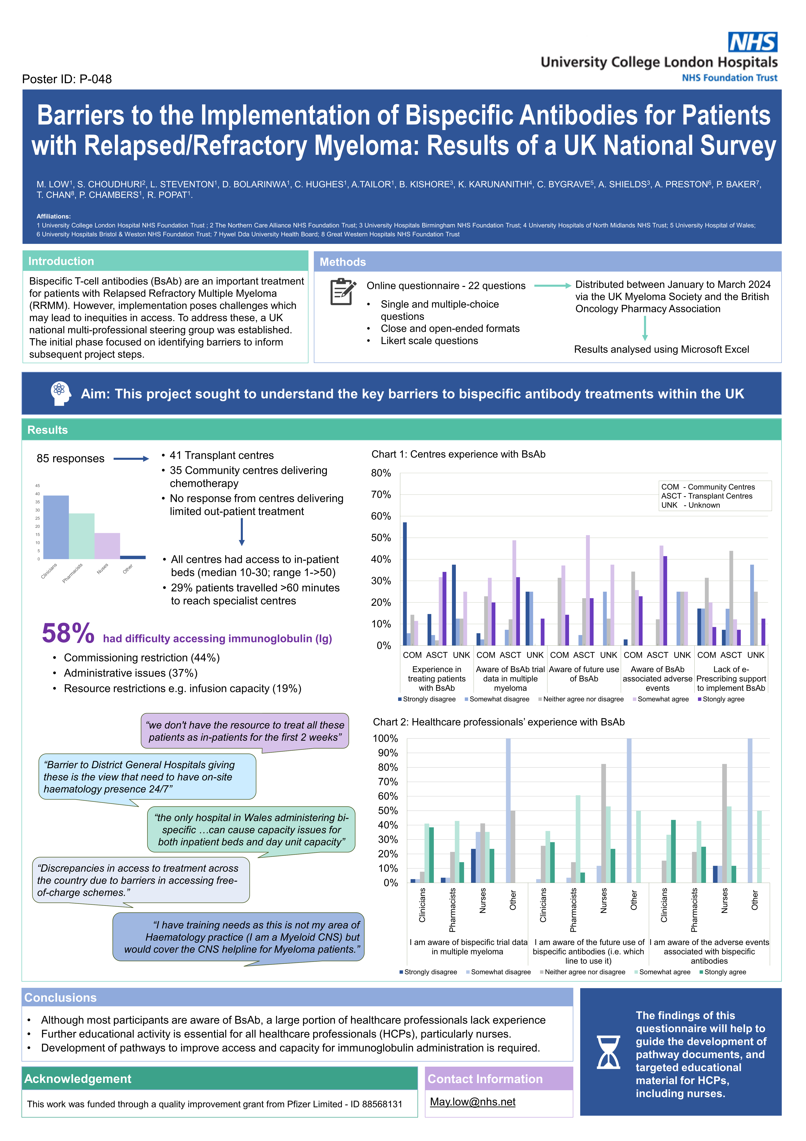

Objectives | Members | Task Groups | Pathway | IVIG | PPIE | Training | Next Steps
Methods
Online questionnaire - 22 questions
Distributed between January to March 2024 via the UK Myeloma Society and the British Oncology Pharmacy Association
Single and multiple-choice questions
Close and open-ended formats
Likert scale questions
Results analysed using Microsoft Excel
85 responses
41 Transplant centres
35 Community centres delivering chemotherapy
No response from centres delivering limited out-patient treatment
All centres had access to in-patient beds (median 10-30; range 1->50)
29% patients travelled >60 minutes to reach specialist centres
Low, M, Choudhuri S, Steventon L et al . Barriers to the Implementation of Bispecific Antibodies for Patient With Relapsed and Refractory Myeloma in the UK: Results of a National Survey. Clinical Lymphoma Myeloma and Leukaemia, Volume 24, Supplement 2,2024, doi.org/10.1016/S2152-2650(24)01951-7.

Slide 7
Objectives | Members | Task Groups | Pathway | IVIG | PPIE | Training | Next Steps
COM - Community Centres
ASCT - Transplant Centres
UNK - Unknown

Slide 8
Objectives | Members | Task Groups | Pathway | IVIG | PPIE | Training | Next Steps
Experiences shared about delivery of bispecific antibodies having participated in a clinical trial
Positive aspects | Negative aspects
Successful management of complications | Capacity and resource challenges e.g. ward and day unit capacity; trial set-up time, access to ophthalmology service; IVIg access
Well-co-ordinated approach in patient care and management of treatment toxicities | Training and support constraints e.g. Time-consuming to train across disciplines
Clinical monitoring and timely intervention e.g. comprehensive monitoring during critical phases of treatment | Clinical management e.g., variability of timing of CRS & neurotoxicity; incidence and management of infections

Slide 9
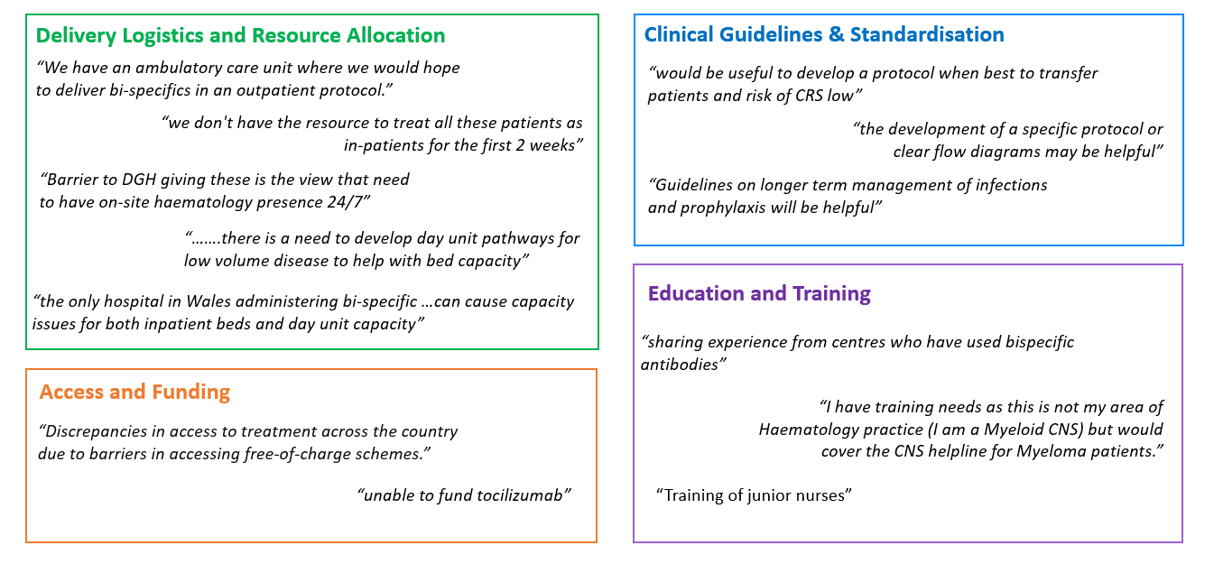
Objectives | Members | Task Groups | Pathway | IVIG | PPIE | Training | Next Steps

Slide 10
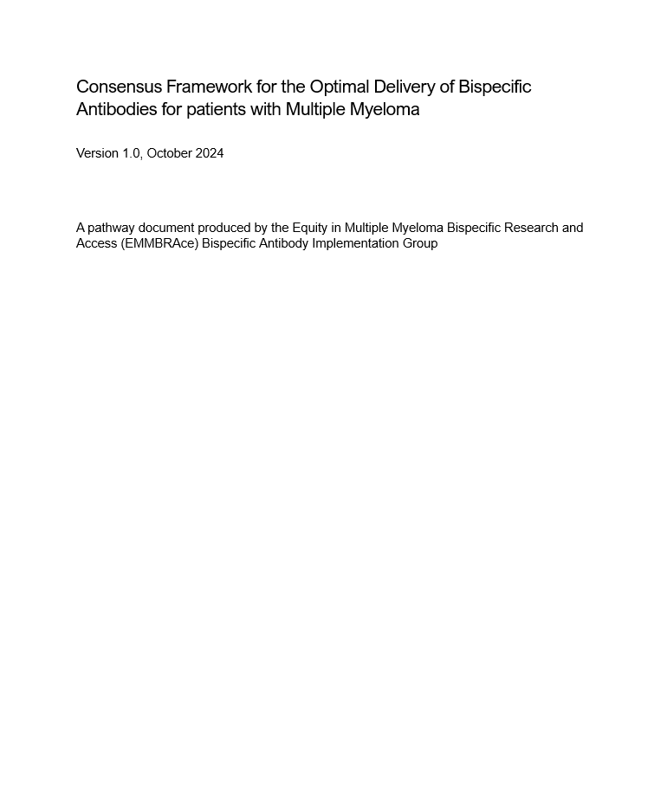
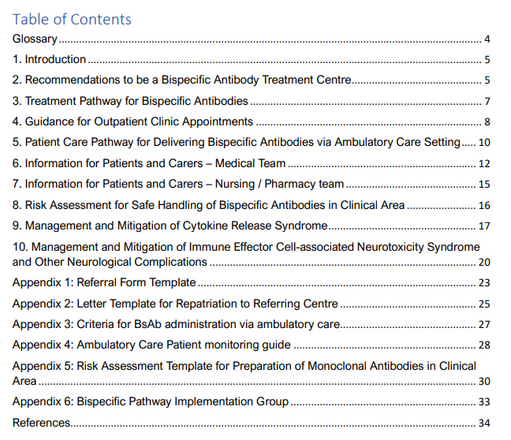
Objectives | Members | Task Groups | Pathway | IVIG | PPIE | Training | Next Steps
https://www.ucl.ac.uk/lifesciences-faculty/research/emmbrace-project

Slide 11
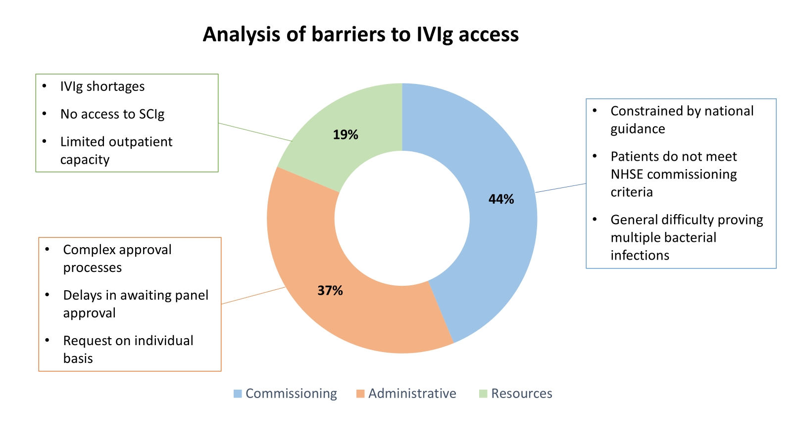
Objectives | Members | Task Groups | Pathway | IVIG | PPIE | Training | Next Steps | Summary
58%
had difficulty accessing immunoglobulin

Slide 12
Objectives | Members | Task Groups | Pathway | IVIG | PPIE | Training | Next Steps
Current NHSE treatment criteria for secondary antibody deficiency in adults:
Underlying cause of hypogammaglobulinaemia cannot be reversed, or reversal is contraindicated;
OR
Hypogammaglobulinaemia associated with drugs including emerging bispecifics, therapeutic monoclonals targeted at B cells and plasma cells (rituximab and other anti-CD20, CD19 agents, daratumumab etc) post-HSCT*, NHL, CLL, MM or other relevant B-cell malignancy confirmed by haematologist
AND
Recurrent or severe bacterial infection despite continuous oral antibiotic therapy for 6 months
IgG <4g/L excluding paraprotein
Documented failure of serum antibody response to unconjugated pneumococcal or other polysaccharide vaccine challenge (may be omitted if IgG <3g/L)
Notes:
BCMA is expressed across the whole B cell lineage; by administered BCMA targeting therapy, you simultaneously render an individual B cell aplasic and remove their long lived humoral immunity in the plasma cell compartment. The level of humoral immune suppression achieved by these drugs (biological equivalent of XLA, where IVIG is used prophylactically) is qualitatively different to most other chemotherapies.
Vaccine responses are not helpful in this situation; even if an individual could make a vaccine response , the next dose of BiTE will destroy the plasmablast/plasma cells made from that vaccine. It is not a useful test to stratify the immune deficiency and should not form part of the assessment.
Most serious infections in these cohorts are respiratory viral infections. Antibiotic prophylaxis is not a rationale treatment for viral infections.

Slide 13
Objectives | Members | Task Groups | Pathway | IVIG | PPIE | Training | Next Steps
Proposal for change in indication to:
Hypogammaglobulinaemia associated with BCMA Bispecific Antibodies when the IgG is <4g/L excluding paraprotein,
without recurrent infection despite 6 months trial of Abx and vaccine challenge.
Outcome March 2025:
The Immunoglobulin Oversight Group have discussed and agreed:
Use of Ig at inception of bi-specific antibody treatment in patients with myeloma and B-cell lymphoma.
The prophylactic use of Ig would be appropriate in patients with a serum IgG of < 4g/l at the time of commencement of BsAbs.
A/w update of commissioning guidelines ?April 2025

Slide 14
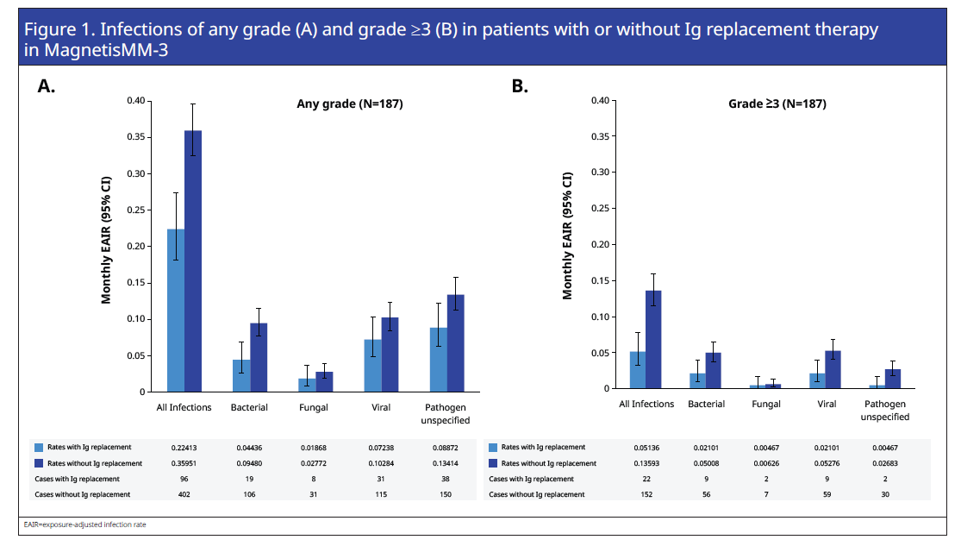
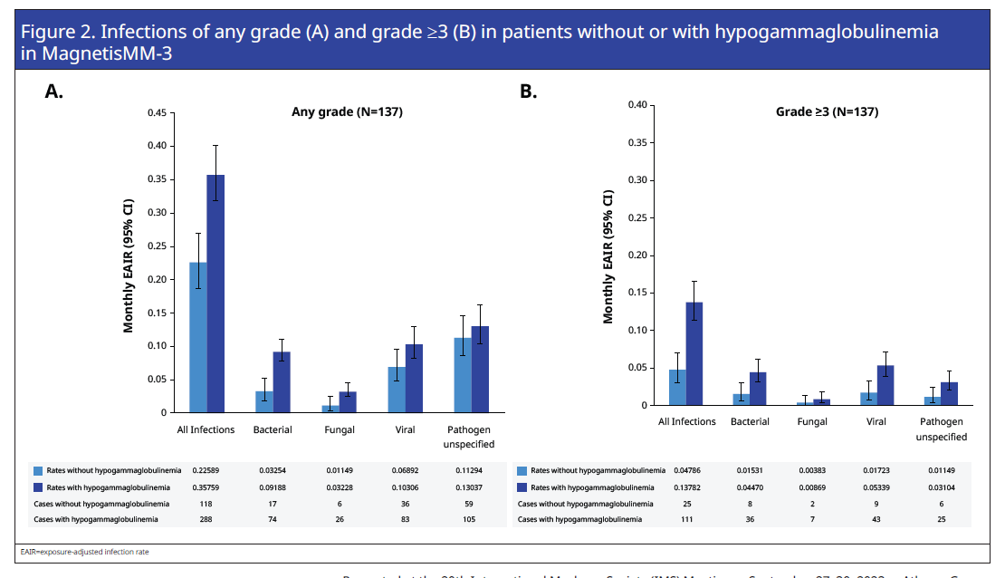
Objectives | Members | Task Groups | Pathway | IVIG | PPIE | Training | Next Steps
Ig replacement therapy were associated with decreased infection rates,
including the rates of G≥3 infections
Leleu et al 2023, IMS Poster presentation P-286 – Impact of Hypogammaglobulinemia and Immunoglobulin Replacement Therapy on Infection Rate in Pateitns with RRMM Treated with Elrantamab: Post-Hoc Analysis From MagnetisMM-3

Slide 15
Objectives | Members | Task Groups | Pathway | IVIG | PPIE | Training | Next Steps
Results from BsAb questionnaire:
Notes:
To develop effective educational resources, we are seeking input from cancer nurses who care for haematology patients about your knowledge and experience with bispecific antibodies, as well as your preferred learning resources.
survey takes just 5 minutes to complete, and your feedback is invaluable in shaping future training and educational materials. Please forward this to your nursing networks to complete the survey.
create an online educational offering around bispecific antibodies

Slide 16
Objectives | Members | Task Groups | Pathway | IVIG | PPIE | Training | Next Steps
Nurse Survey: Bispecific Knowledge & Education Preferences
Knowledge/Experience:
149 responses ( Tertiary centre 57% vs DGs 43%)
  Around 25% had no experience of BsAbs
  Similar proportion lack confidence recognising toxicity & counselling patients on side effects/logistics
  A third not confident in managing toxicity
  Similar between DGH & tertiary
  Variable between roles, notable that higher proportion of staff nurses/ ANPs often report feeling less confident

Slide 17
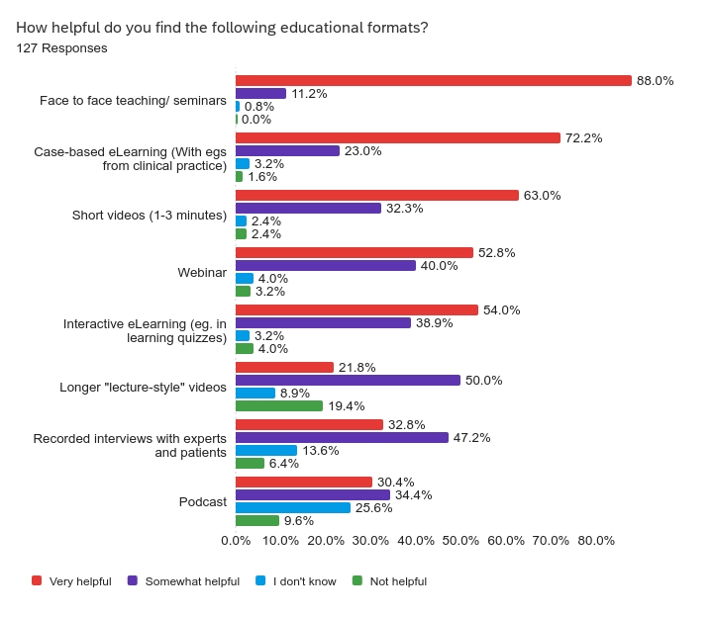

Slide 18
Objectives | Members | Task Groups | Pathway | IVIG | PPIE | Training | Next Steps
Thoughts/ suggestions/ next steps
E-learning
  Supplementing Myeloma academy – different audience e.g. staff nurses, non-specialists, ?disease agnostic, ?relevant to pharmacists/SHOs
In person
  Feasibility of attendance
  Locations
  Supplementing pharma teaching
Getting BsAbs on the agenda of relevant UK based conferences, so far on:
  5th March- UKMS
  24th April - Haemato-Oncology Clinical Updates and Service Delivery Developments (Nottingham, predominantly nurses)
  9th May - J&J Enhancing Haematology Outcomes 2025: A Study Day for Nurses and AHPs (London)
  9th May - The Haematology Patient and Carers Congress - Clinician session. London.

Slide 19





Objectives | Members | Task Groups | Pathway | IVIG | PPIE | Training | Next Steps
Patient and Public Involvement
Aim
Patient representatives to be involved in 'information gathering’ to shape the ease at which we can help UK hospitals to offer BsAbs.
Objective:
Explore myeloma patients' perceptions about BsAbs and how can we best support them to access BsAbs; novel therapies or clinical trials, and what barriers do they face.
Recruited RRMM patients through charities
Responses from 10 patients and panel met in July 2024
PPIE ongoing from Jan 2025 to evaluate pathway document and resources so far.

Slide 20
Objectives | Members | Task Groups | Pathway | IVIG | PPIE | Training | Next Steps
Knowledge about clinical trials (awareness)
Information dissemination
Information content
Impact on treatment
Personal factors/risk perception

Slide 21
Objectives | Members | Task Groups | Pathway | IVIG | PPIE | Training | Next Steps
Pathway Redesign
Immunoglobulin
Evaluate the impact of the Consensus Framework in national uptake of BsAb
Identify further opportunities to further support the implementation of BsAb nationally
Work with commissioners to review current treatment criteria
Best practice guidance on infection management and use of immunoglobulin
Patient and Public Involvement
Education and Training
Recruit into regional focus group, actively start PPIE in Jan 2025
Understand current knowledge and learning needs for nursing staff
Create online educational material for HCPs

Slide 22

Objectives | Members | Task Groups | Pathway | IVIG | PPIE | Training | Next Steps
Bi-specifics data protocol Part 1 : A call for Principal Investigators
Multi-centre study aims to collect data from patients with multiple myeloma being treated in England to understand differences in treatment access and timing across different regions
Primary objective:
To investigate the differences in timeframes to access of novel treatments via the three routes:
Clinical trials
Early access
Baseline commissioning e.g. NICE approved treatments
Secondary objective:
If geographical differences in access to treatment are observed, to investigate whether these differences in access to treatment affect patients equally across demographic groups i.e. ethnicity, sex and region treated.
Aiming 50 sites/PIs - Pharmacists & Nurses
Aiming onboarding sites March - June 2025
Aiming data transfer July 2025
Notes:
To evaluate the success of our initiatives, we would like to understand how quickly treatments are adopted and identify regional availability of treatments. This data will provide insights into regional disparities and help us measure the effectiveness of our efforts to reduce inequalities in treatment access

Slide 23
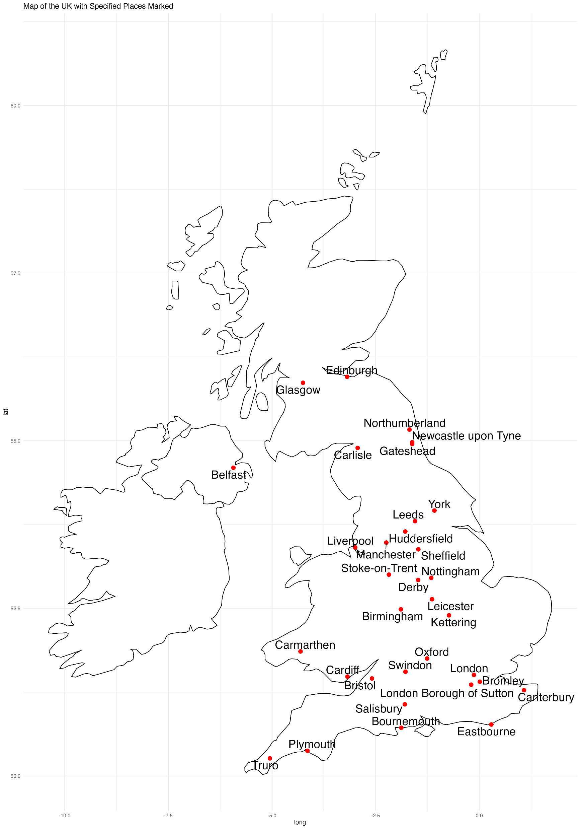
Objectives | Members | Task Groups | Pathway | IVIG | PPIE | Training | Next Steps
Torbay & South Devon
Royal Devon and Exeter NHS Foundation Trust
Barts
Cambridge
Norfolk
Royal United Hospitals Bath NHS Foundation Trust
Frimley Health NHS Foundation Trust
Brighton and Sussex University Hospitals NHS Trust
Royal Surrey NHS Foundation Trust
West Hertfordshire Hospitals NHS Trust
East and North Hertfordshire NHS Trust
Mid and South Essex NHS Foundation Trust
Notes:
To evaluate the success of our initiatives, we would like to understand how quickly treatments are adopted and identify regional availability of treatments. This data will provide insights into regional disparities and help us measure the effectiveness of our efforts to reduce inequalities in treatment access

Slide 24



Bispecifics data protocol PI, contact:
Chantelle.Hughes@nhs.net
General queries: uclh.emmbrace.queries@nhs.net
PPIE queries: uclh.ppie.noveltreat@nhs.net
Consensus Framework:
https://www.ucl.ac.uk/lifesciences-faculty/research/emmbrace-project

