Slide 1
Bispecific in Ambulatory Care
Sharing Our Experience
Amy Colada (amy.colada@nhs.net) – Lead Nurse
Ruby Hortelano (rubyjean.hortelano@nhs.net)- Deputy Lead Nurse

Slide 2
How did we do it?
Bispecisfics (Elranatamab & Teclistamab) regimen used to be administered in IP setting
EBMT April 2024 – Myeloma consultants hinted that the Bispecifics will move to Ambulatory care
May 2024 – discussion between UCLH team & Leeds regarding Bispecific in out-patient setting
May 2024 – drafted SOP, pathway, checklist , other documents
June 2024 – presented in haematology governance for approval
September 2024 – Ambulatory Care received the 1st patient
Before December 2024 – available under compassionate access until NICE approval

Slide 3
Treatment Pathway for Elranatamab & Teclistamab
During clinic visit / pre-admission Clinical team:
◼ Review and discuss treatment with patient
◼ Complete consent form and document clear instruction in notes to proceed via ACU pathway.
◼ Complete baseline ICE score including handwriting, document in notes using smart phrase .icescore.
◼ Complete the ‘inpatient appointment request’ within the SACT plan. State in the comment section that the patient is for Elranatamab AC pathway
◼ Sign SACT plan for Elranatamab
◼ Ensure following investigations performed during OPA:
  Height, weight taken and added to EPIC
  Relapsed Myeloma blood panel on EPIC performed: FBC, U&Es, bone profile, LFTs, LDH, SPEP, SFLC, Coagulation screen including fibrinogen, baseline CMV serology

Slide 4
Admin team:
◼ Scan and upload the consent and handwriting test in the patient’s chart (media section)
Pharmacy team:
◼ Clinically screen SACT plan and raise any queries with the medical team
◼ Provide counselling to patient on supportive medication and dexamethasone rescue dose
◼ Order Elranatamab and supportive medication
After clinic visit ACU team:
◼ Confirm booking within 24-48 hours CNS team (after clinic visit):
◼ Confirm patient is booked in ACU
◼ Ask patient to arrive no later than 9:00am on ACU arrival day ◼ Ensure appointment made for D15 treatment on MCC 2nd floor Chemotherapy Day Unit, and next outpatient clinic

Slide 5
On treatment days (Days 1, 4 and 8)
Admit patient in ACU ◼ Patient will be reviewed by ACU nurse/SpR
ACU team to provide counselling (AC booklet, AC cards, patient agreement, Elranatamab AC checklist and Elranatamab alert card, home monitoring record form)
Complete observations and SACT toxicity assessment
If handwriting test not done in the preceding 10 days, perform baseline ICE score including handwriting, then scan and upload to EPIC prior to drug administration, and document in notes using smartphrase .icescore.
Elranatamab step-up doses given with pre-medication
Patient observed for 1 hour post injection in AC
Twice daily observations performed (HR, RR, BP, O2 saturations Temp)
Medication and reminder chart issued to patient
Patient counselled on the supply of “Just in Case” dose of dexamethasone
Medication supply

Slide 6
Follow-up days (Days 2, 3, 5, 6, 7, 9 and 10)
◼ Patient to return to AC for:
• Daily review by AC nurse/AC SpR • Daily review of patient home monitoring booklet
• Daily bloods (FBC, U+E, LFTs, bone profile, ferritin) • Twice daily ICE score including handwriting uploaded to EPIC
• Twice daily Observations in AC
DISCHARGE
◼ Patient can be discharged from AC 48 hours post dose if:
• no significant adverse events
• post AC SpR medical review
◼ AC team to confirm D15 SACT booked on chemo day unit and OPA in clinic booked
◼ TTAs ordered
◼ Ensure advice line number is supplied to patient
◼ Ensure patient counselled on discharge medicines and continues to carry alert card

Slide 7
In summary:
Monitoring Requirements | Frequency | Parameters
Observations | Twice a day | HR,BP,RR,O2 Sats, Temp
ICE score | Twice a day | See document
Bloods | Daily | FBC, Biochem, ferritin
SACT Toxicity assessment | Daily | As per Trust
Patient home monitoring booklet | Daily | See document

Slide 8
Reason for IP transfer:
Fever
Evidence of CRS
Febrile neutropenia
Evidence of ICANs
Other symptoms requiring admission to hospital (diarrhoea, nausea, vomiting etc)
Patient unable to cope in AC

Slide 9
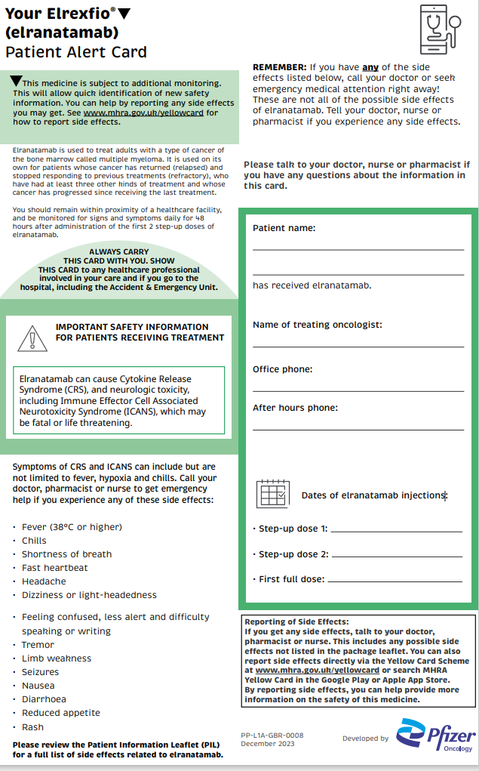
Elranatamb Alert Card

Slide 10
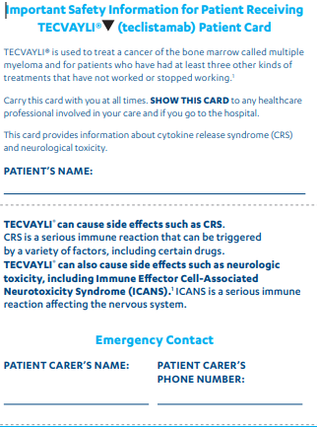
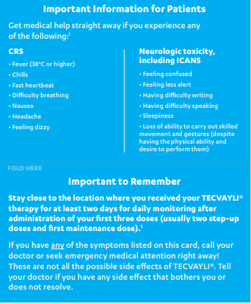
Teclistamab Alert Card

Slide 11
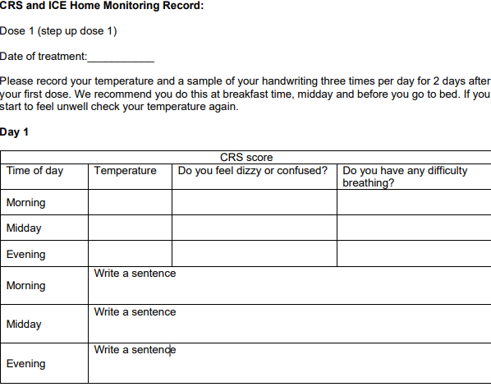
Home Monitoring

Slide 12
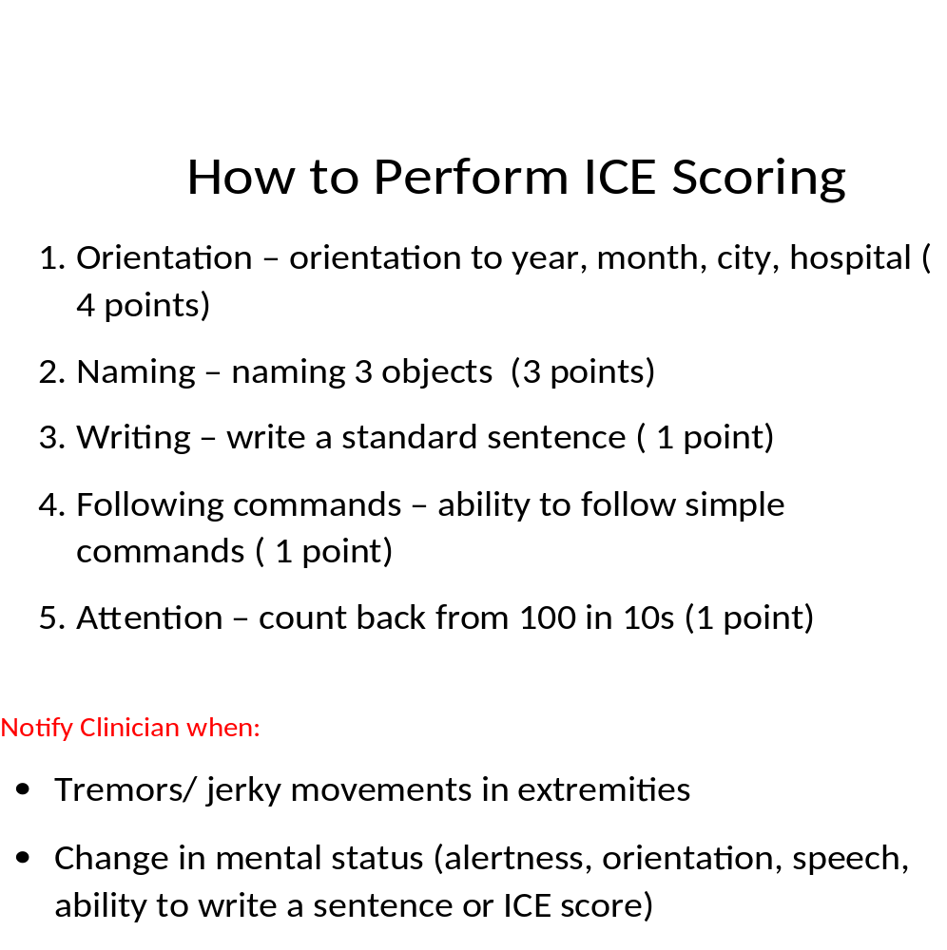

Slide 13
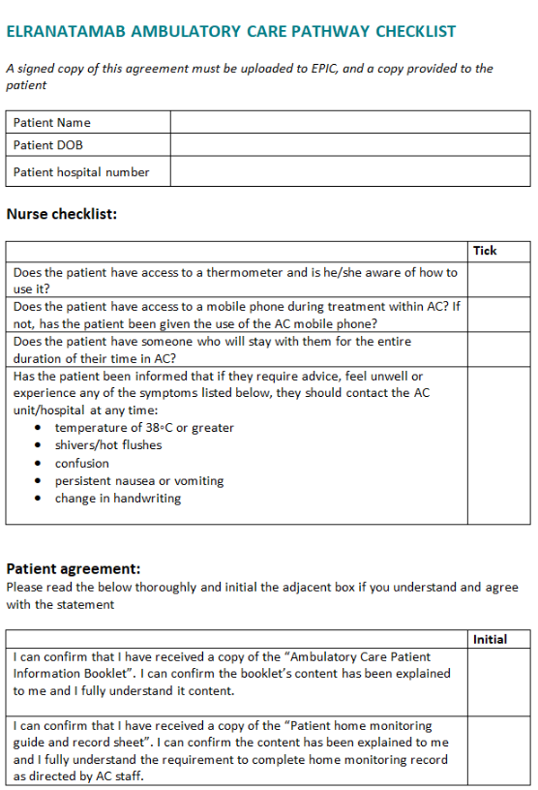
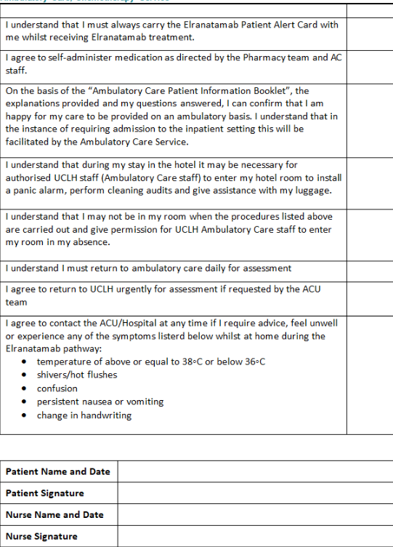

Slide 14
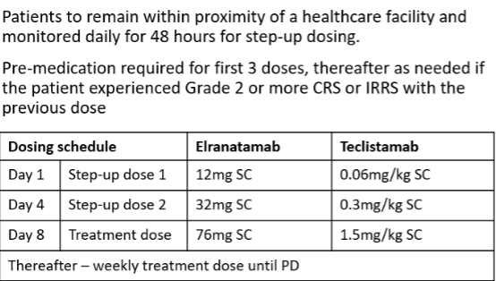
Elranatamab & Teclistamab Dosing Schedule

Slide 15
How are we doing?
1. Since inception in July 2024, there have been five Elranatamab admissions in AC
2. CRS grade1 – fever >38 a. 3 patients had fever within 48 hours of Elran dose b. 2 patients had fever within 24 hours of Elran dose; one not reported by patient – was well throughout & was discharged from AC on D10 c. 1 occurred during AC hours d. 4 occurred out of hours e. 2 via A&E transfer; 2 direct ward transfer; 1 remained in the hotel
3. On-going audit to improve the Bispecific service
4. On-going training & education – nurses on rotation; could be a challenge
5. Nurses becoming more confident in managing bispecific admissions

Slide 16
Case study:
74 y.o. male diagnosed with MM in November 2017, HSCT August 2024.
Hx: Ischaemic Heart Disease March 2023 with stent placement
Medications: Atorvastatin, Bisoprolol, Edoxaban, GTN sublingual, Lansoprazole, Monomil XL, Pregabalin
AC admission : 9/9/24 accompanied by wife for ELRATANAB
D1 - Elranatamab 12 mcg SC administered @17:15
D2 – Rest day; came to AC for evening monitoring; noticed hand tremors, low grade temperature to 37.7°C developed to 38.4°C. As per pathway patient given 10mg Dex pre- A&E transfer. Haem reg on-call and A&E coordinator made aware of incoming patient. No haem bed available. Patient was eventually transferred to haem ward.
During IP stay – patient continued to spike a fever. Highest recorded was 40°C with NEWS of 9, O2 support required via nasal cannula, had chills and rigors, CRS grade 2, ICANS 10/10. ITU outreach review
Patient received Pip Taz over 5 days, had 2 doses of Toci, 1 dose of IV Dex 10mg, fluid support (dropping BP). Symptoms resolved after 48 hours
D4 Elranatamab 32 mcg SC- administered with oral Chlorphenamine, Paracetamol & 20 mg tabs Dex cover. Developed on & off chest pain that lasted for 2 days; GTN spray, ECG negative, Troponin within patient baseline. Cardio review.
D8 Elranatamab 76 mcg SC - administered with cover. Patient tolerated well.
D9 Neutrophils dropped – 1 dose GCSF
D11 - discharged home

Slide 17
THANK YOU!

