Slide 2



The next 25 years:
A Vision for Myeloma Imaging
Dr Tim Bray, MBBChir, PhD, FRCR
Centre for Medical Imaging, University College London
Department of Imaging, University College London Hospitals

Slide 3


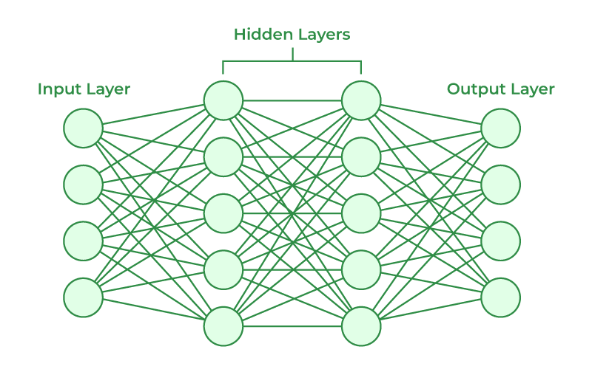
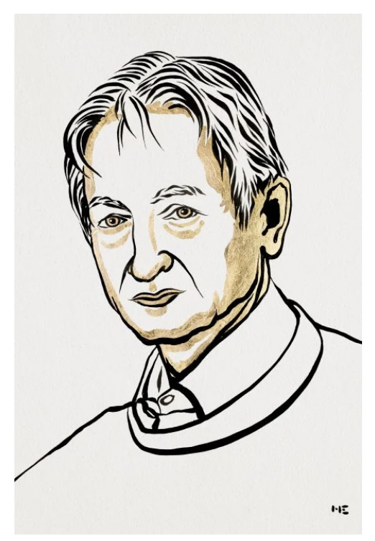
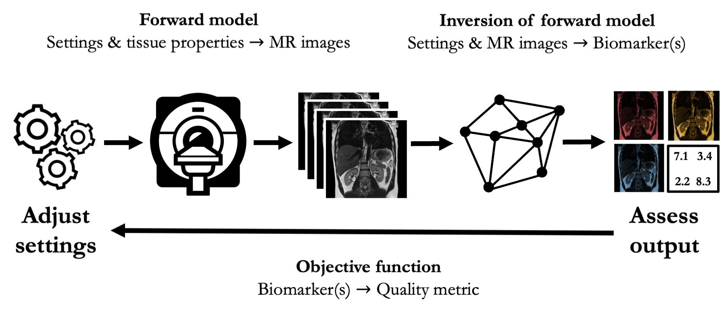
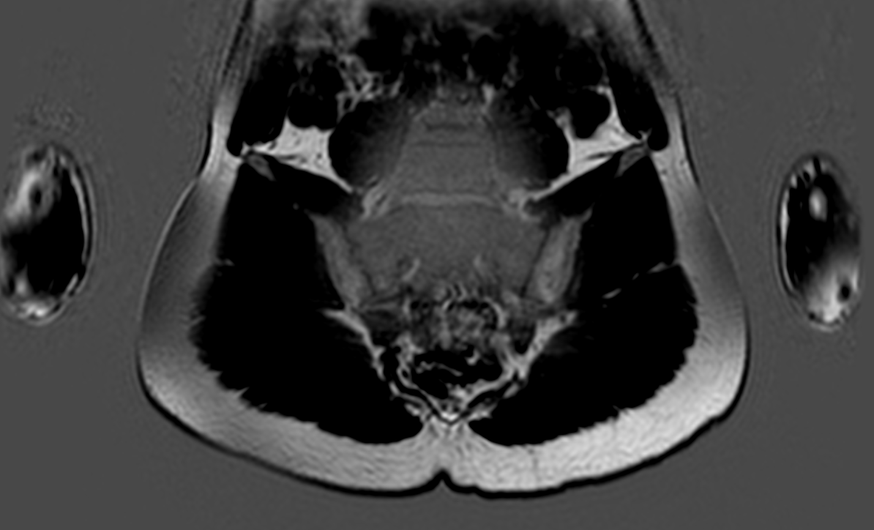
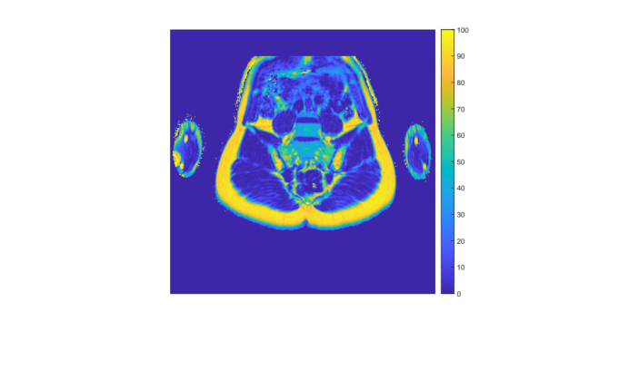
What is happening to imaging?
Dramatic advances in MRI technology
A deep learning revolution
Scan acceleration
New image contrasts
Quantitative MRI (qMRI)
‘Overlapping’ tissue properties can be disentangled
Notes:
Over the last decades, imaging has already undergone huge changes
..
..
..
What might be less clear is how this will actually affect clinical care for patients with myeloma

Slide 4



How can these advances improve myeloma imaging?
Tissue characterisation
Efficiency / speed
Consistent image interpretation

Slide 5
I. HOW CAN WE CHARACTERISE THE TISSUE BETTER?

Slide 6
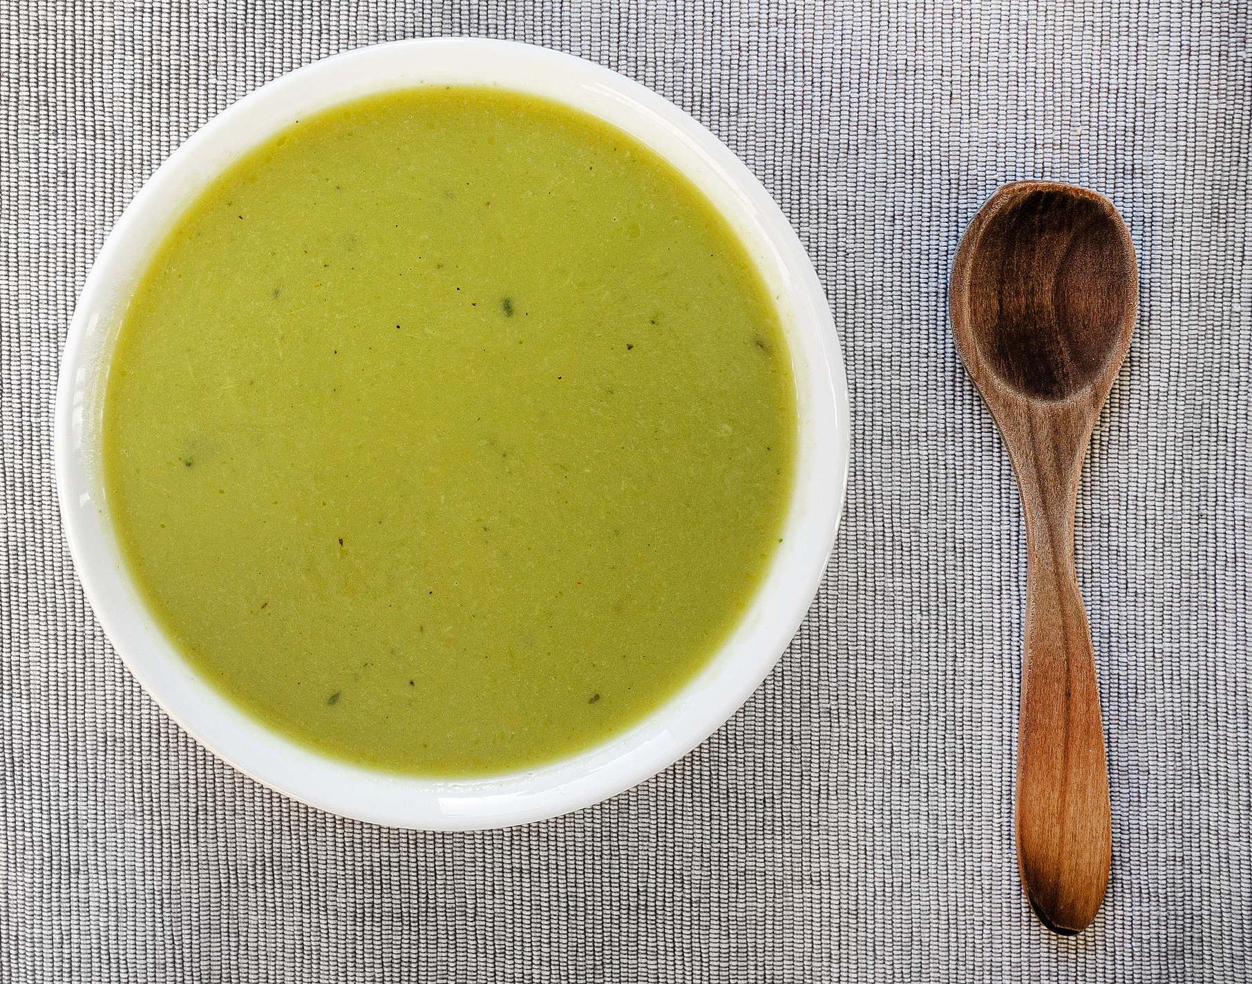
What is the problem with conventional MRI?
The ‘target’ tissue property
Other tissue properties
(confounders)
T₂
T₁
Proton density
Fat content
The conventional MRI signal is confounded by non-target tissue properties
Stikov: Reproducibility and the future of qMRI research. https://www.youtube.com/watch?v=eaaHY_nl7tA

Slide 7
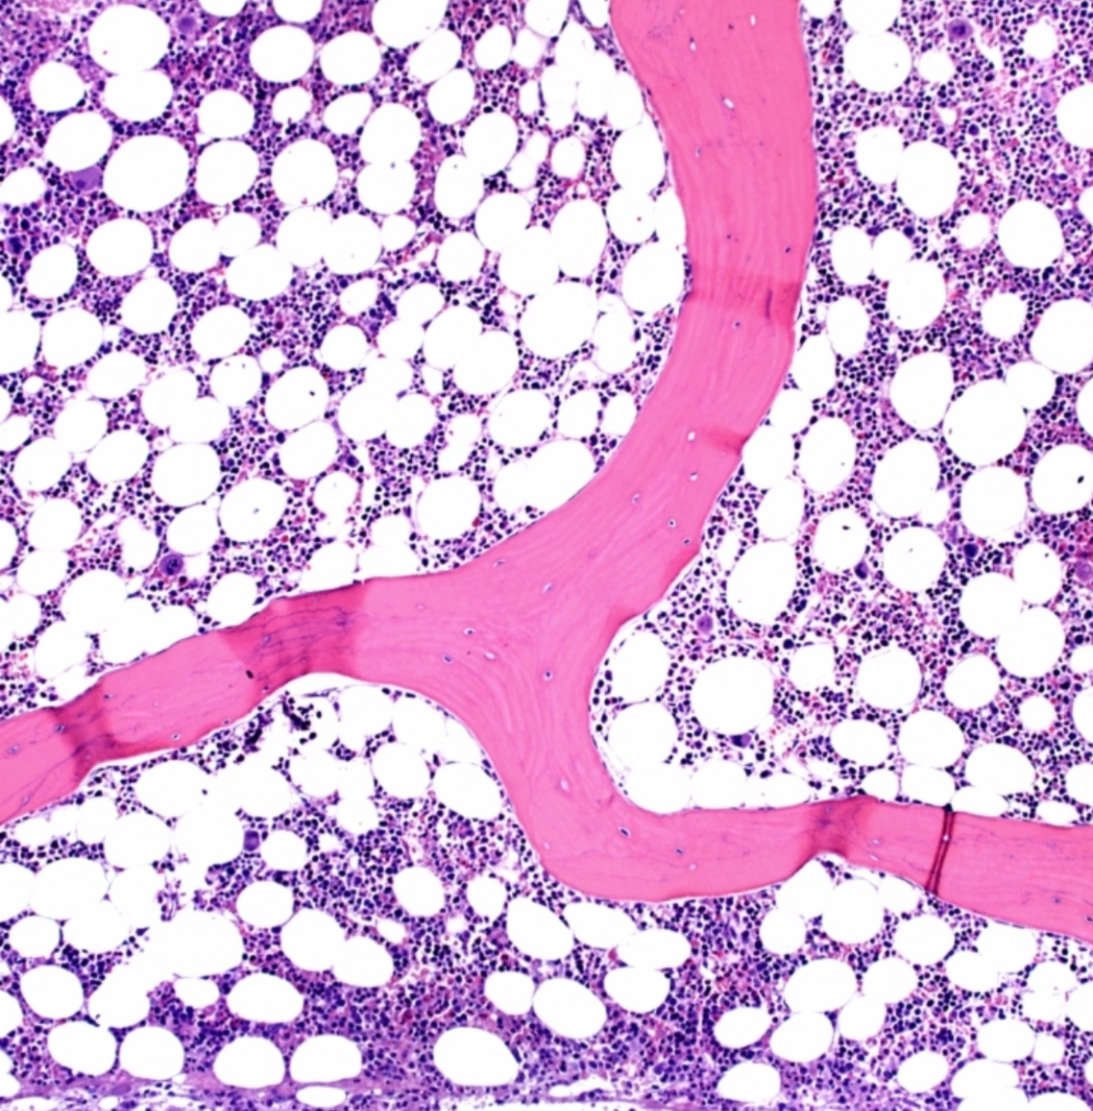
qMRI will enable us to define and separate tissue compartments
Trabeculae
Fat
Water
Cellular
Extracellular
Courtesy of Jabed Iqbal
(presented at ISMRM 2024)

Slide 8

qMRI will enable us to define and separate tissue compartments
Compartment size
T_{2water}
T_{1water}
T_{1fat}
R₂*
qMRI
D
χ
Diffusion, Dixon, relaxometry, etc…
Water
Fat
Bone
Compartment properties
Notes:
Schematic of muscle tissue

Slide 9
qMRI will enable us to define and separate tissue compartments
Cancer cells
Cellularity/packing
Fat
Normal
Malignant infiltration
Bone
Blood cell precursors
Malignant cells
Osteoporosis
Malignant infiltration + lysis
Partially treated lesion
Notes:
?Consider explaining red / yellow marrow

Slide 10
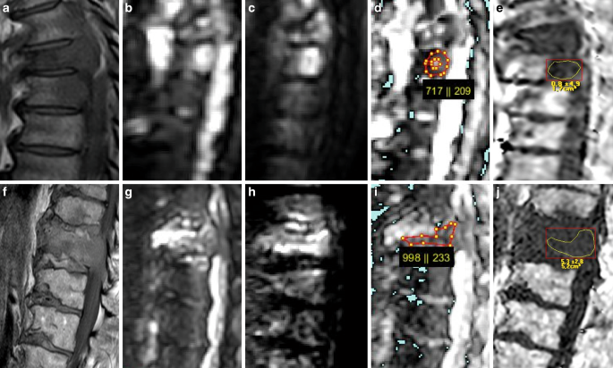
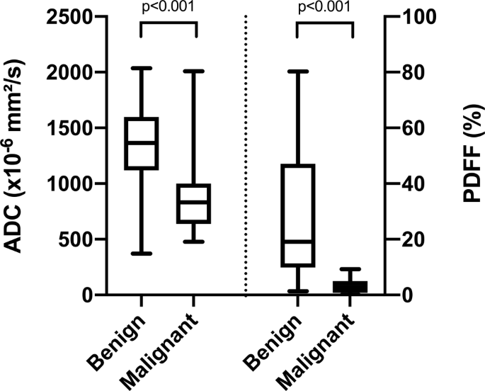
qMRI parameters will be used for lesion characterisation
FF differentiates benign bone marrow lesions from malignant
ADC
PDFF
Schmeel et al. Clinical Neuroradiology 2021
Notes:
Consistent differentiator of benign vs malignant in bone lesions
Very consistent across tissue types and different pathology (for both benign and malignant)

Slide 11
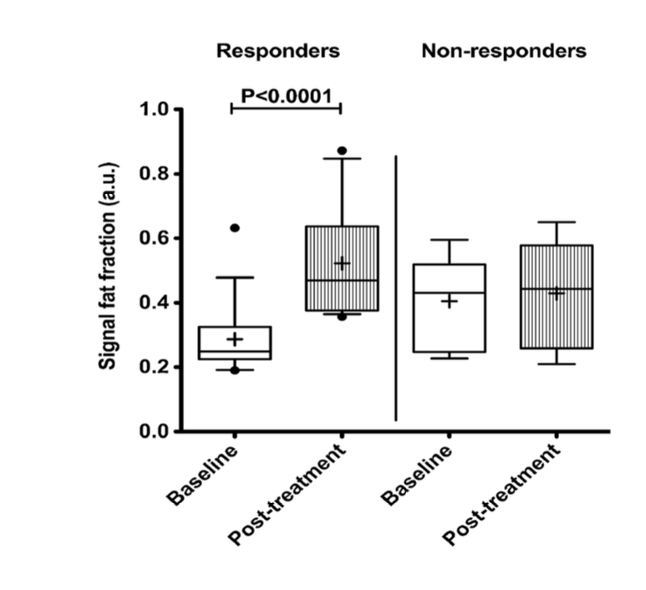
qMRI parameters will be used for response assessment
FF allows discrimination of responding from non-responding tissue
Latifoltojar et al. Eur Radiol 2017
Notes:
3/613 cases demonstrated macroscopic intralesional fat on CT or MRI

Slide 12
Methodological refinements will improve the accuracy of tissue characterisation
Courtesy of Azma & Winfield
***
*
**
**
Notes:
Consistent differentiator of benign vs malignant in bone lesions
Very consistent across tissue types and different pathology (for both benign and malignant)

Slide 13
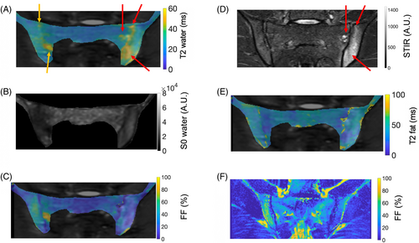
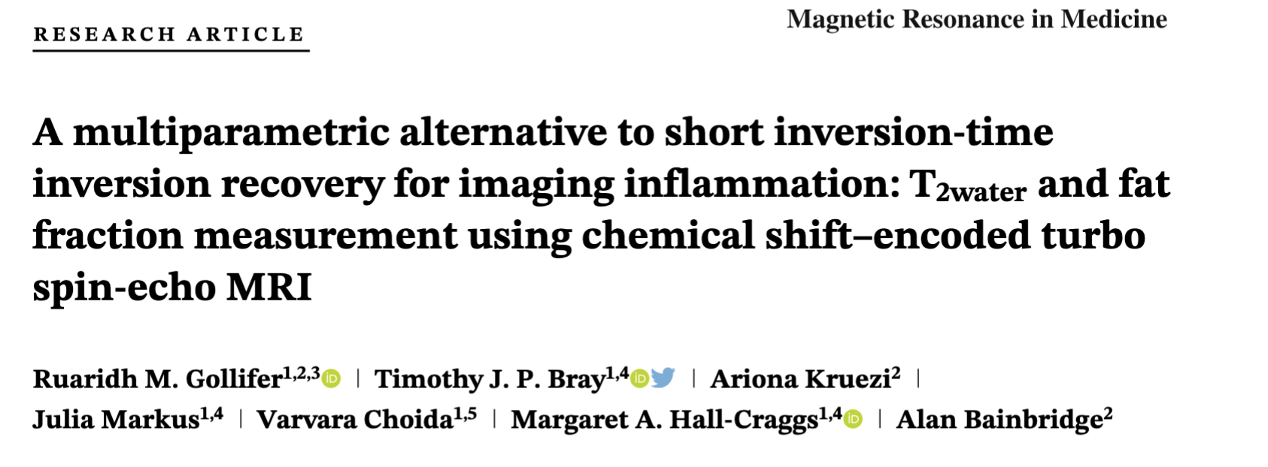
qMRI will enable us to disentangle overlapping processes
Combine T2 mapping with Dixon → ‘Dixon relaxometry’ → water-specific T₂ mapping
qMRI unveils ‘hidden’ pathology

Slide 14
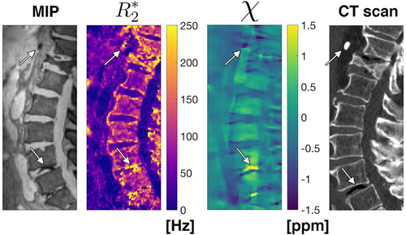
Novel ways for interrogating the bone compartment will emerge
We can now obtain CT-like information from MRI
Sollman et al. JMRI 2020
Notes:
QSM can differentiate between calcification and air

Slide 15
II. HOW CAN WE IMAGE MORE EFFICIENTLY / FASTER?

Slide 16
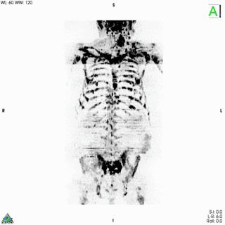
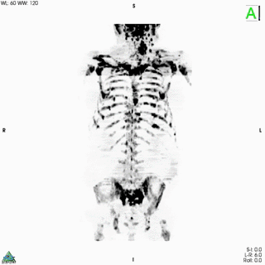
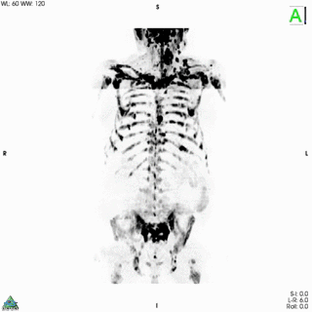
Diffusion MRI will be hugely accelerated
NEX=1
AI-generated
(from NEX=1)
NEX=9
(clinical standard)
b=900 s/mm²
(Maximum Intensity Projection)
Acquisition time = 5 minutes
b=900 s/mm²
ADC map
Zormpas-Petridis et al., Radiology AI 2021

Slide 17
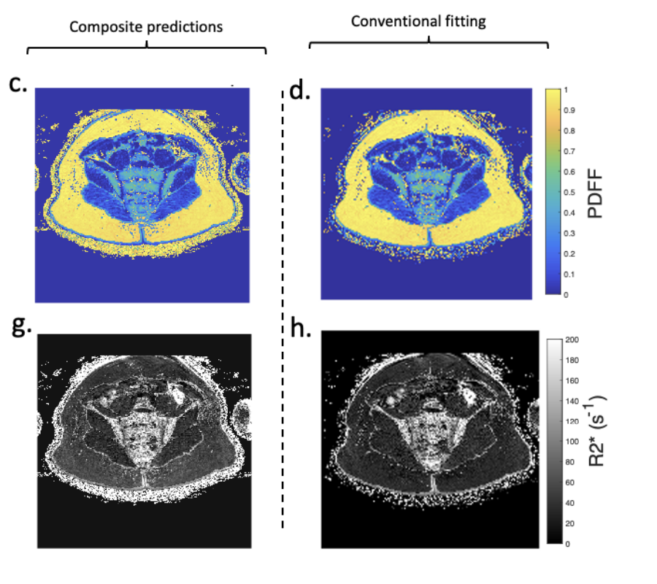
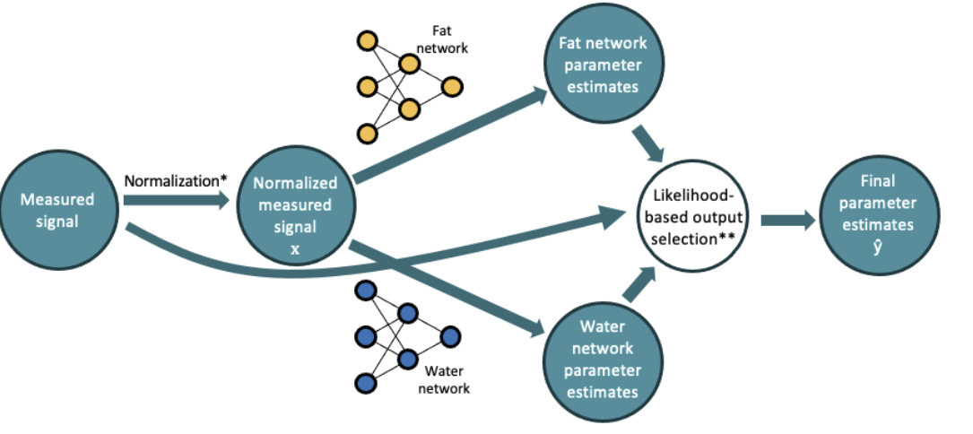
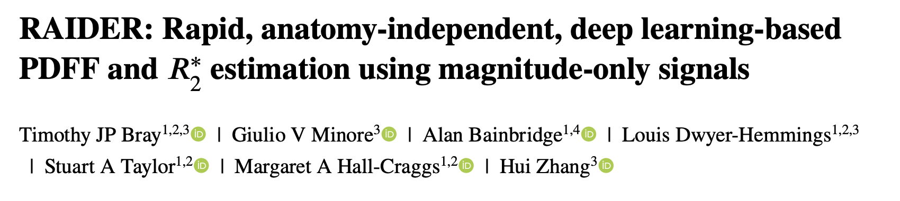
Sophisticated processing will be available at your fingertips
Collaboration with Siemens to develop in-line processing
Deep learning can reduce processing time, allowing sophisticated qMRI within standard workflows
RAIDER
Standard approach
RAIDER is ~ 500 times faster than conventional processing
arXiv:2403.01178
Notes:
This is one example of a fingerprinting approach where the fat-water separation is actually dictionary based., here they use a single dictionary (which was actually obtained by combining two separate dictionaries for water and fat) to achieve fat-water separation as well as quantification of T1 for both fat and water components.

Slide 18
III. HOW CAN WE IMPROVE IMAGE INTERPRETATION?

Slide 19
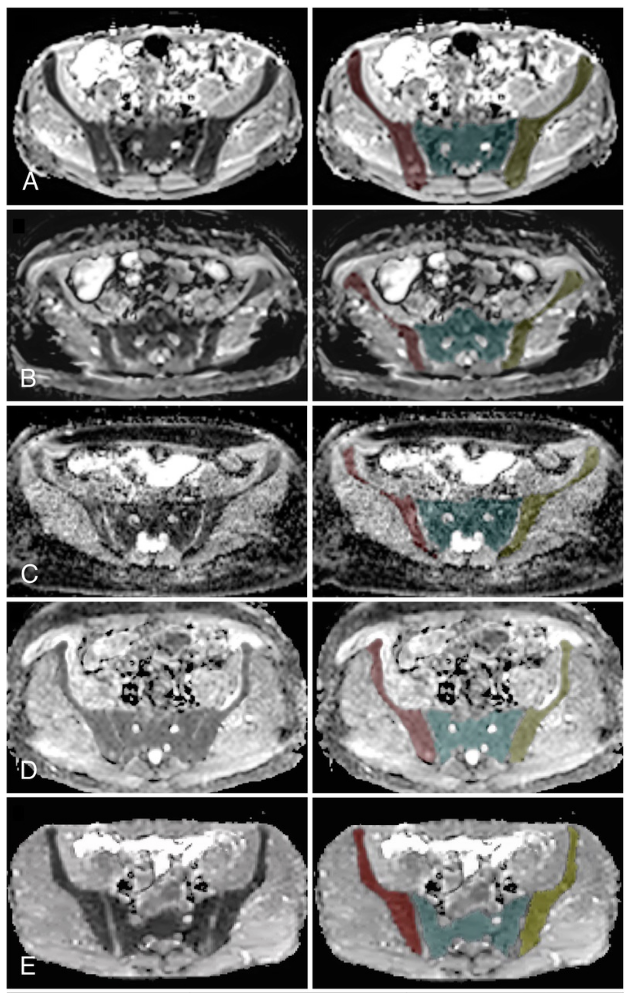
qMRI measurements will be automated
nnU-net trained to automatically segment bone and measure ADC
Close agreement with manual ADC measurements
Wennmann et al. Invest Radiol 2024

Slide 20
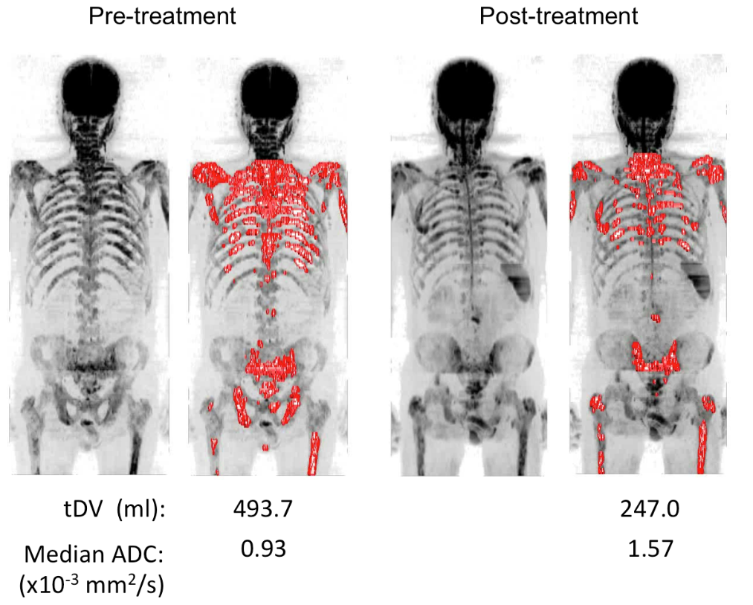
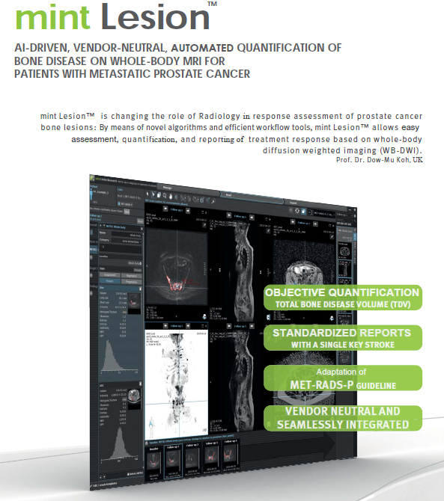
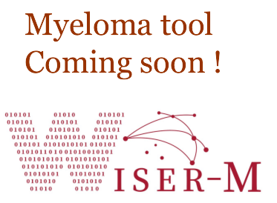
Disease burden will be objectively quantified
Courtesy of Prof Christina Messiou
Blackledge et al. PLOS ONE 2014

Slide 21
The next 25 years of myeloma imaging
Tissue characterisation
Efficiency / speed
Consistent image interpretation

Slide 22

Acknowledgements
Christina Messiou
Jessica Winfield
Azma Yassine
Matthew Blackledge
Jabed Iqbal
Gary Zhang
?
Email: t.bray@ucl.ac.uk
@tjp_bray

