Slide 1

Treatment Pathway
Northern Ireland
Dr Sarah Lawless

Slide 2
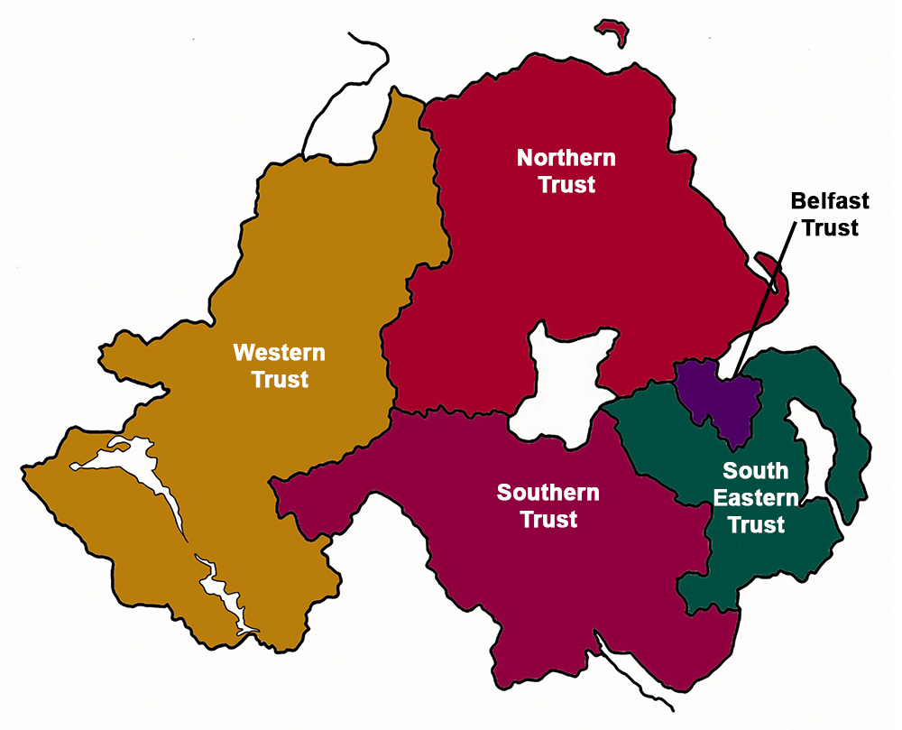
5 health trusts
Belfast City Hospital provides level 3-tertiary haematology care for N.I.
On average 170 patients newly diagnosed with myeloma per year
60+ autografts per year
28% increase in SACT prescribing within last year
24% increase in bed occupancy by haematology patients in BCH

Slide 3

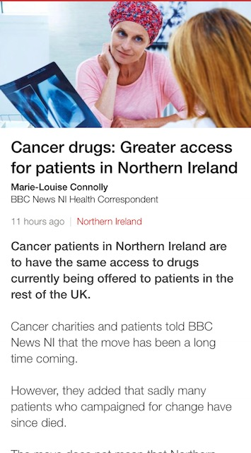
Treatment Pathway 2024
NICE approved drugs available as for NHS England
DoH announced “Improved Access to New Drugs” 12th September 2018 allowing access to cancer drug fund drugs
  Cost per case application (as opposed to blueteq application)
SMC Loophole
If drugs are approved via SMC and there isn’t a NICE decision or NICE pending, drugs can be accessed by submitting a cost per case as per SMC criteria
This allowed earlier access to DVTd in NI relative to England
Notes:
SMC DVTd Jan 2021

Slide 4

Treatment Pathway
N. Ireland Cancer Network (NICaN)- Haematology Clinical Reference Group endorsed proposal to review treatment pathway for newly diagnosed transplant eligible patients

Slide 5
Shaping the next 3-5 years: Key Priorities
Workforce
Expansion of ambulatory care
Equal access to treatment and clinical trials
Networks
and collaboration
Cancer Strategy for N. Ireland 2022-2023
Diagnostics
Imaging

Slide 6
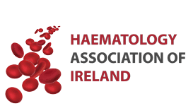
Real World Analysis of Bi-specific Antibodies in the Management of Patients with Multiple Myeloma in Northern Ireland.
D Duncan¹, H Hiles¹, S Lawless¹, O Sheehy¹, P Elder¹, C McConville², A Niblock³, M Bowers⁴, D Donaldson1, S McCloskey³, R McCormick⁴, F McNicholl³
1Haematology, Belfast City Hospital, BHSCT, Belfast, Northern Ireland.2Haematology, Altnagelvin Hospital, WHSCT, Derry/Londonderry, Northern Ireland. 3Haematology, Antrim Hospital, NHSCT, Antrim, Northern Ireland. 4Haematology, Ulster Hospital, SEHSCT, Belfast, Northern Ireland
A MULTI-CENTRE REAL-WORLD OBSERVATIONAL STUDY OF PATIENTS WITH MULTIPLE MYELOMA TREATED WITH BELANTAMAB MAFODOTIN IN NORTHERN IRELAND
P Weir¹, S Haider¹, S Lawless¹, D Donaldson¹, O Sheehy¹, M Bowers², C Bradford³, C McConville⁴, YL Ong2, A Foy³, M Quinn¹, P Elder⁴, C McCauley⁵, B Merron⁵
1Haematology Department, Belfast City Hospital, Belfast, Northern Ireland.2Haematology Department, Ulster Hospital, Belfast, Northern Irelan. 3Haematology Department, Craigavon Area Hospital, Portadown, Northern Irelan. 4Haematology Department, Altnagelvin Area Hospital, Derry, Northern Ireland
5Haematology Department, Antrim Area Hospital, Antrim, Northern Ireland

