Slide 1
Reflections on my career in Myeloma
Sarah Henshaw RGN, MSc, BSc(hons)

Slide 2
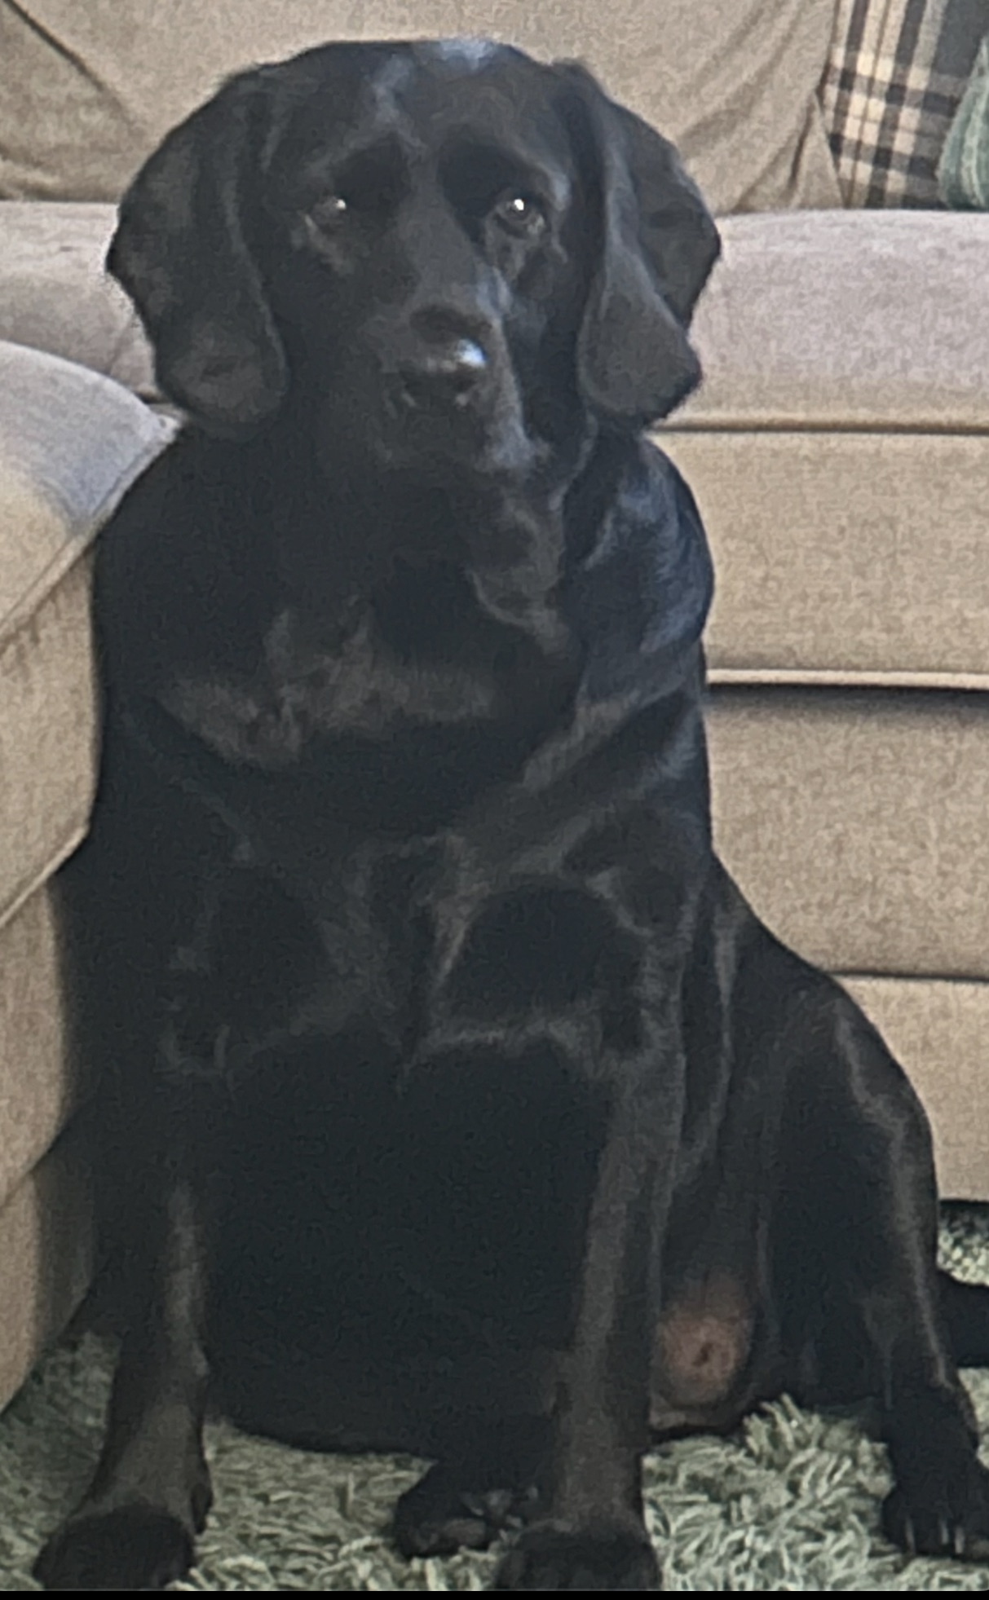

About me
My Family including my Cockerdor Bella
Notts County FC Season Ticket holder

Slide 3
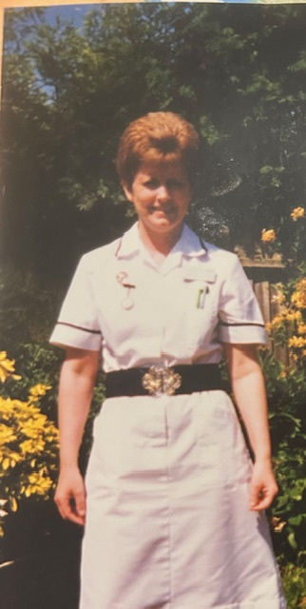
Career in Myeloma
Qualified April 1997
BSc(hons) Health Care Studies (Haem-Onc) 2005
Non Medical Prescriber 2014
MSc Health Care Studies (Palliative care) with distinction 2020
History Taking and Clinical Examination skills 2024
My inspiration to become a nurse

Slide 4
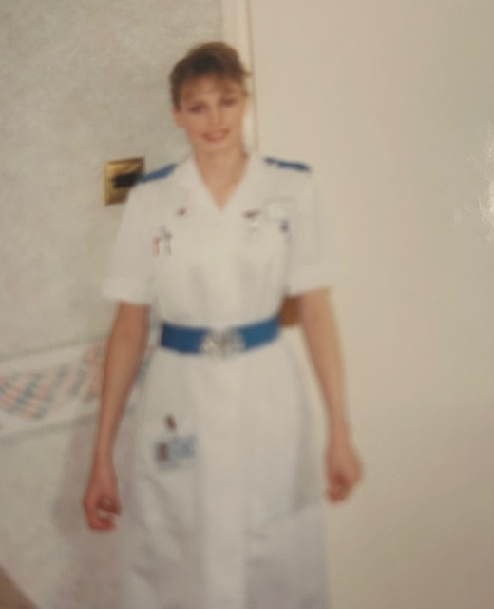
First day as newly qualified nurse about to embark on a career in Haematology

Slide 5
Career to date
  D Grade Staff Nurse at DGH Medical Ward with Haematology – 1997
  E Grade Staff Nurse at DGH Medical Ward with Haematology - 1998 – 2001
  E Grade Staff Nurse at NUH Haematology and Bone Marrow transplant unit – 2001 – 2005
  F Grade Clinical Educator NUH Haematology and Bone Marrow transplant unit – 2005 – 2007
  April 2007 appointed as Myeloma Clinical Nurse Specialist

Slide 6
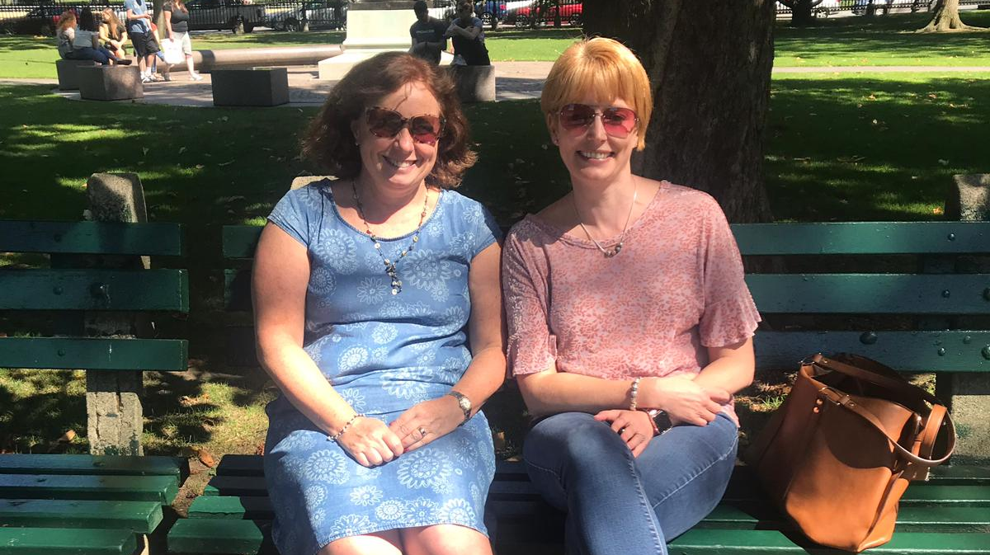
Inspiration in the development of Myeloma Service at NUH
Dr Cathy Williams
Consultant Hematologist

Slide 7
Changes in treatment
2007 – only 2 lines of treatment available
    Key skill when applying for the post was Palliative Care skills and courses
Present day – Multiple lines of treatment available survivorship more of the focus
    Focus has moved to long term management of the condition
    Palliative care skills are still required
    Management of late effect and long term consequences

Slide 8
The changing role of the nurse specialist 2007 to present day
  2007
    Information giving
    Patient advocate
    Main contact for patients and carers
    Symptom Management of treatments and myeloma
    Psycho-social support
    Organization of patient appointments
    Support patients in medical clinics
    Member of the MDT
    Organization of PEER review
    Training and Education of HCPs

Slide 9
  Present day
    As in 2007 plus;
      Nurse Led Clinics
      Development of patient information for all the new treatments
      Management of long term consequences of living with myeloma
      Radiology requesting
      Non Medical Prescribing including SACT
      History taking and clinical examination
      Own case load of patients
      Present cases at MDT

