Slide 1

Barriers to the Implementation of Bispecific Antibodies for Patients with Relapsed/Refractory Myeloma: Results of a UK National Survey
May Low, Senior Haematology Pharmacist
November 2024
Notes:
Thank you UKMS committee, UKMS and The Binding Site for the opportunity to present our work at IMS in Rio.
Bispecific T cell antibodies (BsAb) are an important treatment for patients with Relapsed Refractory Multiple Myeloma (RRMM).
Implementation poses challenges which may lead to inequities in access.
To address these, a UK national multi-professional steering group was formed improve patient access to bispecific antibodies.
This project sought to understand the key barriers to BsAb treatment

Slide 2

Method | Results | Summary
Methods
Online questionnaire - 22 questions
Distributed between January to March 2024 via the UK Myeloma Society and the British Oncology Pharmacy Association
Results analysed using Microsoft Excel
Thematic analysis performed
Single and multiple-choice questions
Close and open-ended formats
Likert scale questions
85 responses
41 Transplant centres
35 Community centres delivering chemotherapy
No response from centres delivering limited out-patient treatment
All centres had access to in-patient beds (median 10-30; range 1->50)
29% patients travelled >60 minutes to reach specialist centres
93% of centres have access to chemotherapy hotline service, A&E department and Critical Care Unit
Low, M, Choudhuri S, Steventon L et al . Barriers to the Implementation of Bispecific Antibodies for Patient With Relapsed and Refractory Myeloma in the UK: Results of a National Survey. Clinical Lymphoma Myeloma and Leukemia, Volume 24, Supplement 2,2024, doi.org/10.1016/S2152-2650(24)01951-7.
Notes:
on-line questionnaire of 22 questions was developed to allow quantitative and qualitative data collection.
The questionnaire was distributed between January to March 2024 via the UK Myeloma Society and the British Oncology Pharmacy Association.
Transplant centres – L3
Community centres – L2a/2b
9 unknown – we’re not sure if Level of care

Slide 3
Method | Results | Summary
COM - Community Centres
ASCT - Transplant Centres
UNK - Unknown
Notes:
Majority of Level 2a and Level 2b centres have limited experience with bispecific antibodies (both trials and non-trials), however are generally aware of the trial data, adverse events and place in treatment in multiple myeloma.
Doesn’t seem like e-prescribing support is a barrier to

Slide 4
Method | Results | Summary
Notes:
Interested to know

Slide 5
Method | Results | Summary
Experiences shared about delivery of bispecific antibodies having participated in a clinical trial
Positive aspects | Negative aspects
Successful management of complications | Capacity and resource challenges e.g. ward and day unit capacity; trial set-up time, access to ophthalmology service; IVIg access
Well-co-ordinated approach in patient care and management of treatment toxicities | Training and support constraints e.g. Time-consuming to train across disciplines
Clinical monitoring and timely intervention e.g. comprehensive monitoring during critical phases of treatment | Clinical management e.g. variability of timing of CRS & neurotoxicity; incidence and management of infections
Notes:
Controlled environment

Slide 6
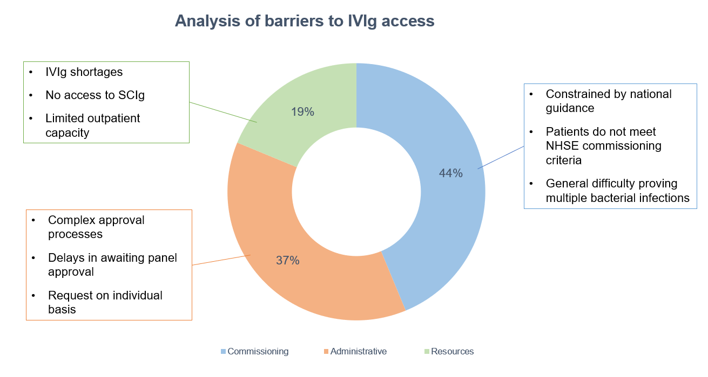
Method | Results | Summary
58%
had difficulty accessing immunoglobulin
Notes:
Explore challenges around Immunoglobulin – largely due to meeting criteria for immunoglobulin use and complexity around approval process.

Slide 7
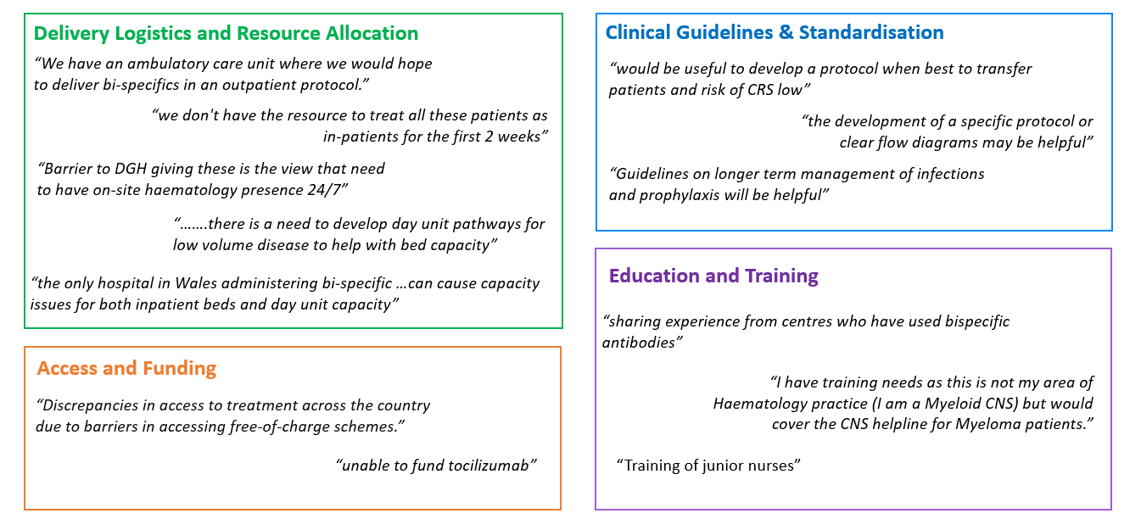
Method | Results | Summary
Notes:
further comments or areas that will need to be addressed in our national quality improvement initiative
Mentioning of capacity issues with both inpatient and dayunit abilities; requirement on guidelines and pathways to manage Bispecific patients;
Educating and training the workforce

Slide 8
Method | Results | Summary
Majority of Level 2a and Level 2b centres have limited experience with bispecific antibodies (both trials and non-trials), however are generally aware of the trial data, adverse events and place in treatment in multiple myeloma.
Haematologists, Pharmacists and CNSs have more awareness of the trial data, adverse events and place in treatment in multiple myeloma.
Need to further understand the awareness and learning needs from nursing team and other healthcare professionals.
There is a clear need to streamline the IVIg approval processes, address capacity issues, and provide more flexibility to access IVIg in emergency situations.
There is a need to develop outpatient or ambulatory pathways to overcome logistical and administrative challenge of delivering BsAbs.
Notes:
Limited experience
To explore E&T needs, especially in nursing workforce
Review IVIg process
Development of shared-care protocol / guidance on managing patients
Task groups form – pathway redesign, IVIg, PPIE and E&T

Slide 9
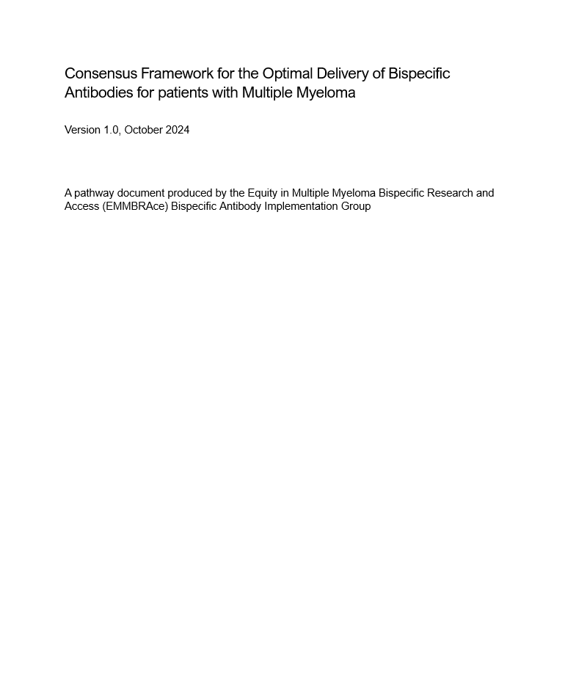
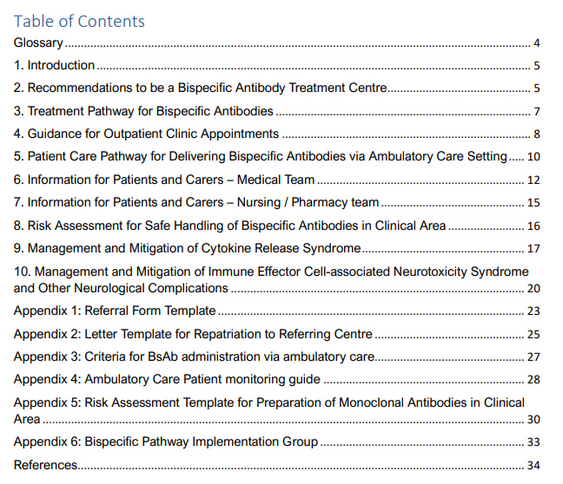
Method | Results | Summary
https://www.ucl.ac.uk/lifesciences-faculty/research/emmbrace-project
Notes:
Published consensus framework for the optimal delivery of BsAb
Other task groups within the project group – IVIg, PPIE, nursing education
Plan to write a BSH best practice document for bispecs in collaboration with the British Society for Immunology to include IVIG guidance

Slide 10

Acknowledgement – Equity in Multiple Myeloma Bispecific Research and Access (EMMBRAce) group members
NHS Lothian Scotland
Neil Storrar
Lesley Symington
Patient and Charity Group
Antoinette Carr, Patient Representative
Suzanne Stainer, Patient Representative
Sandra Quinn, Myeloma UK
The Northern Care Alliance NHS Foundation Trust
Satarupa Choudhuri
The Newcastle Upon Tyne Hospitals NHS Foundation Trust
Jane Aston
Jennifer Young
Michelle Amos
Sumantha Gabriel
Belfast City Hospital
Jackie Quinn
University Hospitals of North Midlands NHS Trust
Kamaraj Karunanithi
Nottingham University Hospitals NHS Trust
Sarah Henshaw
University Hospitals Birmingham NHS Foundation Trust
Adrian Shields
Bhuvan Kishore
Hayder Hussein
Helen Parry
Nicola Lawton
Nicola Parry
Hywel Dda University Health Board
Peter Baker
University College London Hospital NHS Foundation Trust
Rakesh Popat, Co-chair
Pinkie Chambers, Co-chair
Anish Tailor
May Low
Dunsi Bolarinwa
Chantelle Hughes
Luke Steventon
Cardiff and Vale University Health Board
Emma Williams
Grant Mehrjou
University Hospital of Wales
Ceri Bygrave
University Hospitals Bristol & Weston NHS Foundation Trust
Andrea Preston
Great Western Hospitals NHS Foundation Trust
Tiffany Chan
Royal Cornwall Hospitals NHS Trust
Adam Forbes
University Hospitals Dorset NHS Foundation Trust
Rachel Hall
Notes:
Collaborative work from multi-professional network, chaired by UCL

Slide 11


Thank you
Email contact: uclh.emmbrace.queries@nhs.net
Consensus Framework:
https://www.ucl.ac.uk/lifesciences-faculty/research/emmbrace-project

