Slide 1





Circulating proteins and multiple myeloma risk
Dr Lucy Goudswaard
Senior Research Associate
University of Bristol

Slide 2
Overview
A Mendelian randomization project estimating causal effect of circulating proteins on multiple myeloma risk.
Pilot study to validate blood for biomarker discovery in multiple myeloma.

Slide 3
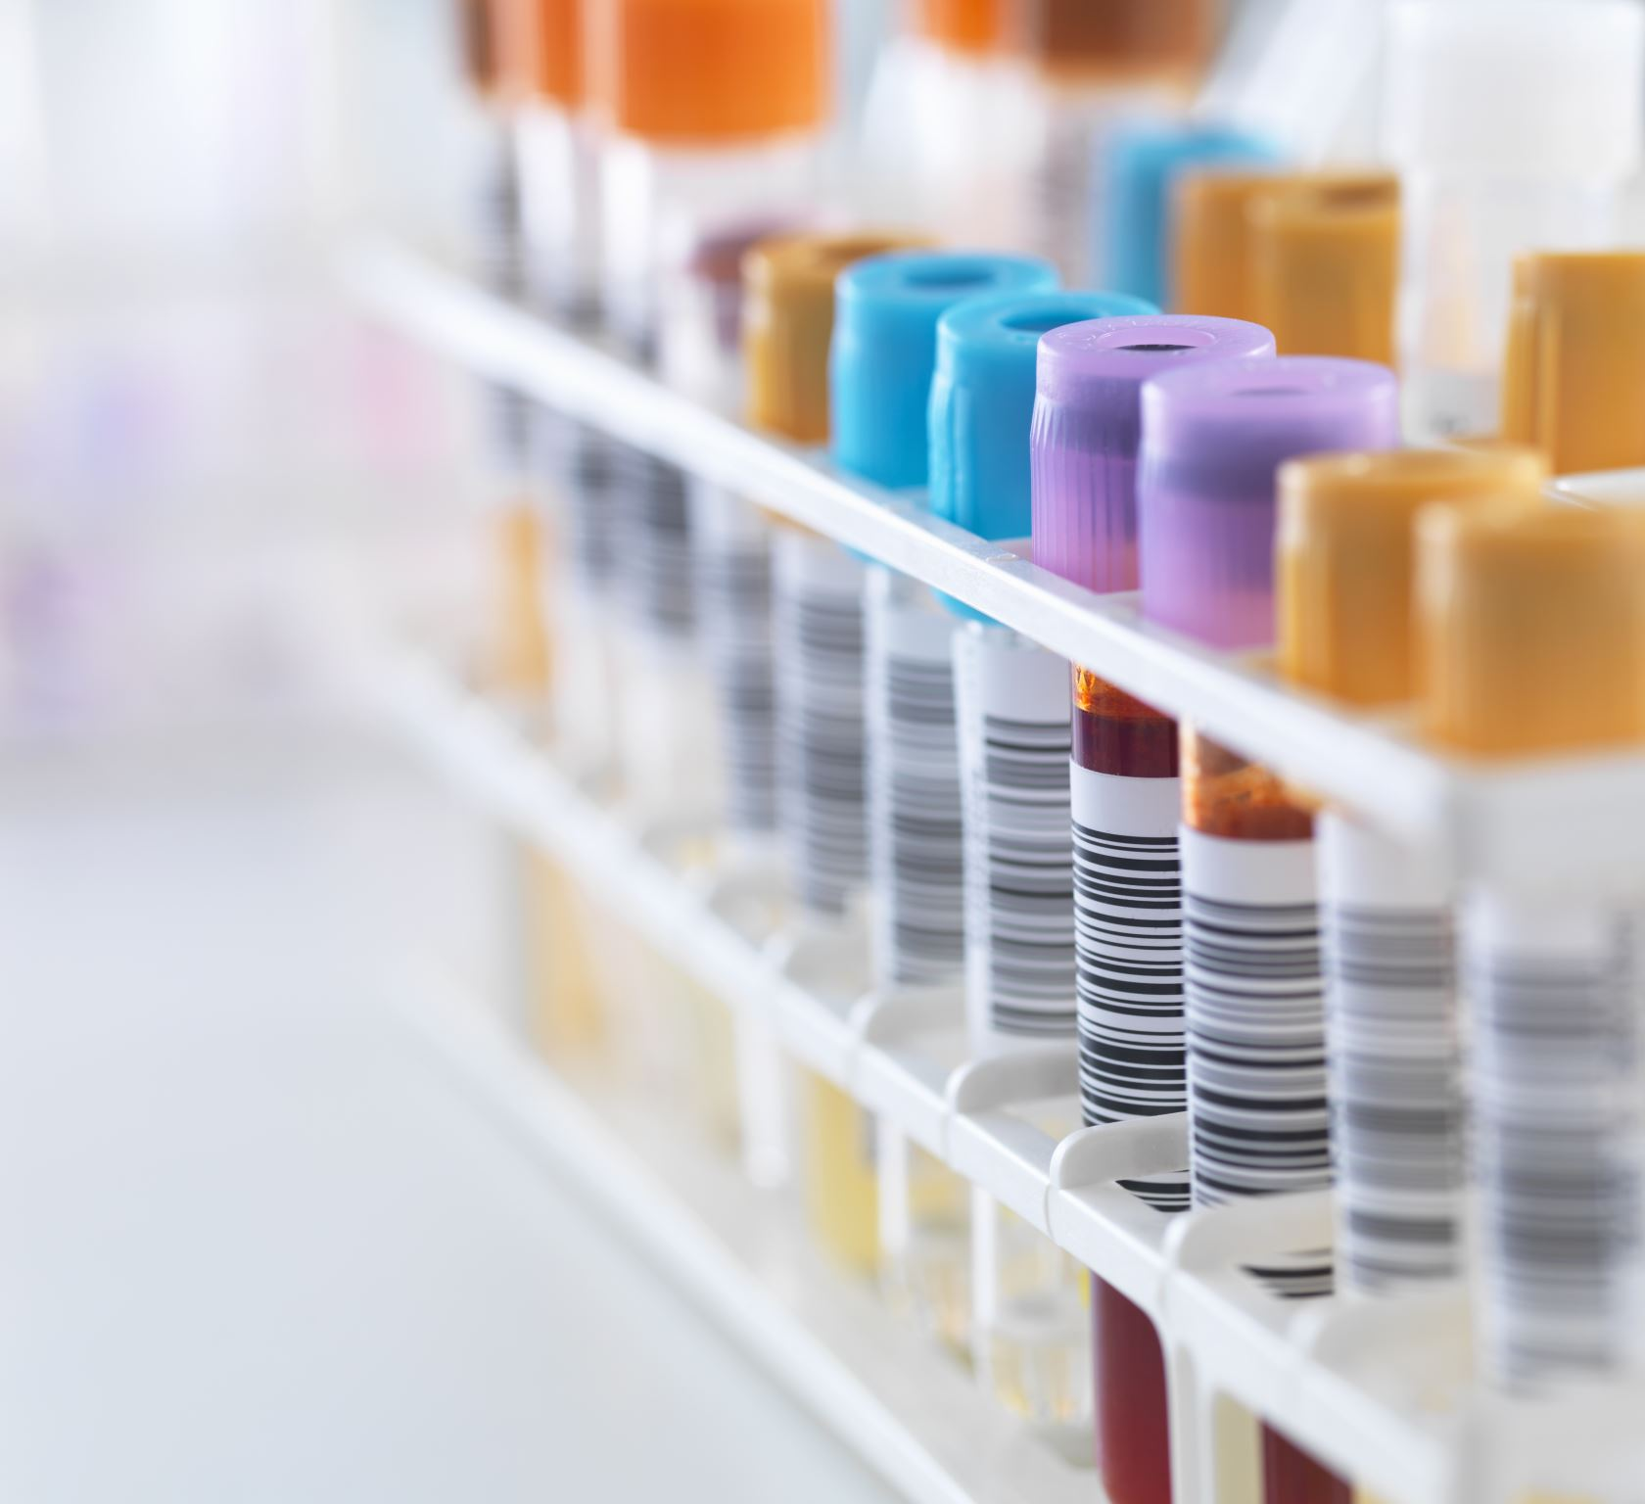
Background
Multiple myeloma (MM) currently has no curative treatments.
More needs to be understood about the involvement of molecular traits in MM development
Proteins are the target of most drugs.
New technologies can measure thousands of proteins from small quantities of blood

Slide 4
What is Mendelian randomization (MR)?
Conventional trial
Mendelian randomization
Sample
Population
Randomization
Random allocation of alleles
Intervention (e.g. drug)
Control
Genotype A
Genotype B
Lower protein
Protein unchanged
Protein unchanged
Higher protein
Myeloma risk lower
Myeloma risk unchanged
Myeloma risk unchanged
Myeloma risk higher

Slide 5
What is Mendelian randomization (MR)?
Conventional trial
Mendelian randomization
Sample
Population
Requirements:
Genome-wide association study results for both exposure (risk factor) and outcome (disease).
Randomization
Random allocation of alleles
Intervention (e.g. drug)
Control
Genotype A
Genotype B
Lower protein
Protein unchanged
Protein unchanged
Higher protein
Myeloma risk lower
Myeloma risk unchanged
Myeloma risk unchanged
Myeloma risk higher

Slide 6



Aim & Methods
Dr Matt Lee
Postdoc IARC
Aim: Estimate causal relationship of circulating proteins on multiple myeloma risk
Methods
34000 British participants
3000 plasma proteins
Olink (antibodies)
35000 Icelandic participants
>4000 plasma proteins
SomaLogic (aptamers)
Protein levels
Exposure

Slide 7

Aim & Methods
Dr Matt Lee
Postdoc IARC
Aim: Estimate causal relationship of circulating proteins on multiple myeloma risk
Methods
Finnish participants
1,085 MM cases, 271,463 controls
British participants
564 MM cases, 455,784 controls
Protein levels
Multiple myeloma
Exposure
Outcome

Slide 8
Aim & Methods
Dr Matt Lee
Postdoc IARC
Aim: Estimate causal relationship of circulating proteins on multiple myeloma risk
Methods
Confounders
Single nucleotide polymorphism (SNP)
Protein levels
Multiple myeloma
Instrumental variable
Exposure
Outcome

Slide 9
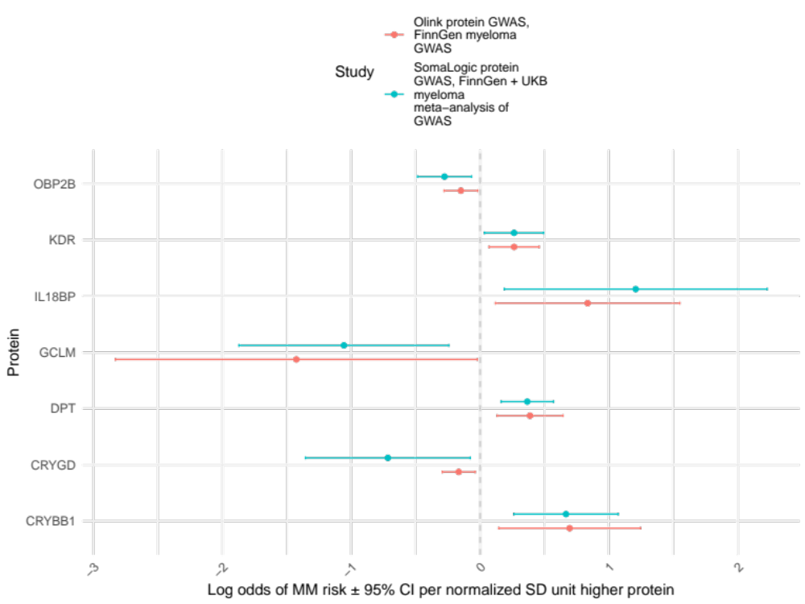
Results
440 proteins with two causal estimates (discovery and replication, represented by colour)
Circulating levels of 7 proteins may have a causal influence on multiple myeloma risk

Slide 10
Results
440 proteins with two causal estimates (discovery and replication, represented by colour)
Circulating levels of 7 proteins may have a causal influence on multiple myeloma risk

Slide 11
Proteins implicated in MM risk
Gene | Protein | Protein function
DPT | Dermatopontin | Extracellular matrix protein with potential role in bone marrow microenvironment
CRYBB1 | Beta-crystallin B1 | Crystallins are the dominant structural components of the vertebrate eye lens.
OBP2B | Odorant-binding protein 2b | Probably binds and transports small hydrophobic volatile molecules.
GCLM | Glutamate-cysteine ligase regulatory subunit | First rate limiting enzyme of glutathione synthesis. Treating MM cells with bortezomib has been shown to lead to higher levels of GCLM.
IL18BP | Interleukin-18-binding protein | Inhibitor of the proinflammatory cytokine, IL18.
KDR | Vascular endothelial growth factor receptor 2 | Involved in endothelial migration and proliferation and is implicated in liver, renal and thyroid cancers.
CRYGD | Gamma-crystallin D | Crystallins are the dominant structural components of the vertebrate eye lens.

Slide 12
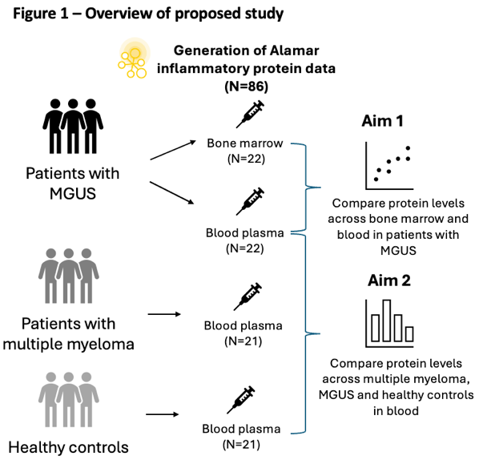
Pilot study: Validating the circulating proteome for multiple myeloma biomarker research
Using samples from Iceland Screens, Treats and Prevents Multiple Myeloma (iStopMM) and generating inflammatory protein data.
Research questions:
1) How well does blood plasma reflect the inflammatory environment of the bone marrow in MGUS?
2) Are there differences in inflammatory proteins across multiple myeloma, MGUS and control plasma samples?

Slide 13
Conclusions
- MR can be a useful tool to explore the involvement of circulating proteins in myeloma.
- Initial results indicate 7 proteins for further exploration (e.g. KDR/VEGFR2).
- MR has limitations; generating more data from patient samples is needed to further understand the role of circulating proteins in myeloma.

Slide 14



Acknowledgements
@MRC_IEU
@lucygoudswaard
International Agency for Research on Cancer
Dr Matthew Lee
University of Bristol
Emma Hazelwood
Professor Sarah Lewis
Dr Kate Burley
Prof Nic Timpson
Dr Laura Corbin
University of Iceland
Sæmundur Rögnvaldsson
Sigurður Yngvi Kristinsson
University Hospitals Bristol
Dr Sally Moore

