Slide 1
‘Doing Well’
is not
“Well”

Slide 2
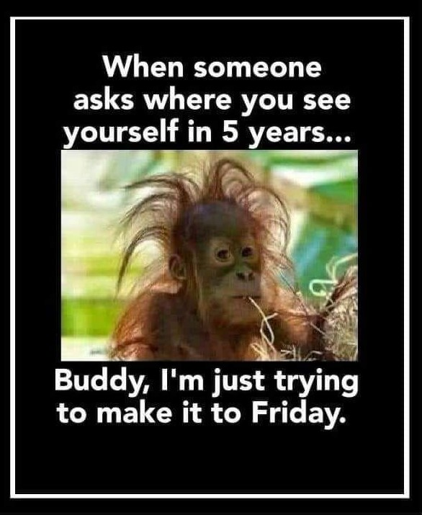

Slide 3
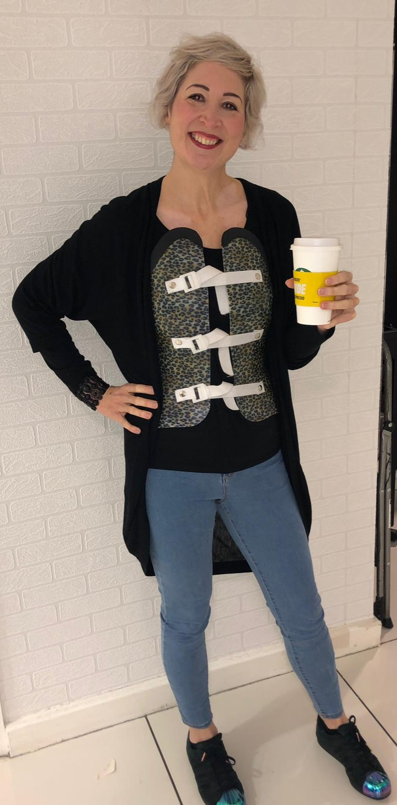

Slide 4
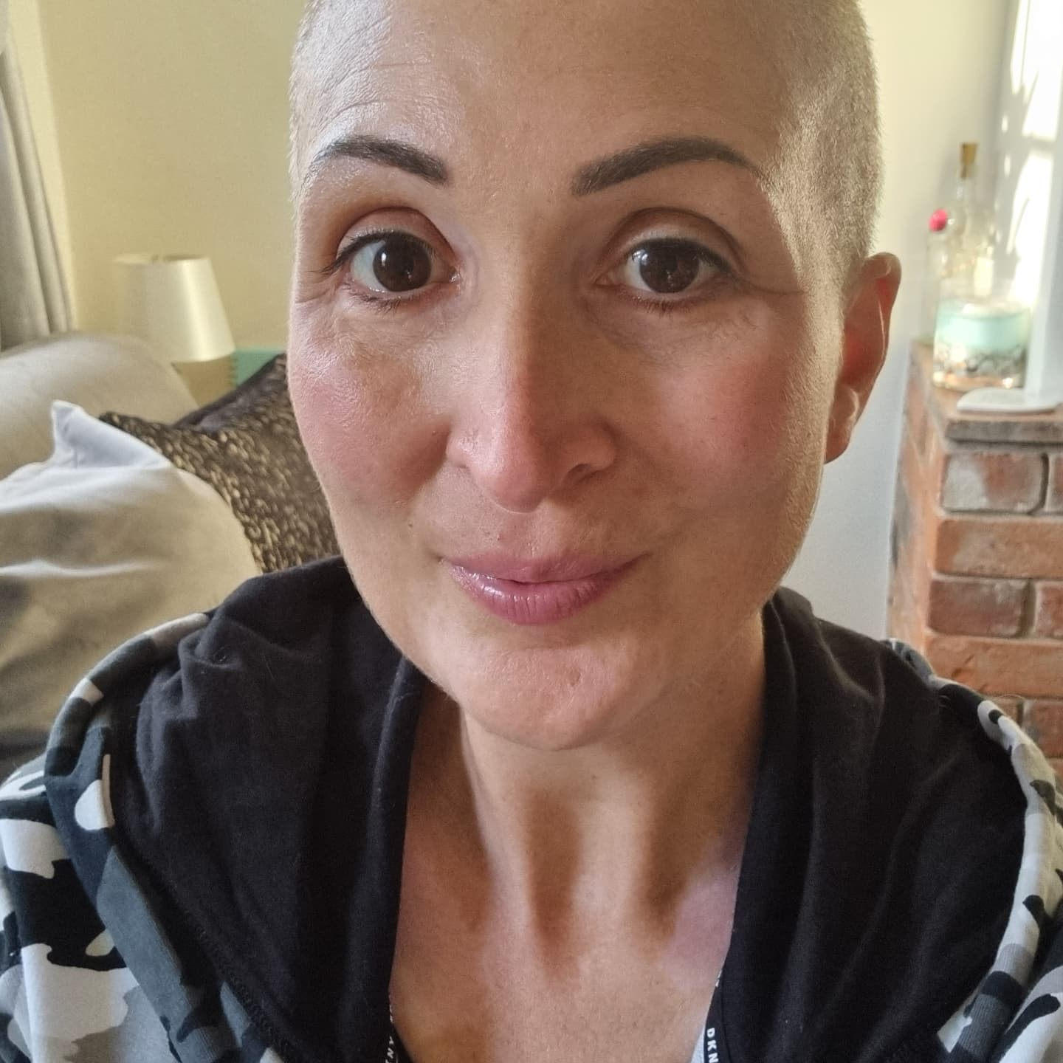

Slide 5
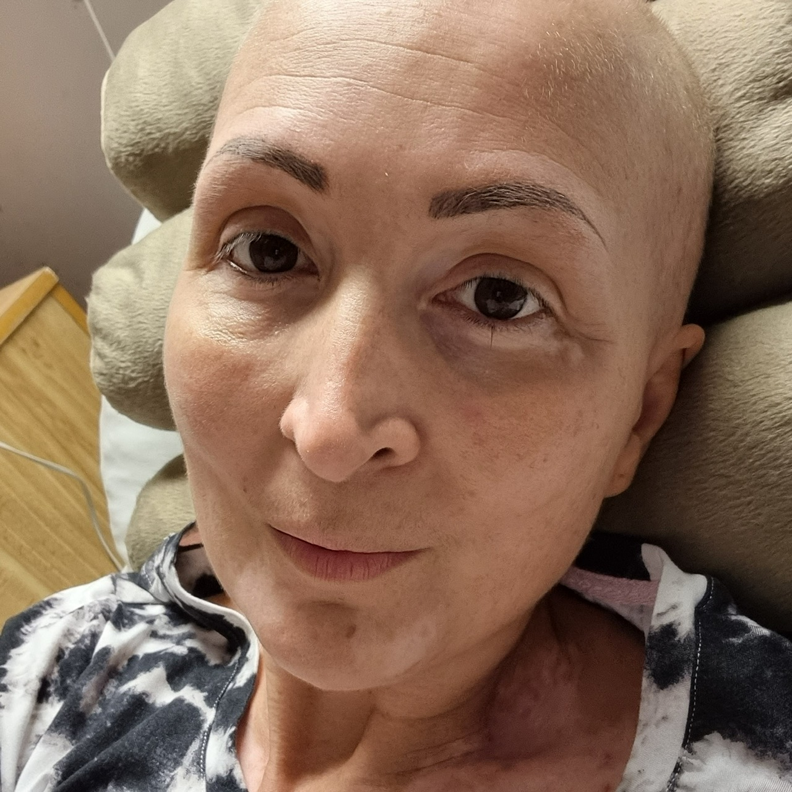

Slide 6
‘Doing Well’
is not
“Well”

Slide 7
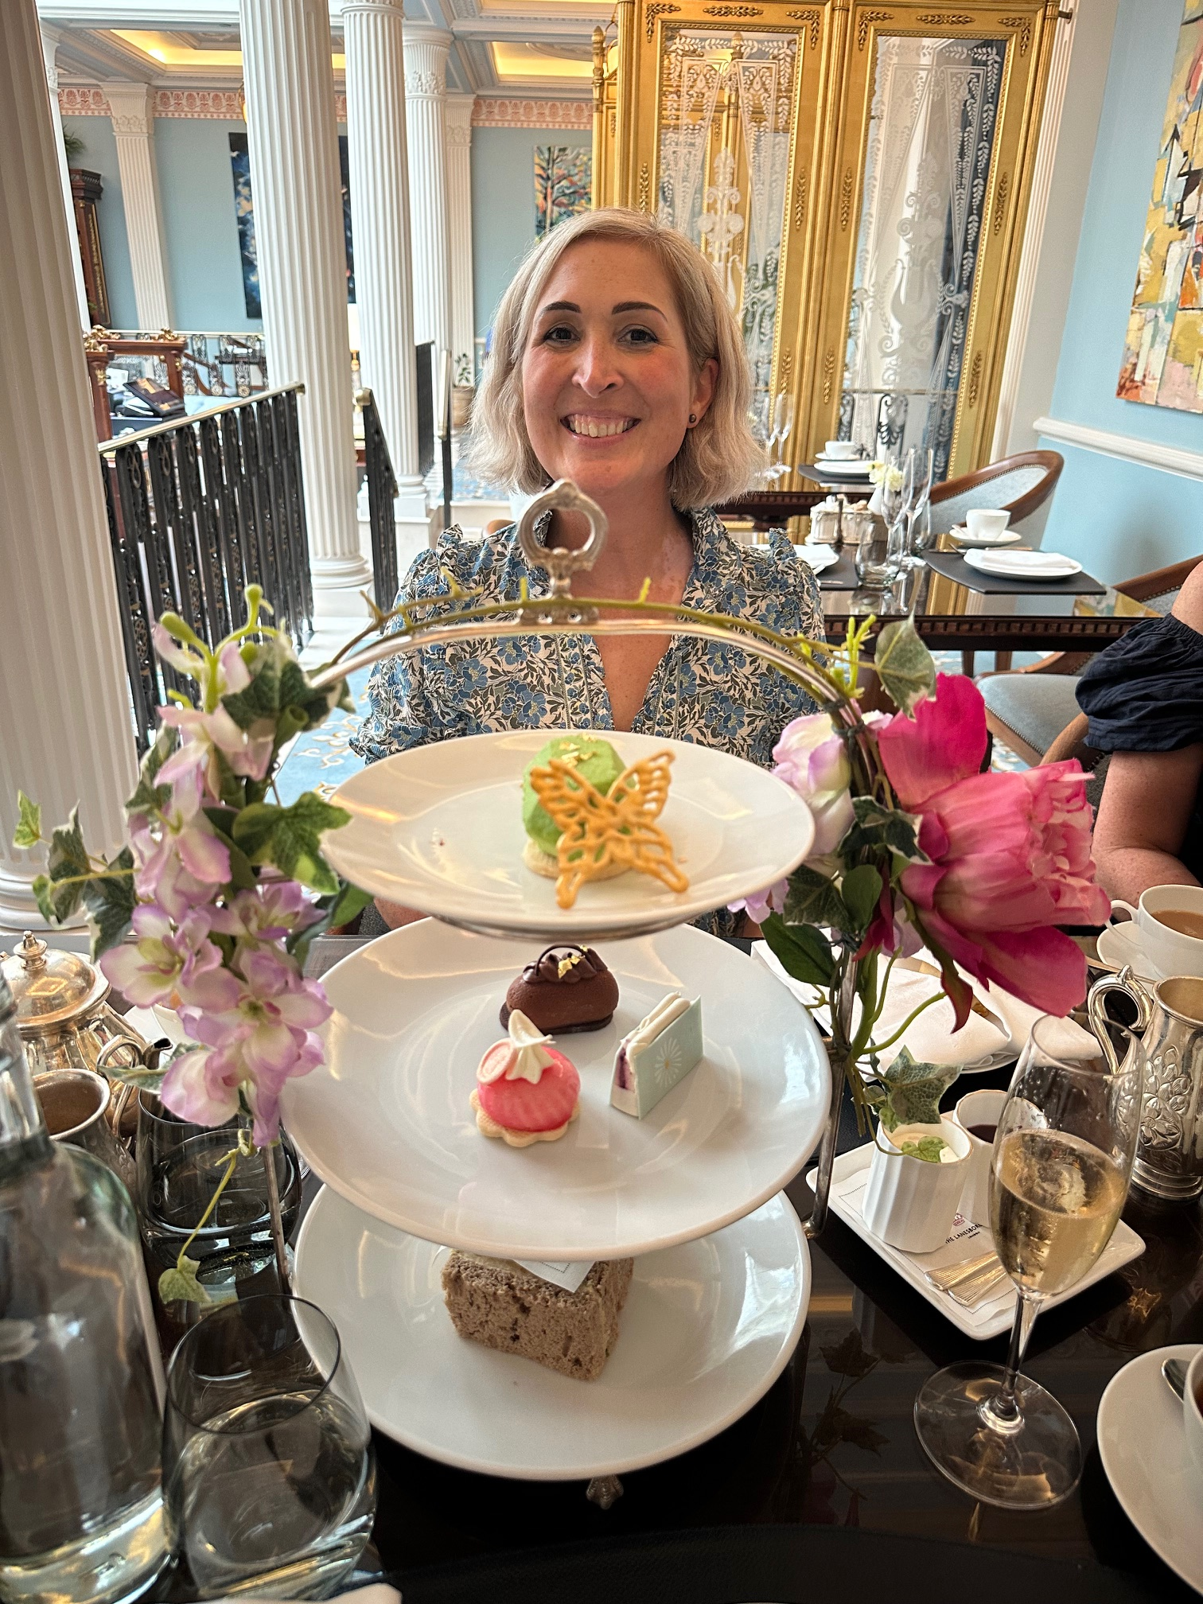

Slide 8
What do we need NOW?
Better drugs with fewer side effects
Newer and more effective drugs at line one or two
Personalised treatment plans for younger patients
More emotional and practical support
Prescriptions when we need them
Because we’re alive TODAY!

Slide 9
