Slide 1
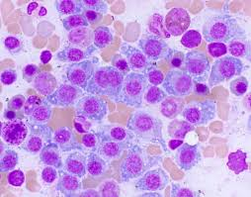

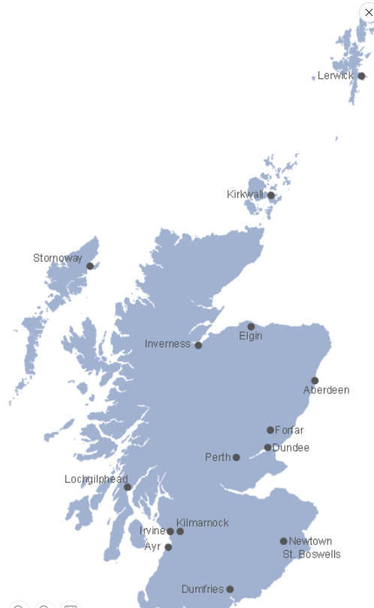



Myeloma Treatment Pathway
NHS Scotland
Dr Jennifer Travers
Beatson, West of Scotland Cancer Centre

Slide 2
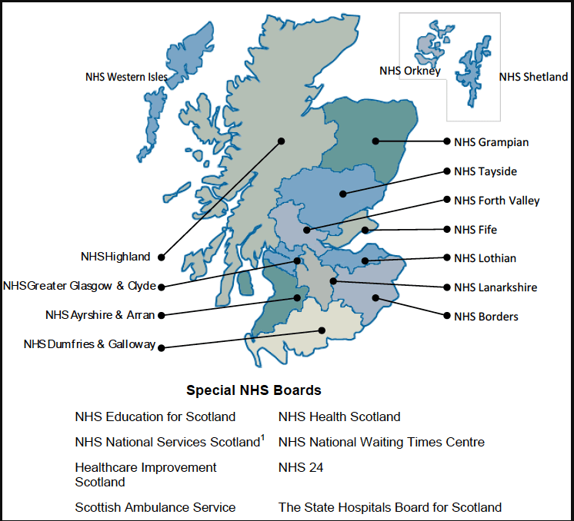
Approvals of medicines for use in NHS Scotland
Scottish Medicines Consortium SMC
NICE
Cancer Drug Fund
Blueteq

Slide 3



Slide 4



Assessment of comparative clinical effectiveness and cost effectiveness and accept those that represent good value of money for NHS Scotland
Before a medicine can be prescribed routinely in Scotland it has to be accepted for use by SMC
Provides a quick, uniform introduction of beneficial treatments across NHS Scotland
Patient and Clinician Engagement Process ( PACE)
PACE provides a wider opinion and may act as a ‘modifier’ of certainty
22 weeks timeline for advice published with PACE included

Slide 5
First Line Treatment Transplant Eligible Transplant Ineligible Dara – VTD x 4 DRD continuous Autograft 1 Lenalidomide Dex Dara- VTD x 2 Bortezomib dex (AKI risk) Maintenance Lenalidomide Tandem Autograft in selected cases
Second Line Carfilzomib lenalidomide Dexamethasone KRd Daratumumab Bortezomib Dexamethasone Dvd Carfilzomib Dexamethasone Kd Bortezomib Dexamethasone Bd Lenalidomide Dexamethasone Rd Selinexor Bortezomib Dexamethasone SVd 2nd Autograft in selected patients
Third Line Carfilzomib Dexamethasone Kd *No Ixazomib Lenalidomide Dex Pomalidomide Dexamethasone Pd * Carfilzomib Dex 2nd line onwards Panobinostat Bortezomib Dexamethasone PVd Bortezomib Dexamethasone Bd Lenalidomide Dexamethasone Rd
Fourth Line Isatuximab Pomalidomide Dex IsaPd Pomalidomide Dex Pd Daratumumab Monotherapy Elranatamab Teclistamab Panobinostat Bortezomib Dexamethasone PVd Carfilzomib Dex Kd
Fifth Line Elranatamab Teclistamab Selinexor Dex Sd
NHS Scotland
Myeloma
Treatment
Pathway
Nov 2024

Slide 6
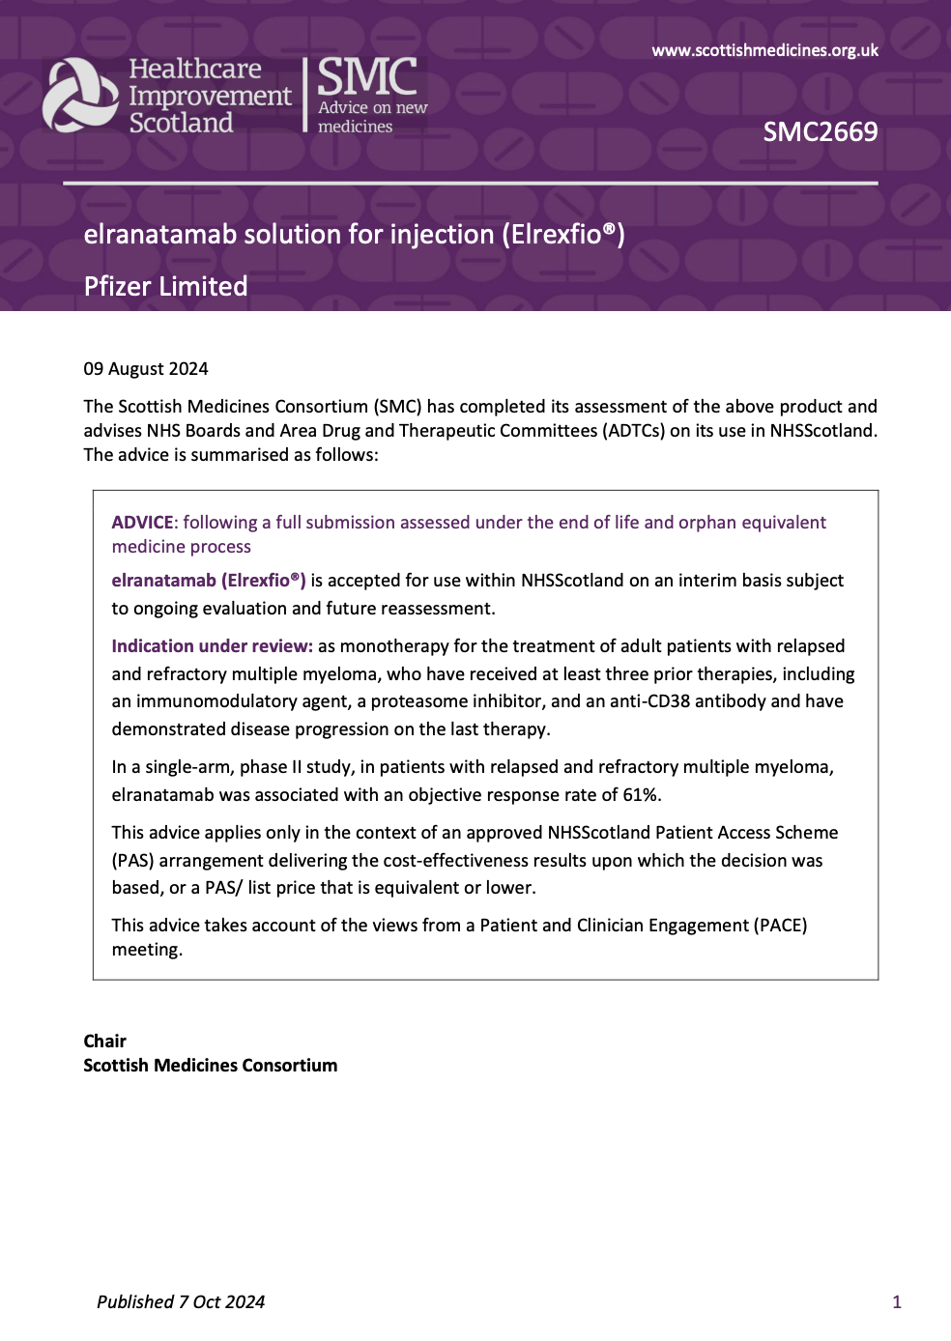
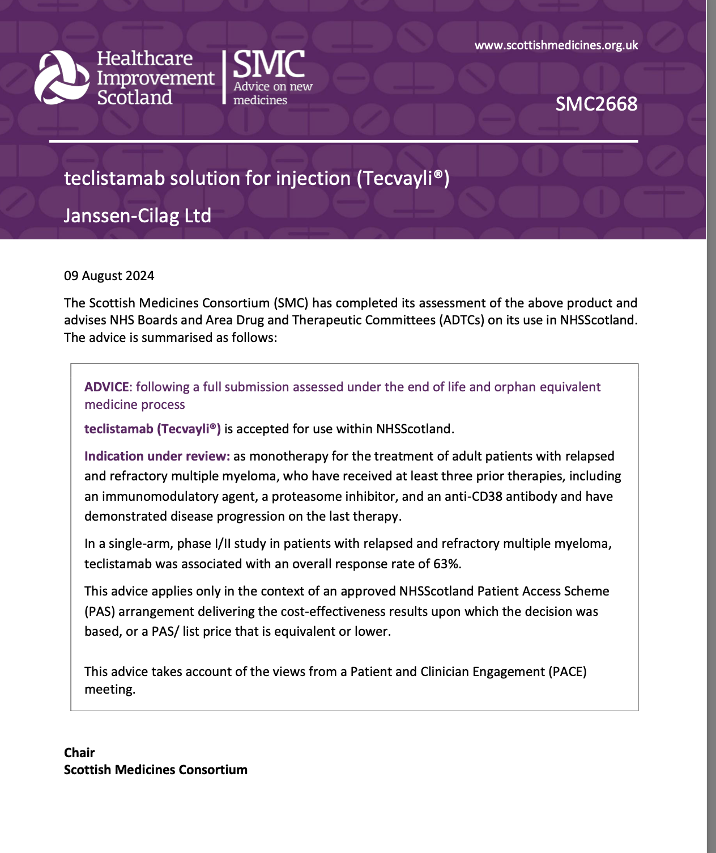

Slide 7
NATIONAL CANCER MEDICINES ADVISORY GROUP (NCMAG)
Established during Covid 19 Pandemic
Introduced NCMAG business as usual to NHS Scotland in 2021
A ‘Once for Scotland’ proposal seeking support for routine use of a treatment in the following categories;
-off-label uses of a licensed medicine ( branded, generic or biosimilar) for a patient population not specified within the marketing authorization
-off patent use of licensed, generic or biosimilar medicines previously not approved by SMC, where patent has expired since SMC advice given and cost effectiveness is unknown

Slide 8
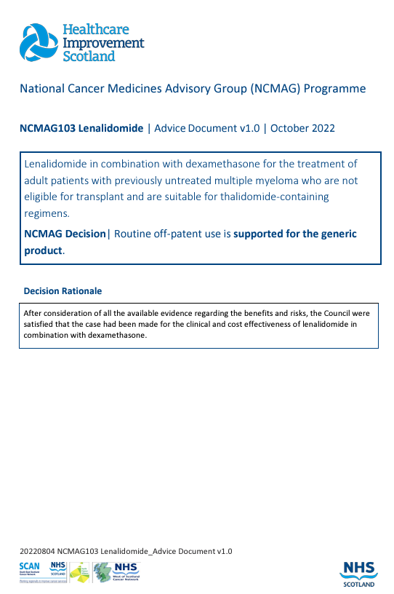
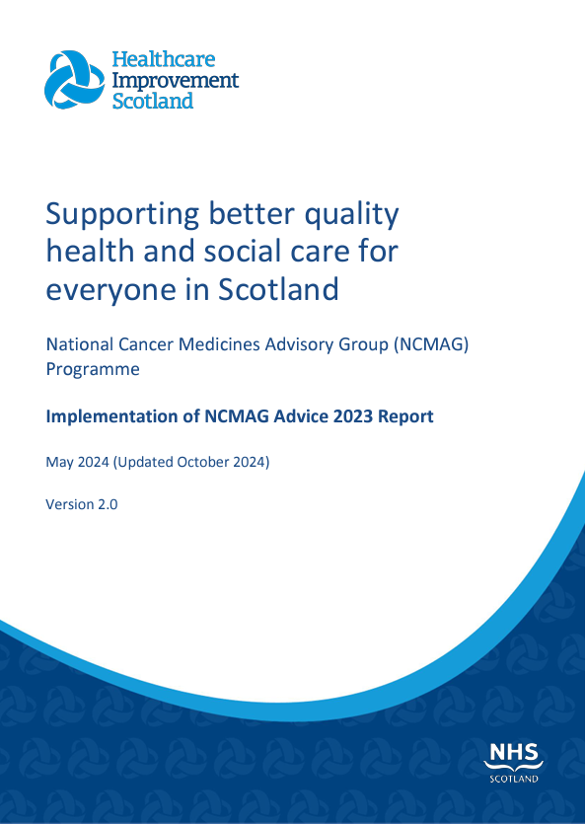
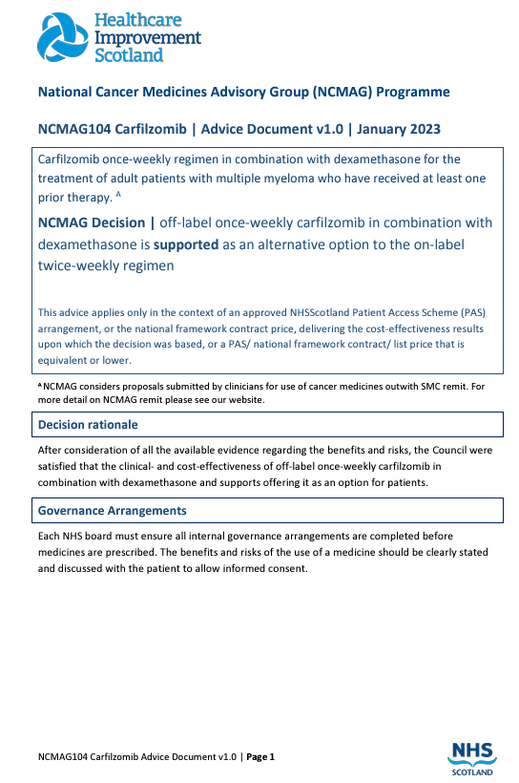

Slide 9
