Slide 1
Real-World Evidence in Clinical Practice
Opportunities and challenges
Geoff Hall
Professor of Digital Health and Cancer Medicine, University of Leeds
Consultant Medical Oncologist (Gynae), Leeds Cancer Centre
Director of DATA-CAN, the HDRUK Hub for Cancer
Chief Clinical Data Officer for HDRUK
Notes:
Programme Overview & Approach
Recent Highlights
Programme Impact

Slide 2

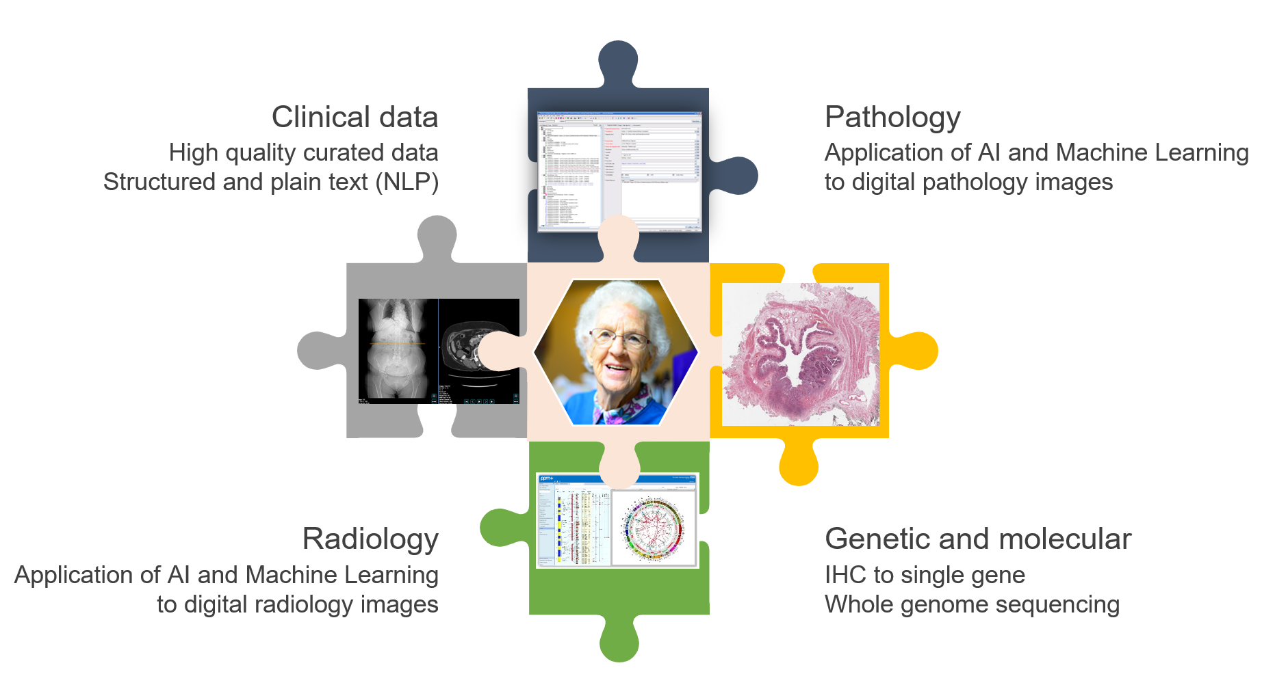
DATA-CAN:
Improve access to existing data
  Clinical, academic & commercial
Improve quality of data
  Better data at the point of care
  Enhanced curation of current data
Improve UK coverage
  Four nations of the UK
Add new datasets at scale
  Genetic/molecular, imaging, pathology
  Primary care, PROMs
Ensure fair value
  NHS & UK, Trusts & CCGs, Patients & public

Slide 3
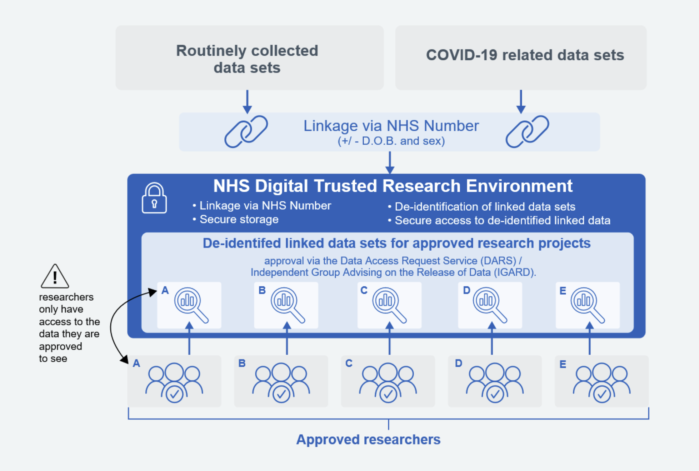
DATA-CAN:
Improve access to existing data
  Clinical, academic & commercial
Improve quality of data
  Better data at the point of care
  Enhanced curation of current data
Improve UK coverage
  Four nations of the UK
Add new datasets at scale
  Genetic/molecular, imaging, pathology
  Primary care, PROMs
Ensure fair value
  NHS & UK, Trusts & CCGs, Patients & public
COSD, SACT, RTDS, 2WW
COVID-19 data sets
64B rows of data on 60M patients

Slide 4
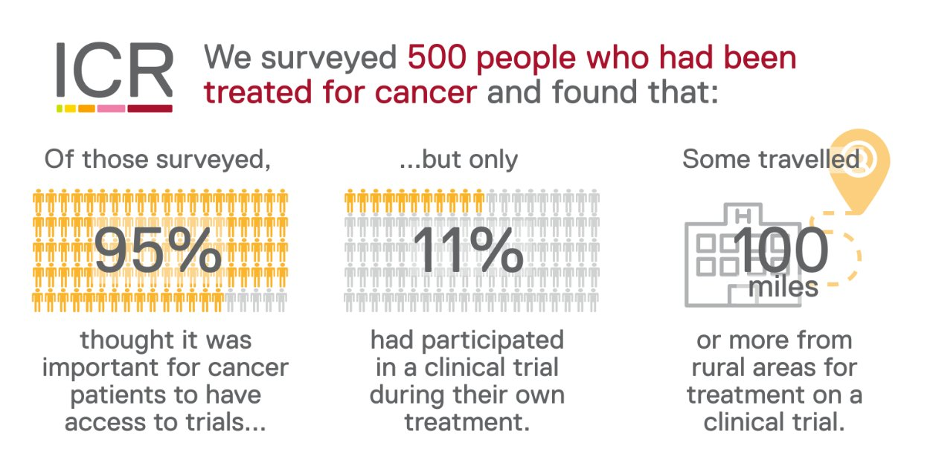
Clinical trials - the gold standard ?
PAOLA-1
2019
ICON2
1998
ICON3
2002
ICON5
2009
ICON7
2011
ICON8
2019
GOG172
2006
JOG3016
2009
SOLO-1
2018
PRIMA
2019
Leeds Ovarian cancer ~ 5,000 - ~ 4% recruitment
Why ? Elderly, frail, co-morbidity
Patient choice
Trial availability,
Research capacity
Clinical Trials in Cancer: ICR Dec 2021. https://tinyurl.com/bdf2jtwj

Slide 5
Clinical trials & Real World Evidence
Clinical trials
  “Perfect” data on an imperfect population
Real World Evidence
  Imperfect data on the perfect population
They are not in conflict, they are complementary
  Look at the same thing, through a different lens

Slide 6
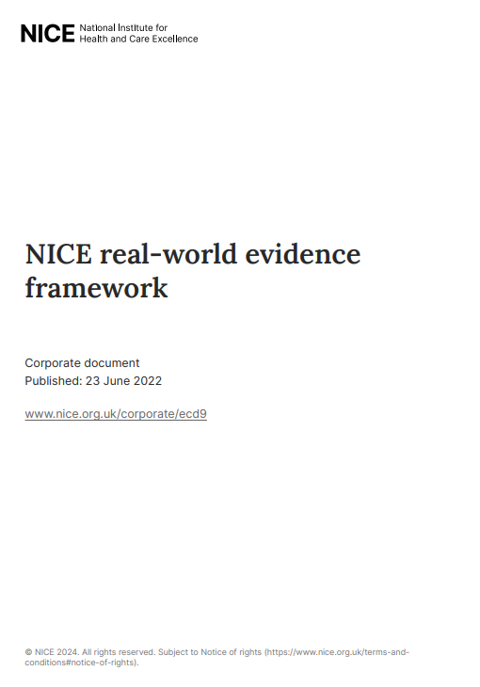
NICE and Real-World Data
Improve understanding of health delivery and effects of intervention
Use RWD to resolve gaps in knowledge and drive forward innovation
  RCTs are the preferred source of evidence
  RCTs are sometimes unavailable or are not directly relevant to decisions about patient care in the NHS.
  Real-world data could be used more routinely to fill evidence gaps and speed up patient access
  Define best practice to improve trust in RWE studies

Slide 7
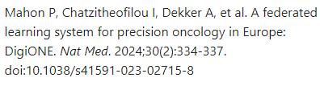
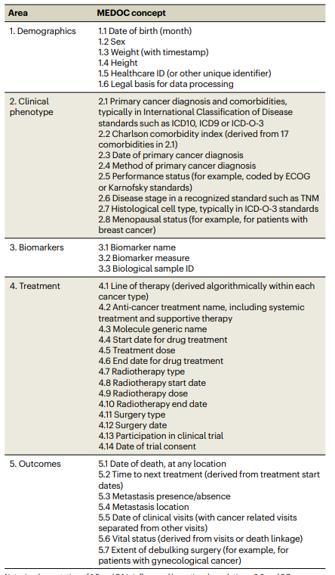

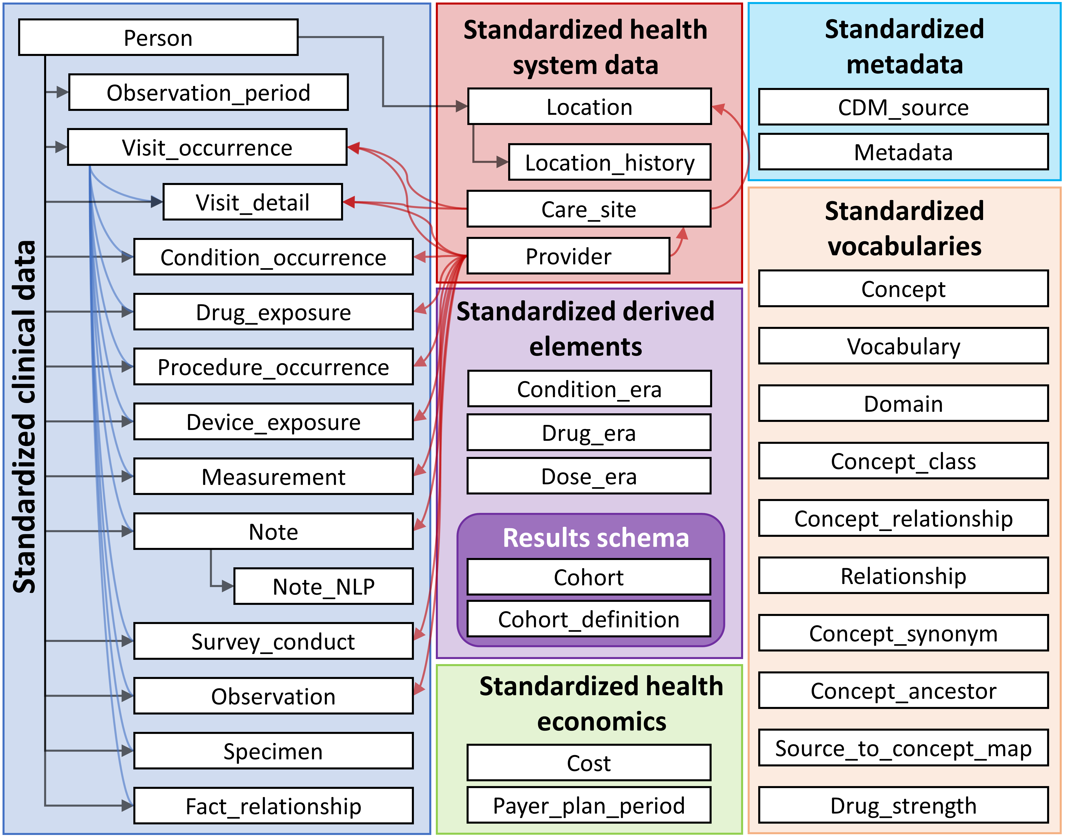
RWE: Future plans
Common Data Model
We need a common language
for Real World Evidence
We need to agree key definitions
  Date of diagnosis ?
  Progression or Time to Next Treatment ?
We need a common data model

Slide 8


RWE: Future plans
Data Curation
85% of EHR data is plain text and requires curation
Coded data will never replace plain text in EPRs
Next Generation Informatics - AI/ML, NLP
Manual curation remains state of the art
  Regulatory grade curation beyond NHS
  Requires clinical/commercial partnerships

Slide 9
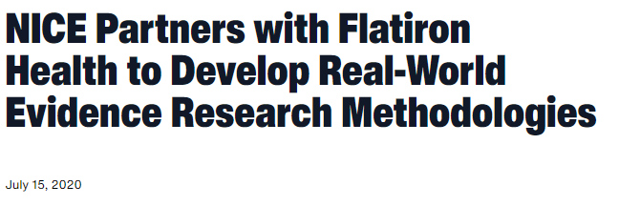
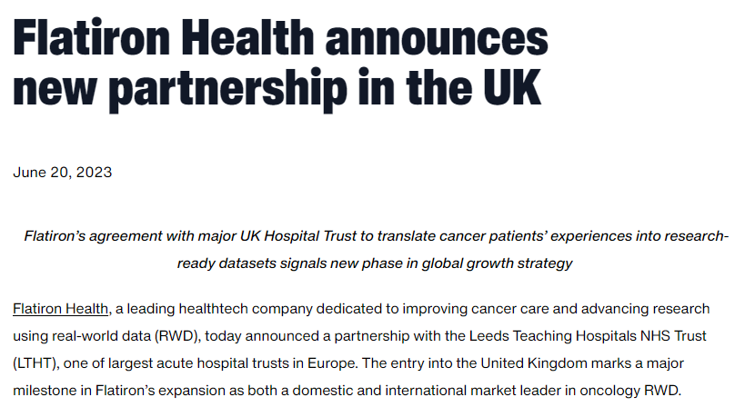
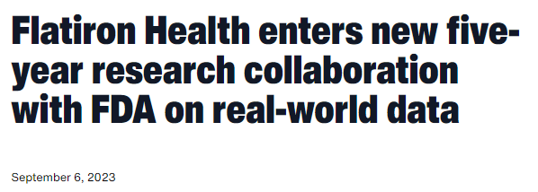
RWE: Future plans
Data Curation

Slide 10
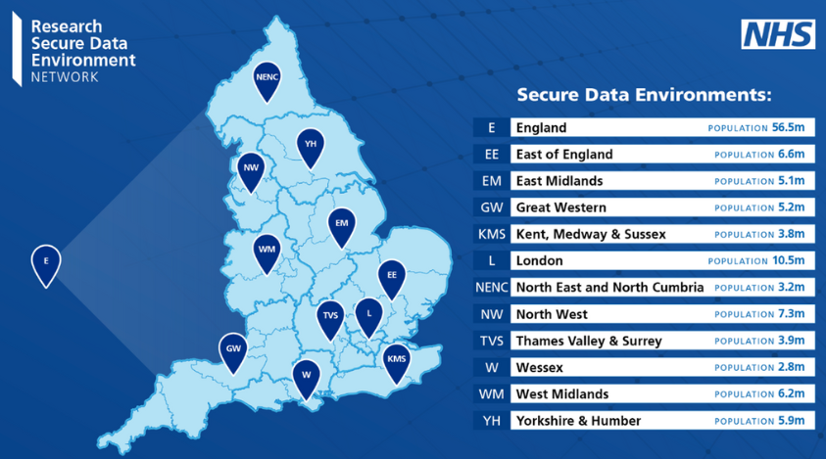
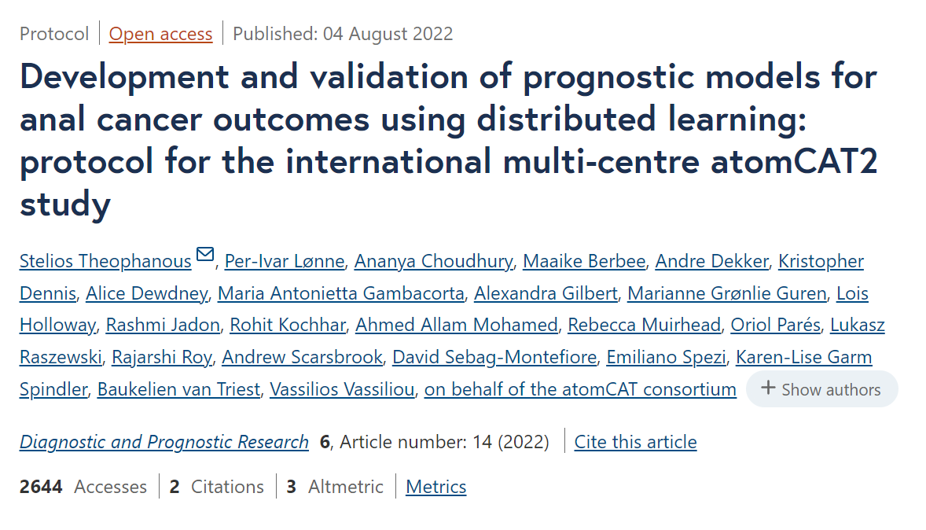
RWE: Future plans
Data Privacy
Data sharing is challenging
  Secure data environments – national, regional, local
Sharing data between countries is very complex
  Bring the analysis to the data - FEDERATED ANALYSIS
atomCAT programme
  Anal cancer, 1428 patients
  16 centres Europe and Australia
  No exchange of any individual patient-level data

Slide 11
RWE: Future plans
Uniting clinical trials and RWE
RWE to support clinical trial design
  Model impact of inclusion/exclusion criteria
RWE to support clinical trial delivery
  Include consent to national data linkage to facilitate long-term follow-up
  Integrate routine data (co-morbidity, co-medication, acute admissions)
RWE to facilitate post-trial evaluation
  Common end-points - RECIST reported PFS cannot be replicated with RWE
  Define reproducible RWE end-points within trial protocol

Slide 12
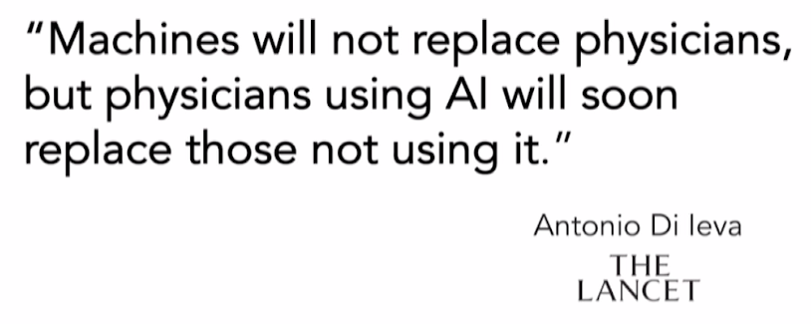

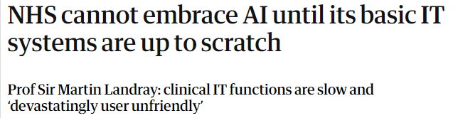
RWE: Future plans from Big Data to AI development

Slide 13
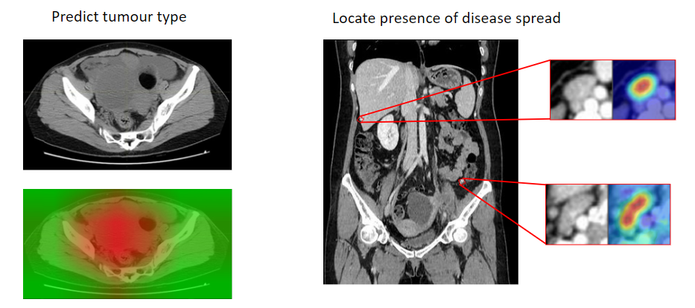
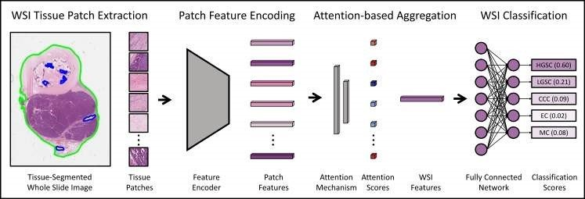
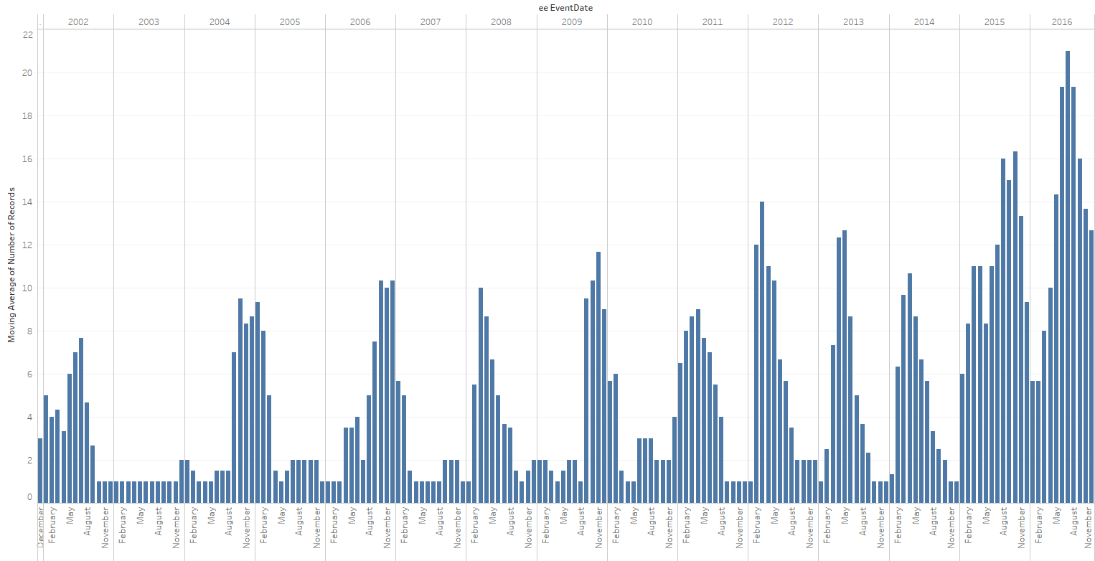
RWE: Future plans from Big Data to AI development
Multi modal AI in ovarian cancer
  Radiology
    characterisation of pelvic mass
    suitability for surgical resection
  Pathology
    morphological subtyping
    Identification of metastatic disease in LNs and omentum
  EHR data
    extraction of high-quality curated data from narrative of care
    automated identification of cancer recurrence

Slide 14
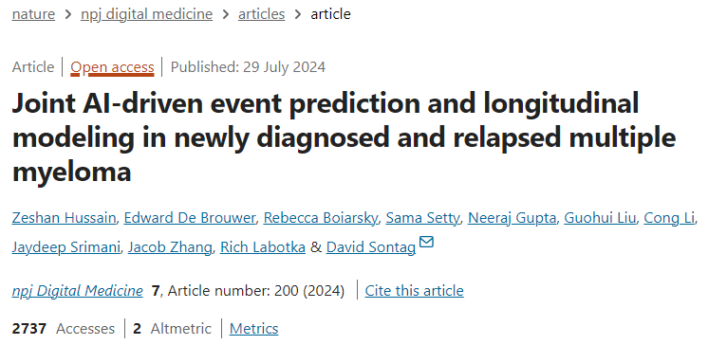
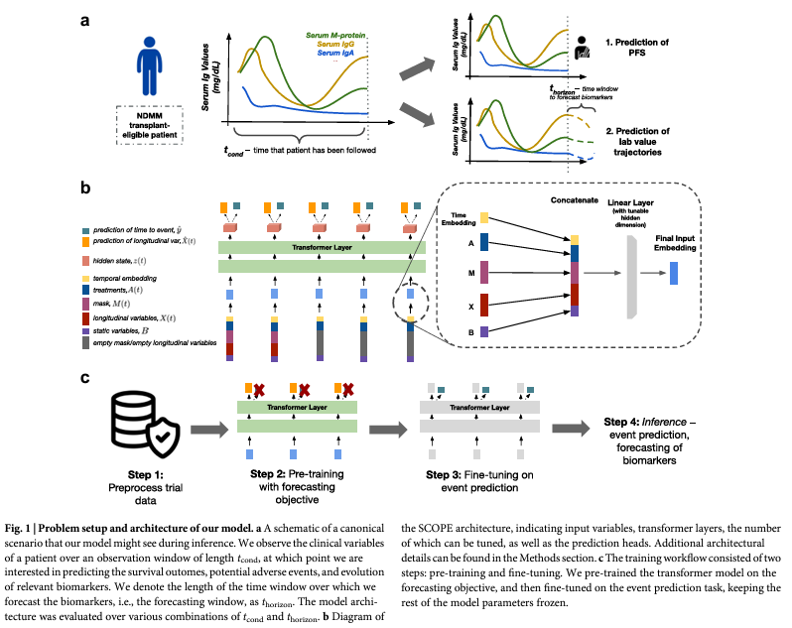
RWE:
Big Data & AI development in Myeloma
703 patients from TOURMALINE trial
“To address this limitation, we developed a transformer-based machine learning model that jointly (1) predicts progression-free survival (PFS), overall survival (OS), and adverse events (AE), (2) forecasts key disease biomarkers, and (3) assesses the effect of different treatment strategies, e.g., ixazomib, lenalidomide, dexamethasone (IRd) vs lenalidomide, dexamethasone (Rd). ”

Slide 15
DATA-CAN:
COSD, SACT, RTDS, 2WW
COVID-19 data sets
Improve access to existing data
  Clinical, academic & commercial
Improve quality of data
  Better data at the point of care
  Enhanced curation of current data
Improve UK coverage
  Four nations of the UK
Add new datasets at scale
  Genetic/molecular, imaging, pathology
  Primary care, PROMs
Ensure fair value
  NHS & UK, Trusts & CCGs, Patients & public

Slide 16
Thankyou
g.hall@leeds.ac.uk
Notes:
Programme Overview & Approach
Recent Highlights
Programme Impact

